Slide 1
Final Major Project
Sketchbook Pages (Developmental Work)

Slide 2
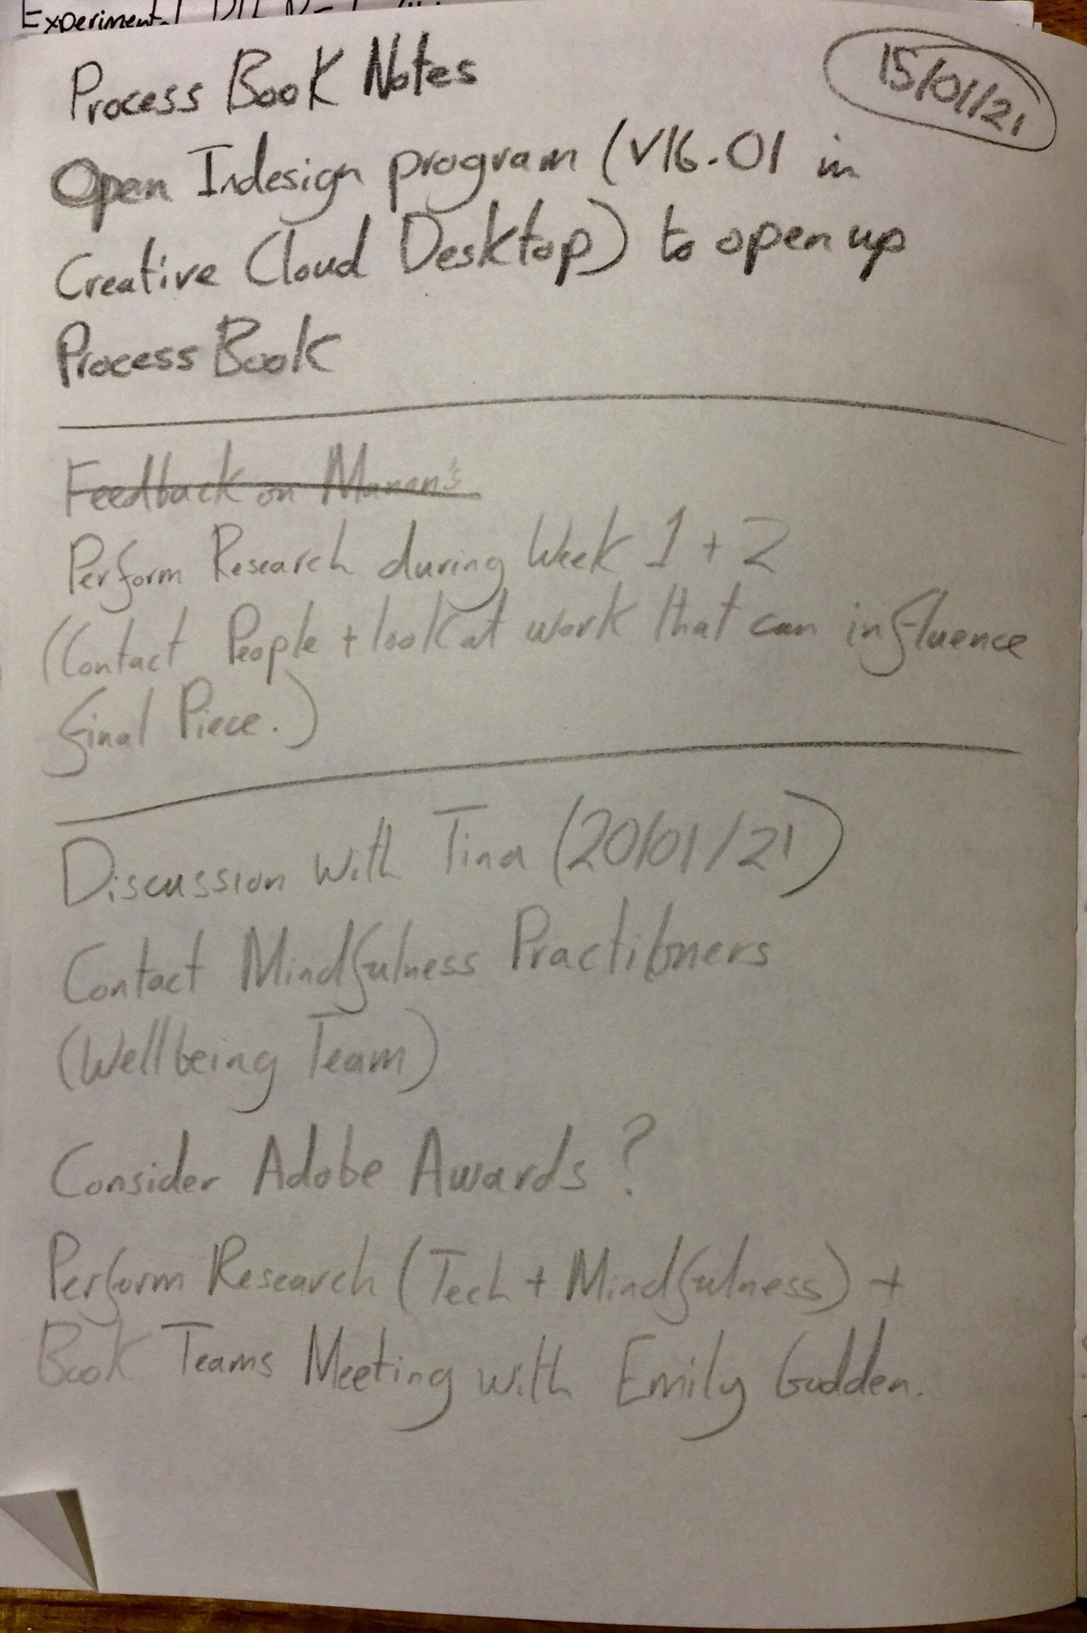
Notes written during the First Teams Meeting of Trimester 1. 15/01/21.

Slide 3
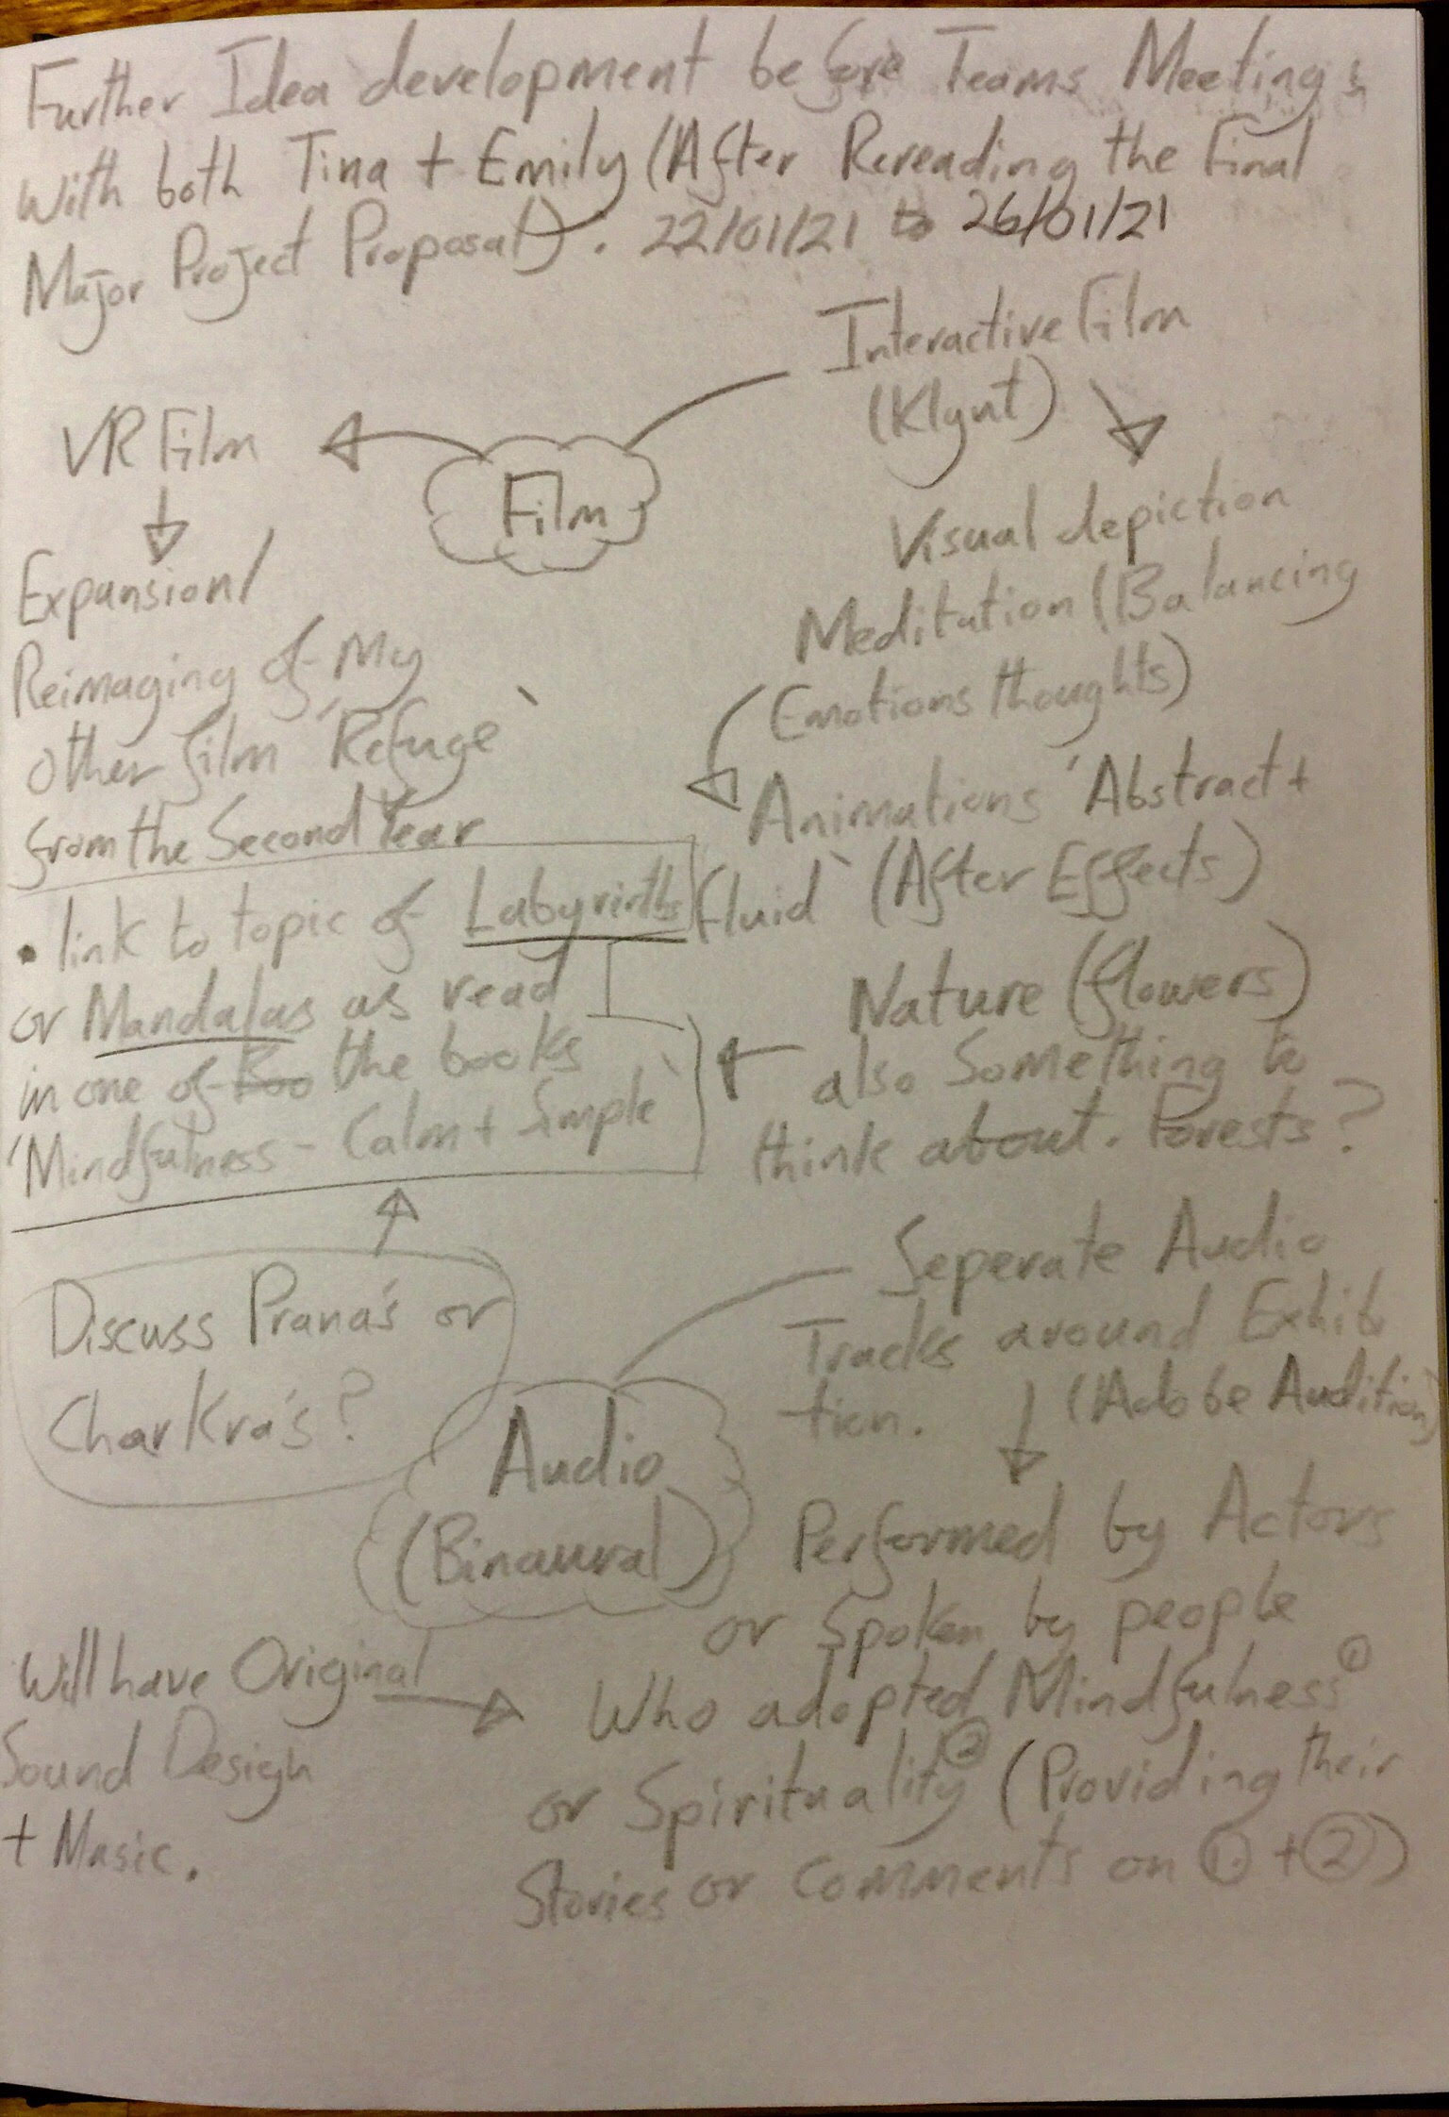
Further expansion on ideas that could become the final major project. 26/01/21.

Slide 4
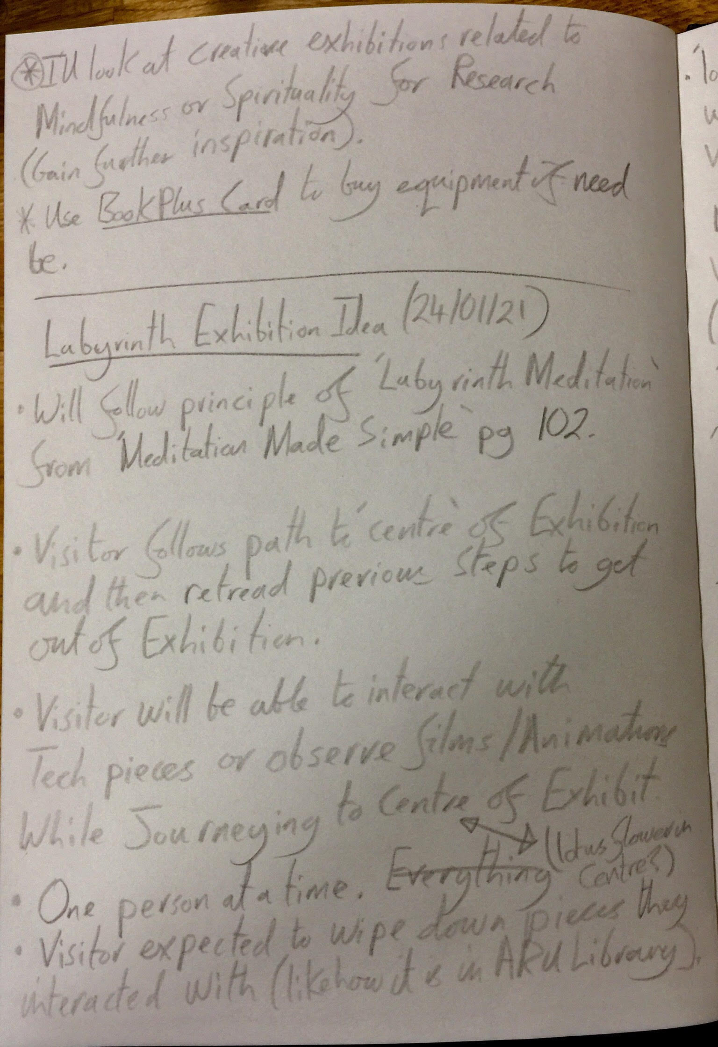
Further notes and ideas (Labyrinth Exhibition) from a Teams Meeting during Week 1. 24/01/21.

Slide 5
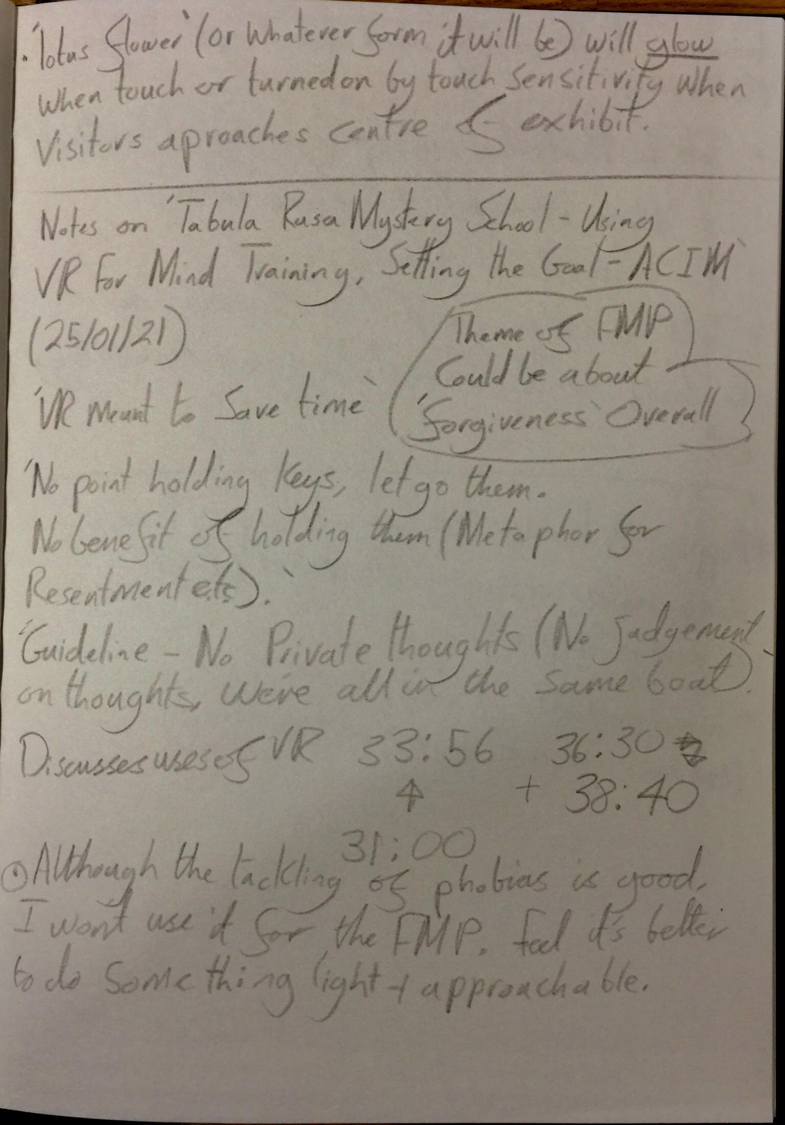
Notes on Podcast I listened to for Research (How Virtual reality can be used to promote Mindfulness and/or Spirituality). 25/01/21.

Slide 6
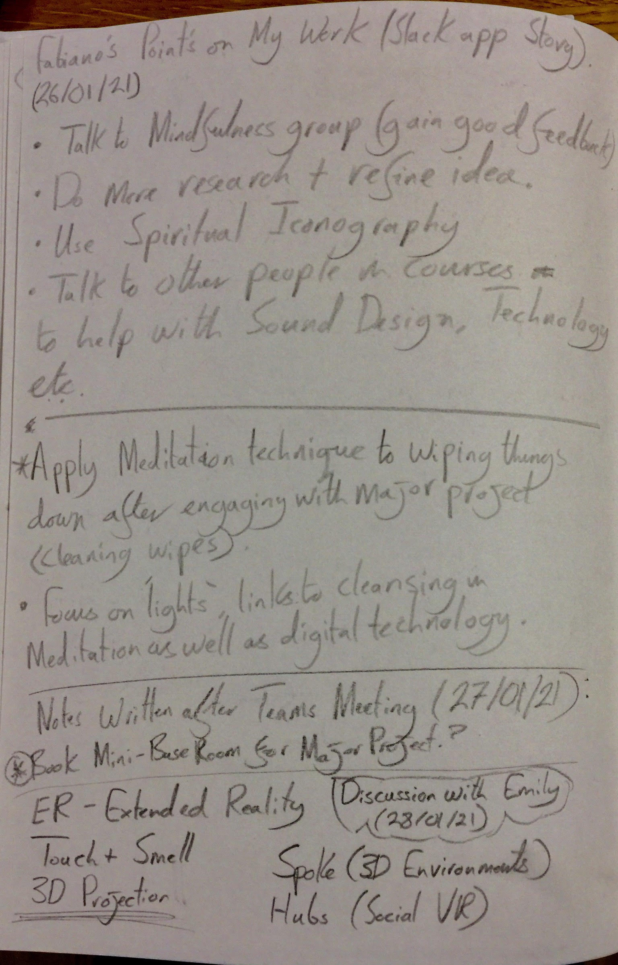
Notes written after Teams Meetings with Fabiano Tavares and Emily Godden.
26/01/21.

Slide 7
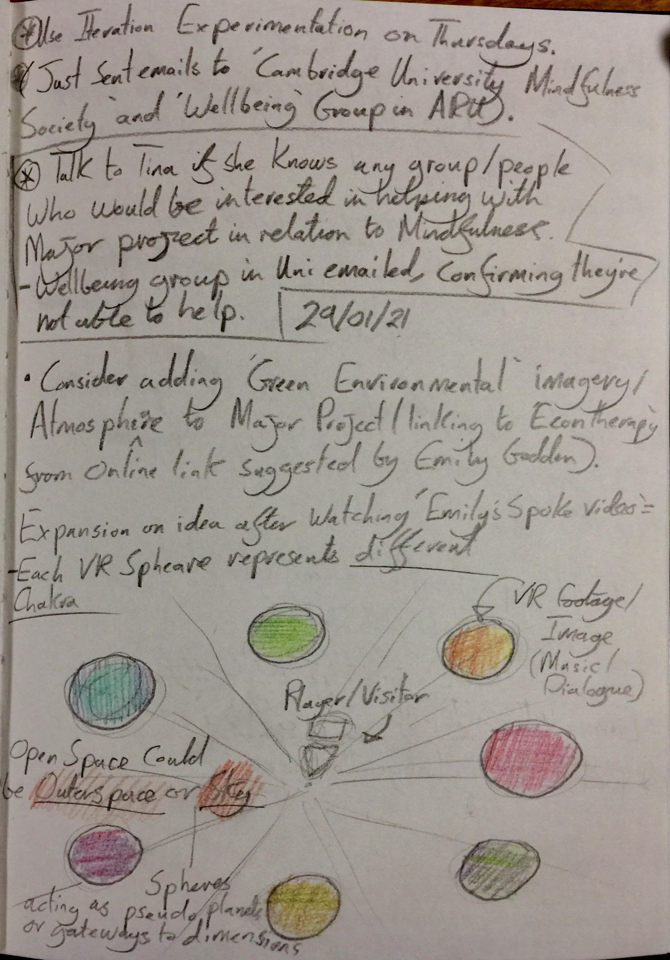
Early Development of ‘Spoke Chakra Idea’ and further notes after talking Emily Godden.
29/01/21.

Slide 8
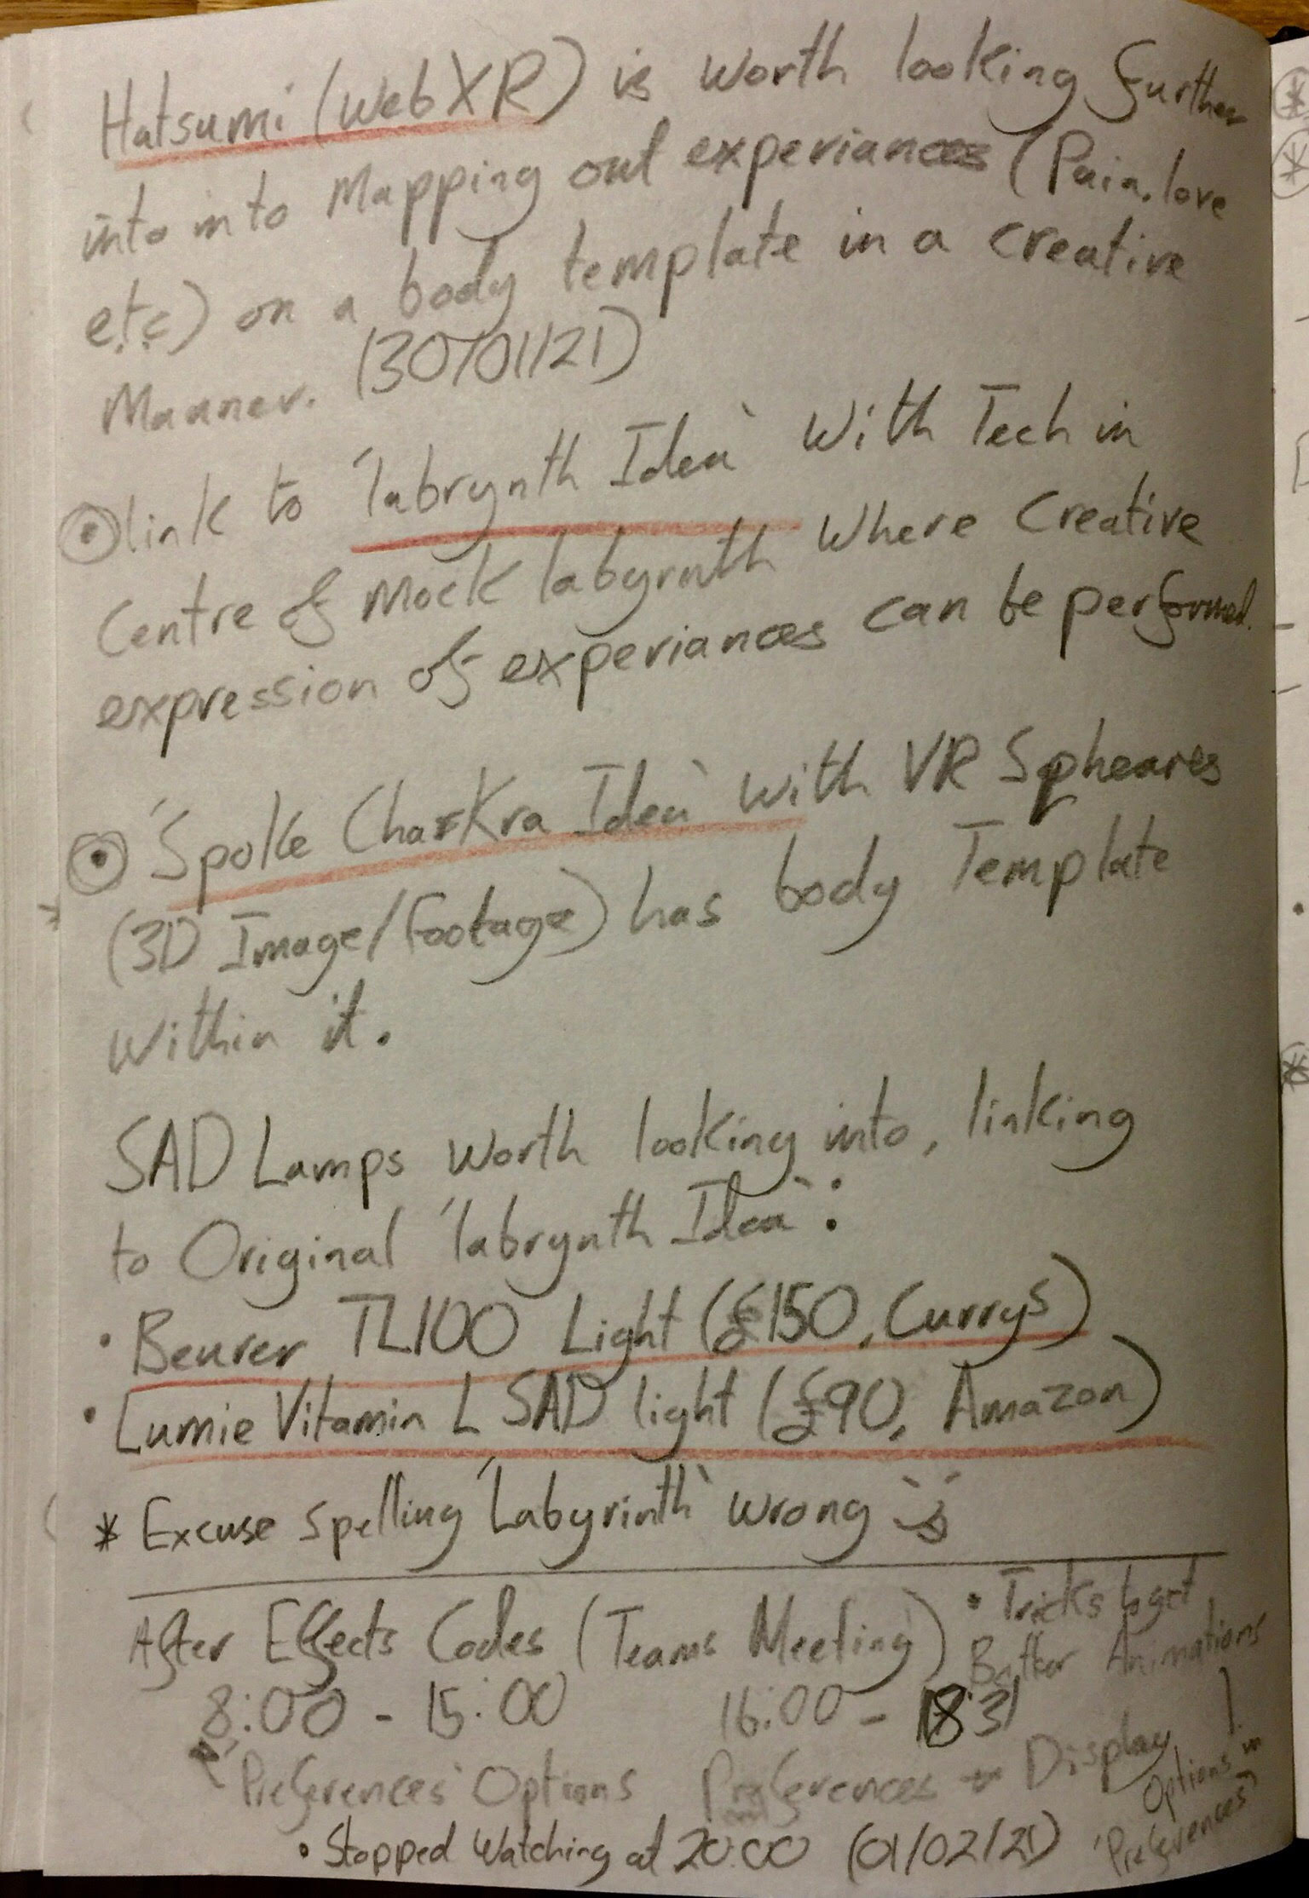
Research into physical ‘Labyrinth Idea’ exhibition alongside early development for ‘Spoke/8 Chakra Idea’.
30/01/21.

Slide 9
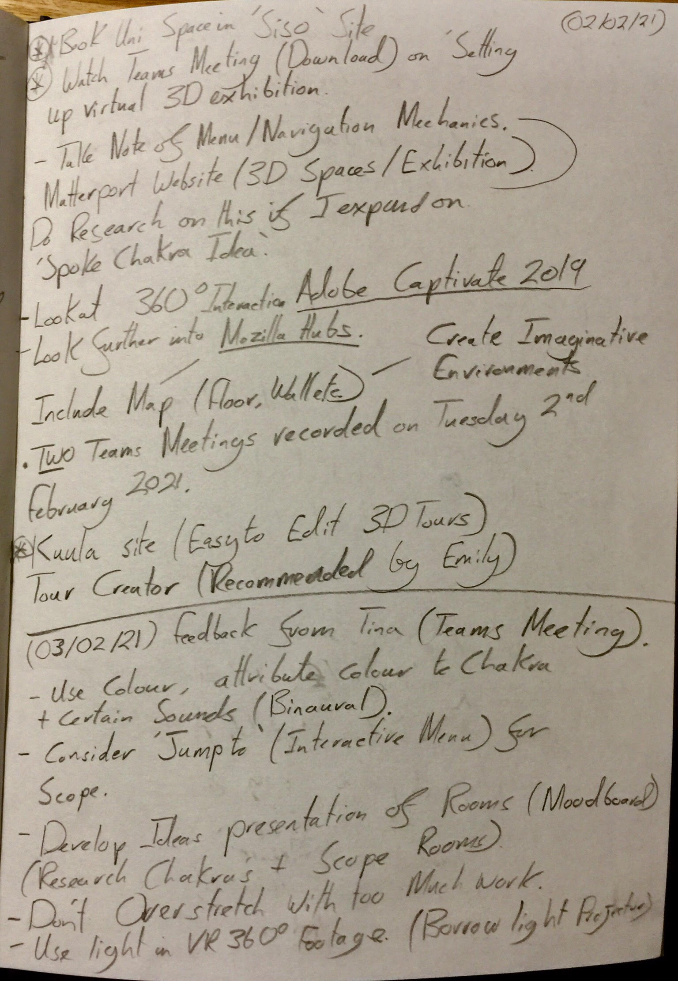
Notes written during Teams Meetings on 02/02/21 and 03/02/21.

Slide 10
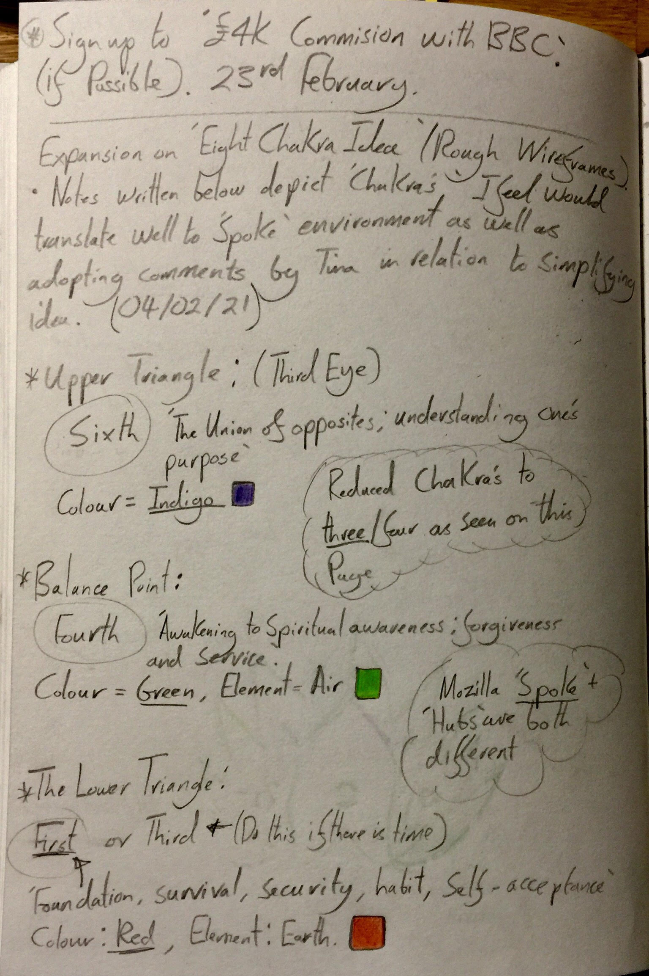
Further development on ‘8 Chakra Idea’, choosing three chakras for the Mozilla Hub room. 04/02/21.

Slide 11
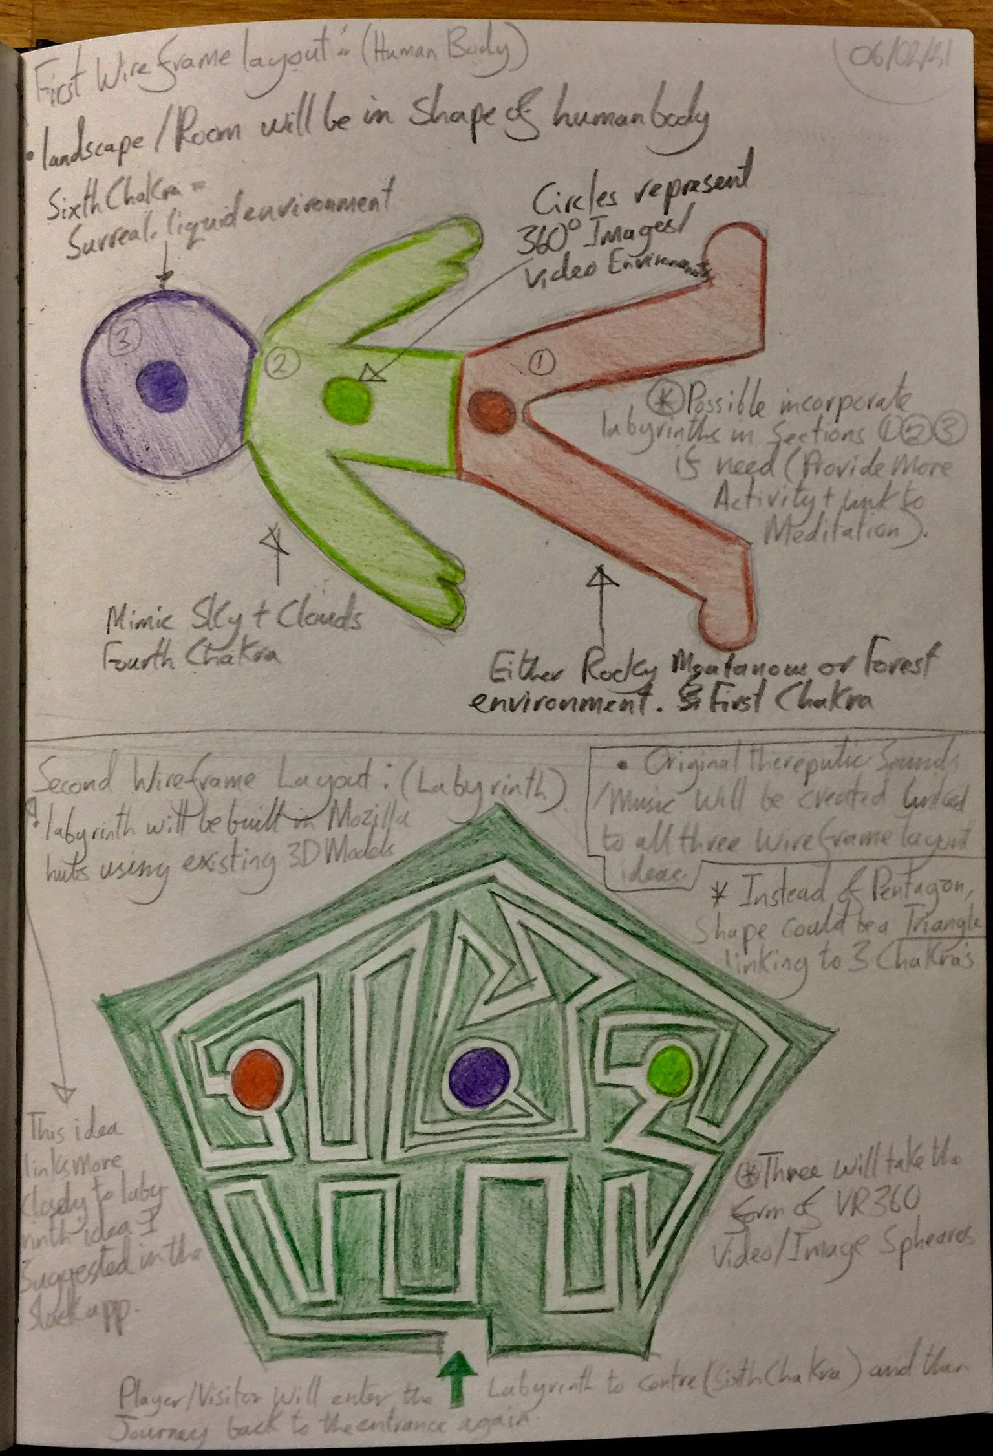
First two ideas on what form the ‘8 Chakra Idea’ will take.
06/02/21.

Slide 12
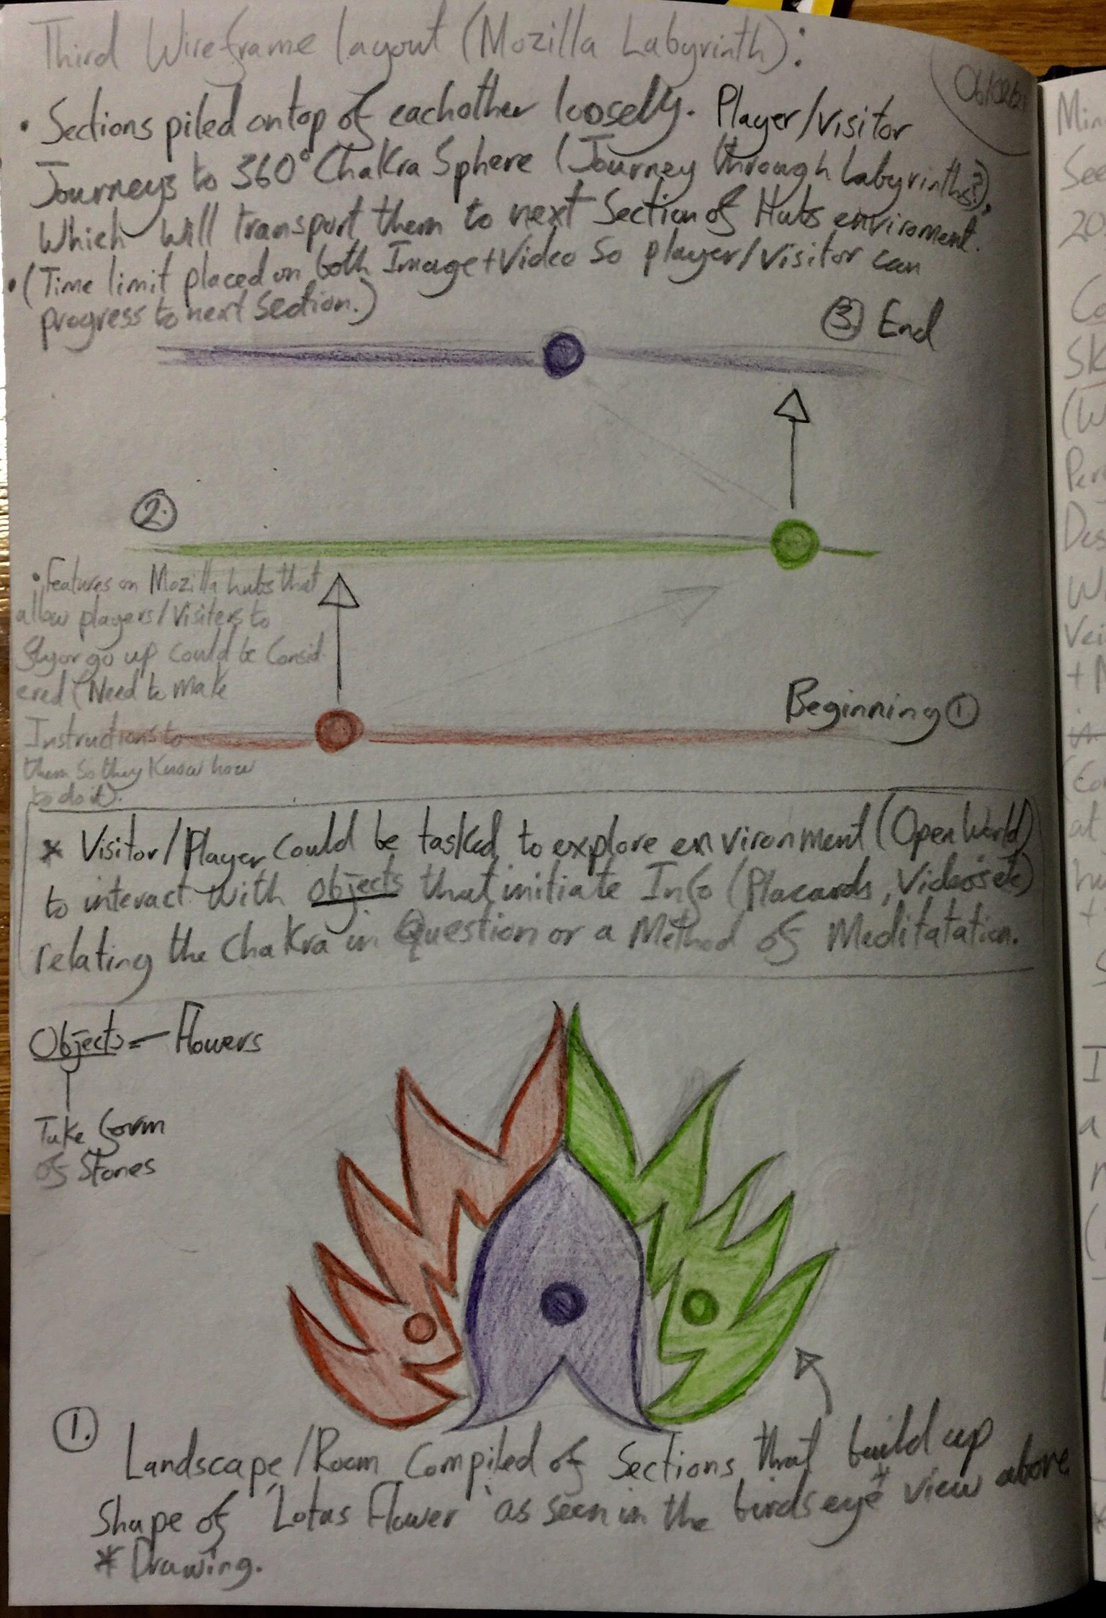
Third and Final Idea for the ‘8 Chakra Idea’.
06/02/21.

Slide 13
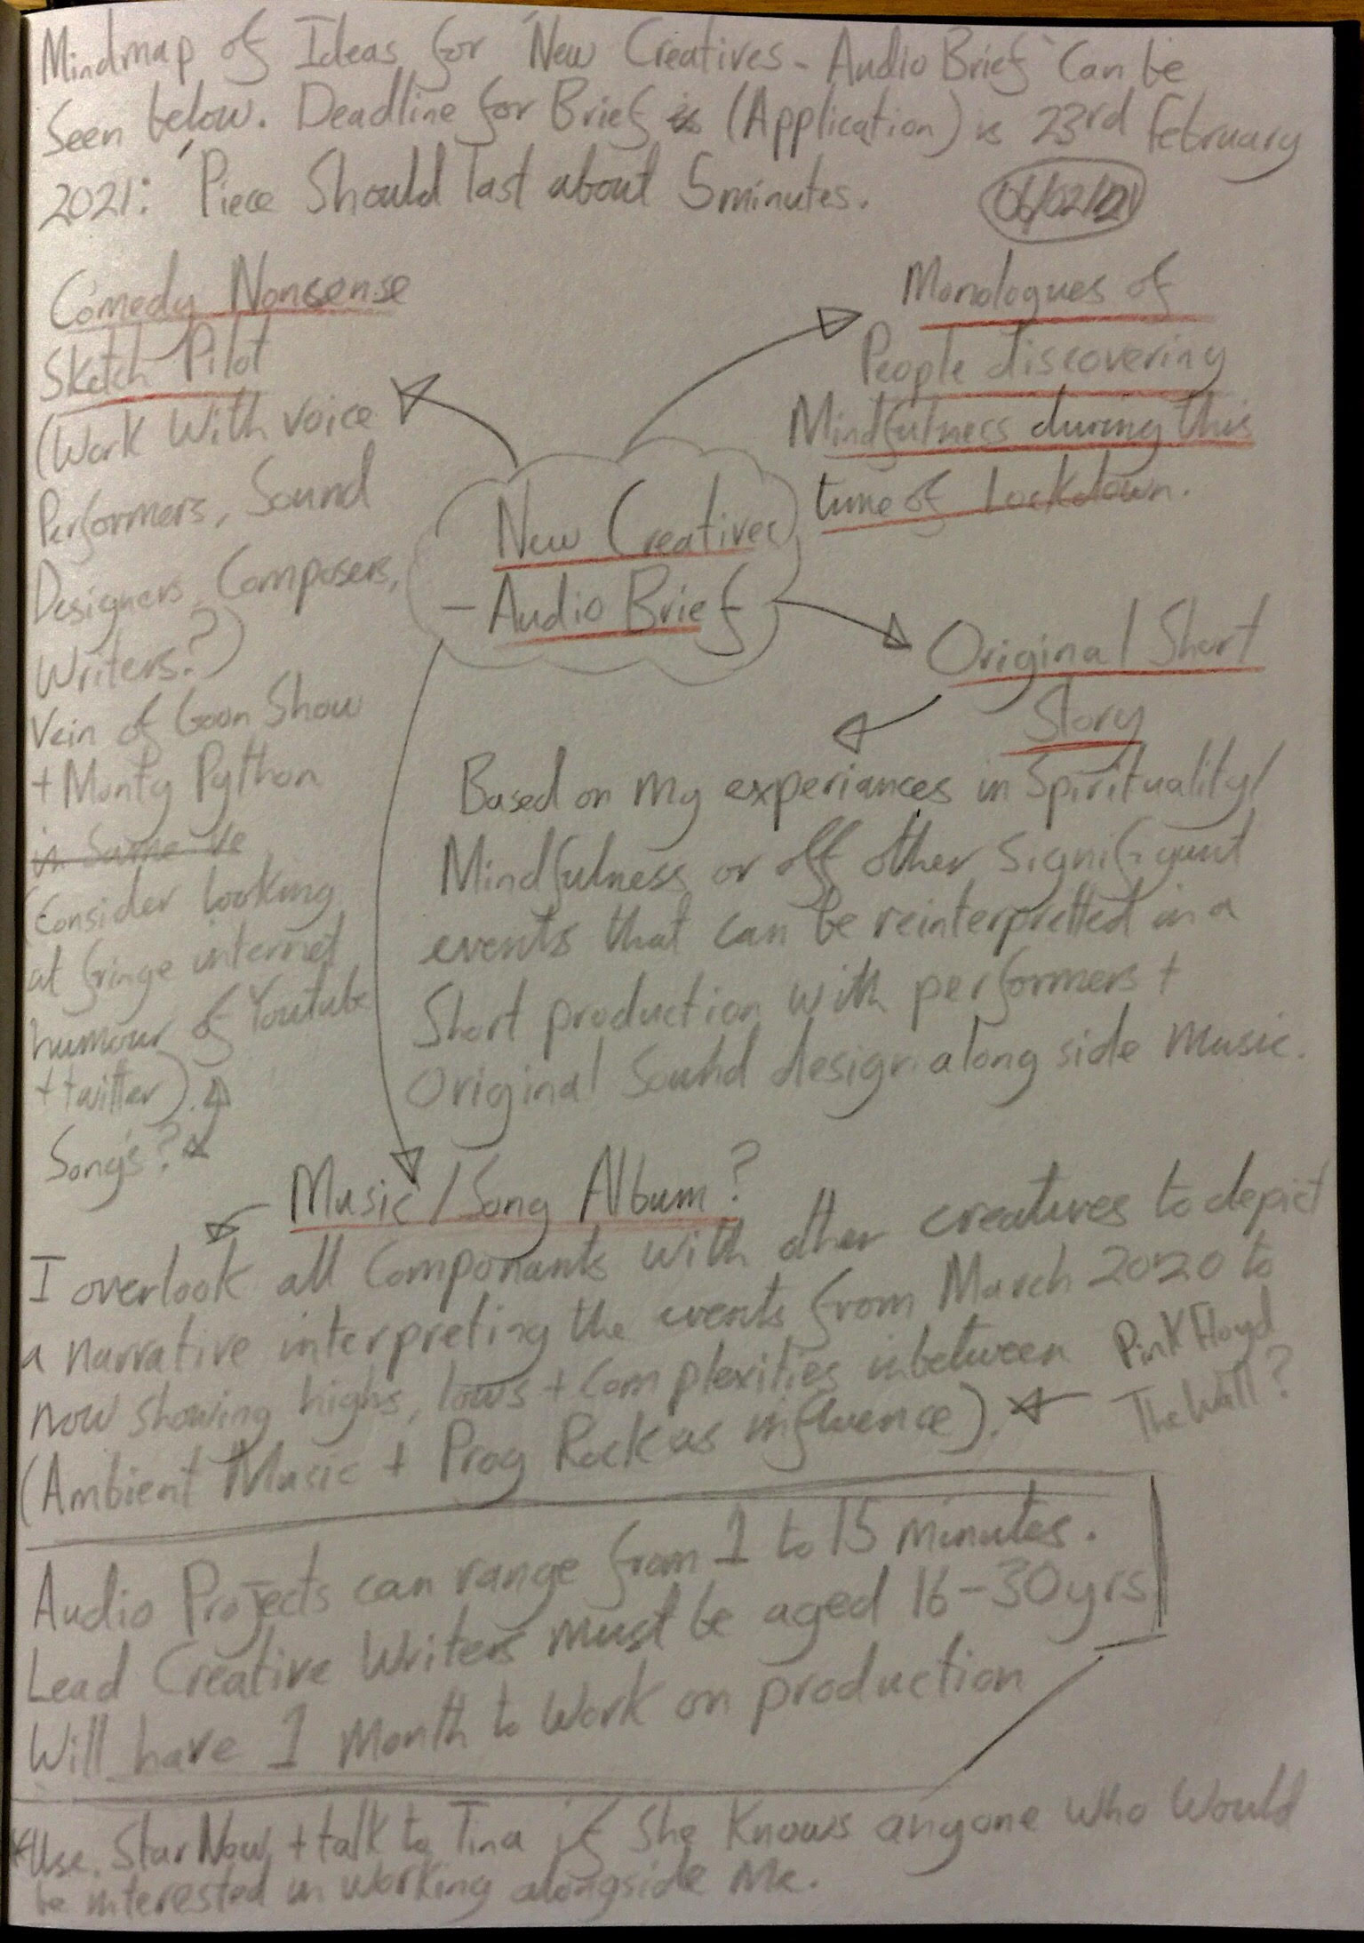
Mind map of potential ideas for ‘New Creatives- Audio Brief’ opportunity.
06/02/21.

Slide 14
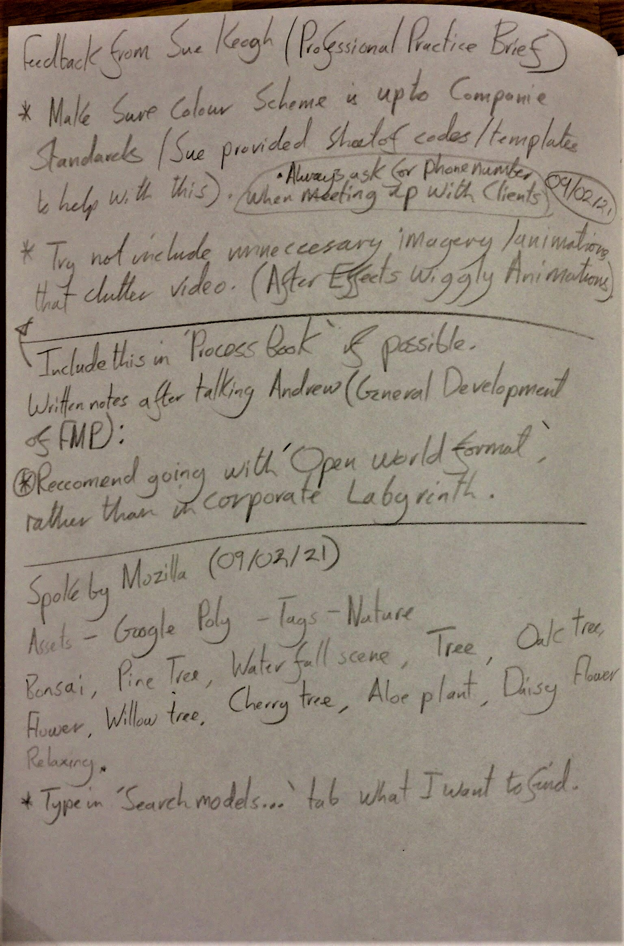
Feedback from Sue Keough on the Promos I created for her company ‘Sookio’. Further development on Mozilla Spoke/Hubs. 09/02/21.

Slide 15
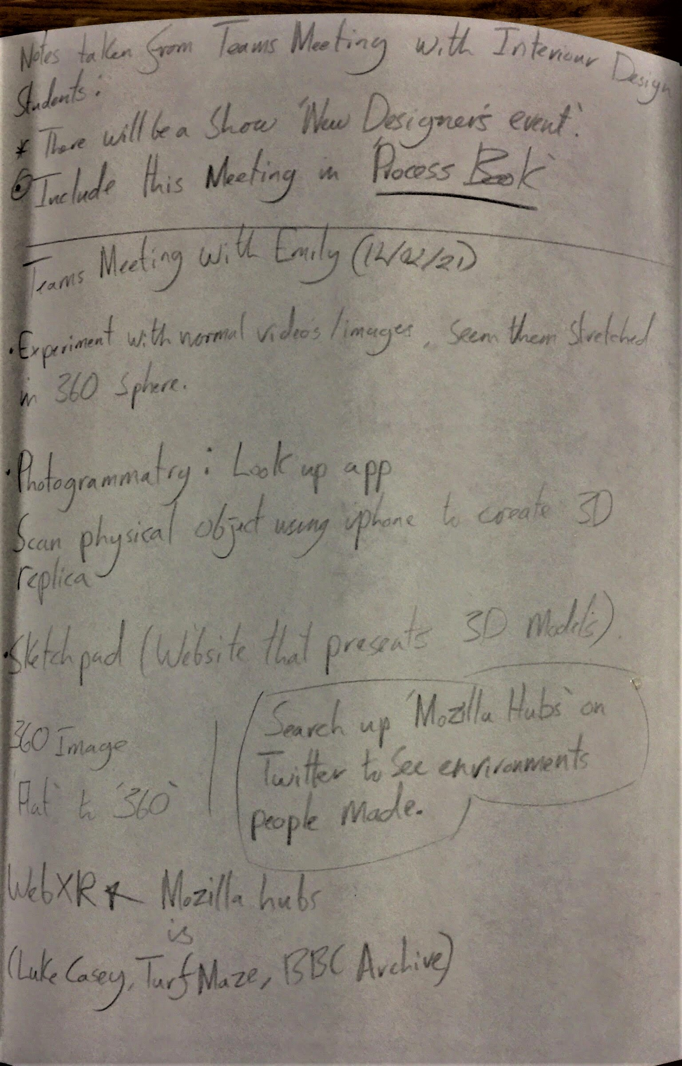
Notes from Teams Meeting with Emily Godden ‘Photogrammetry app etc.’. 12/02/21.

Slide 16
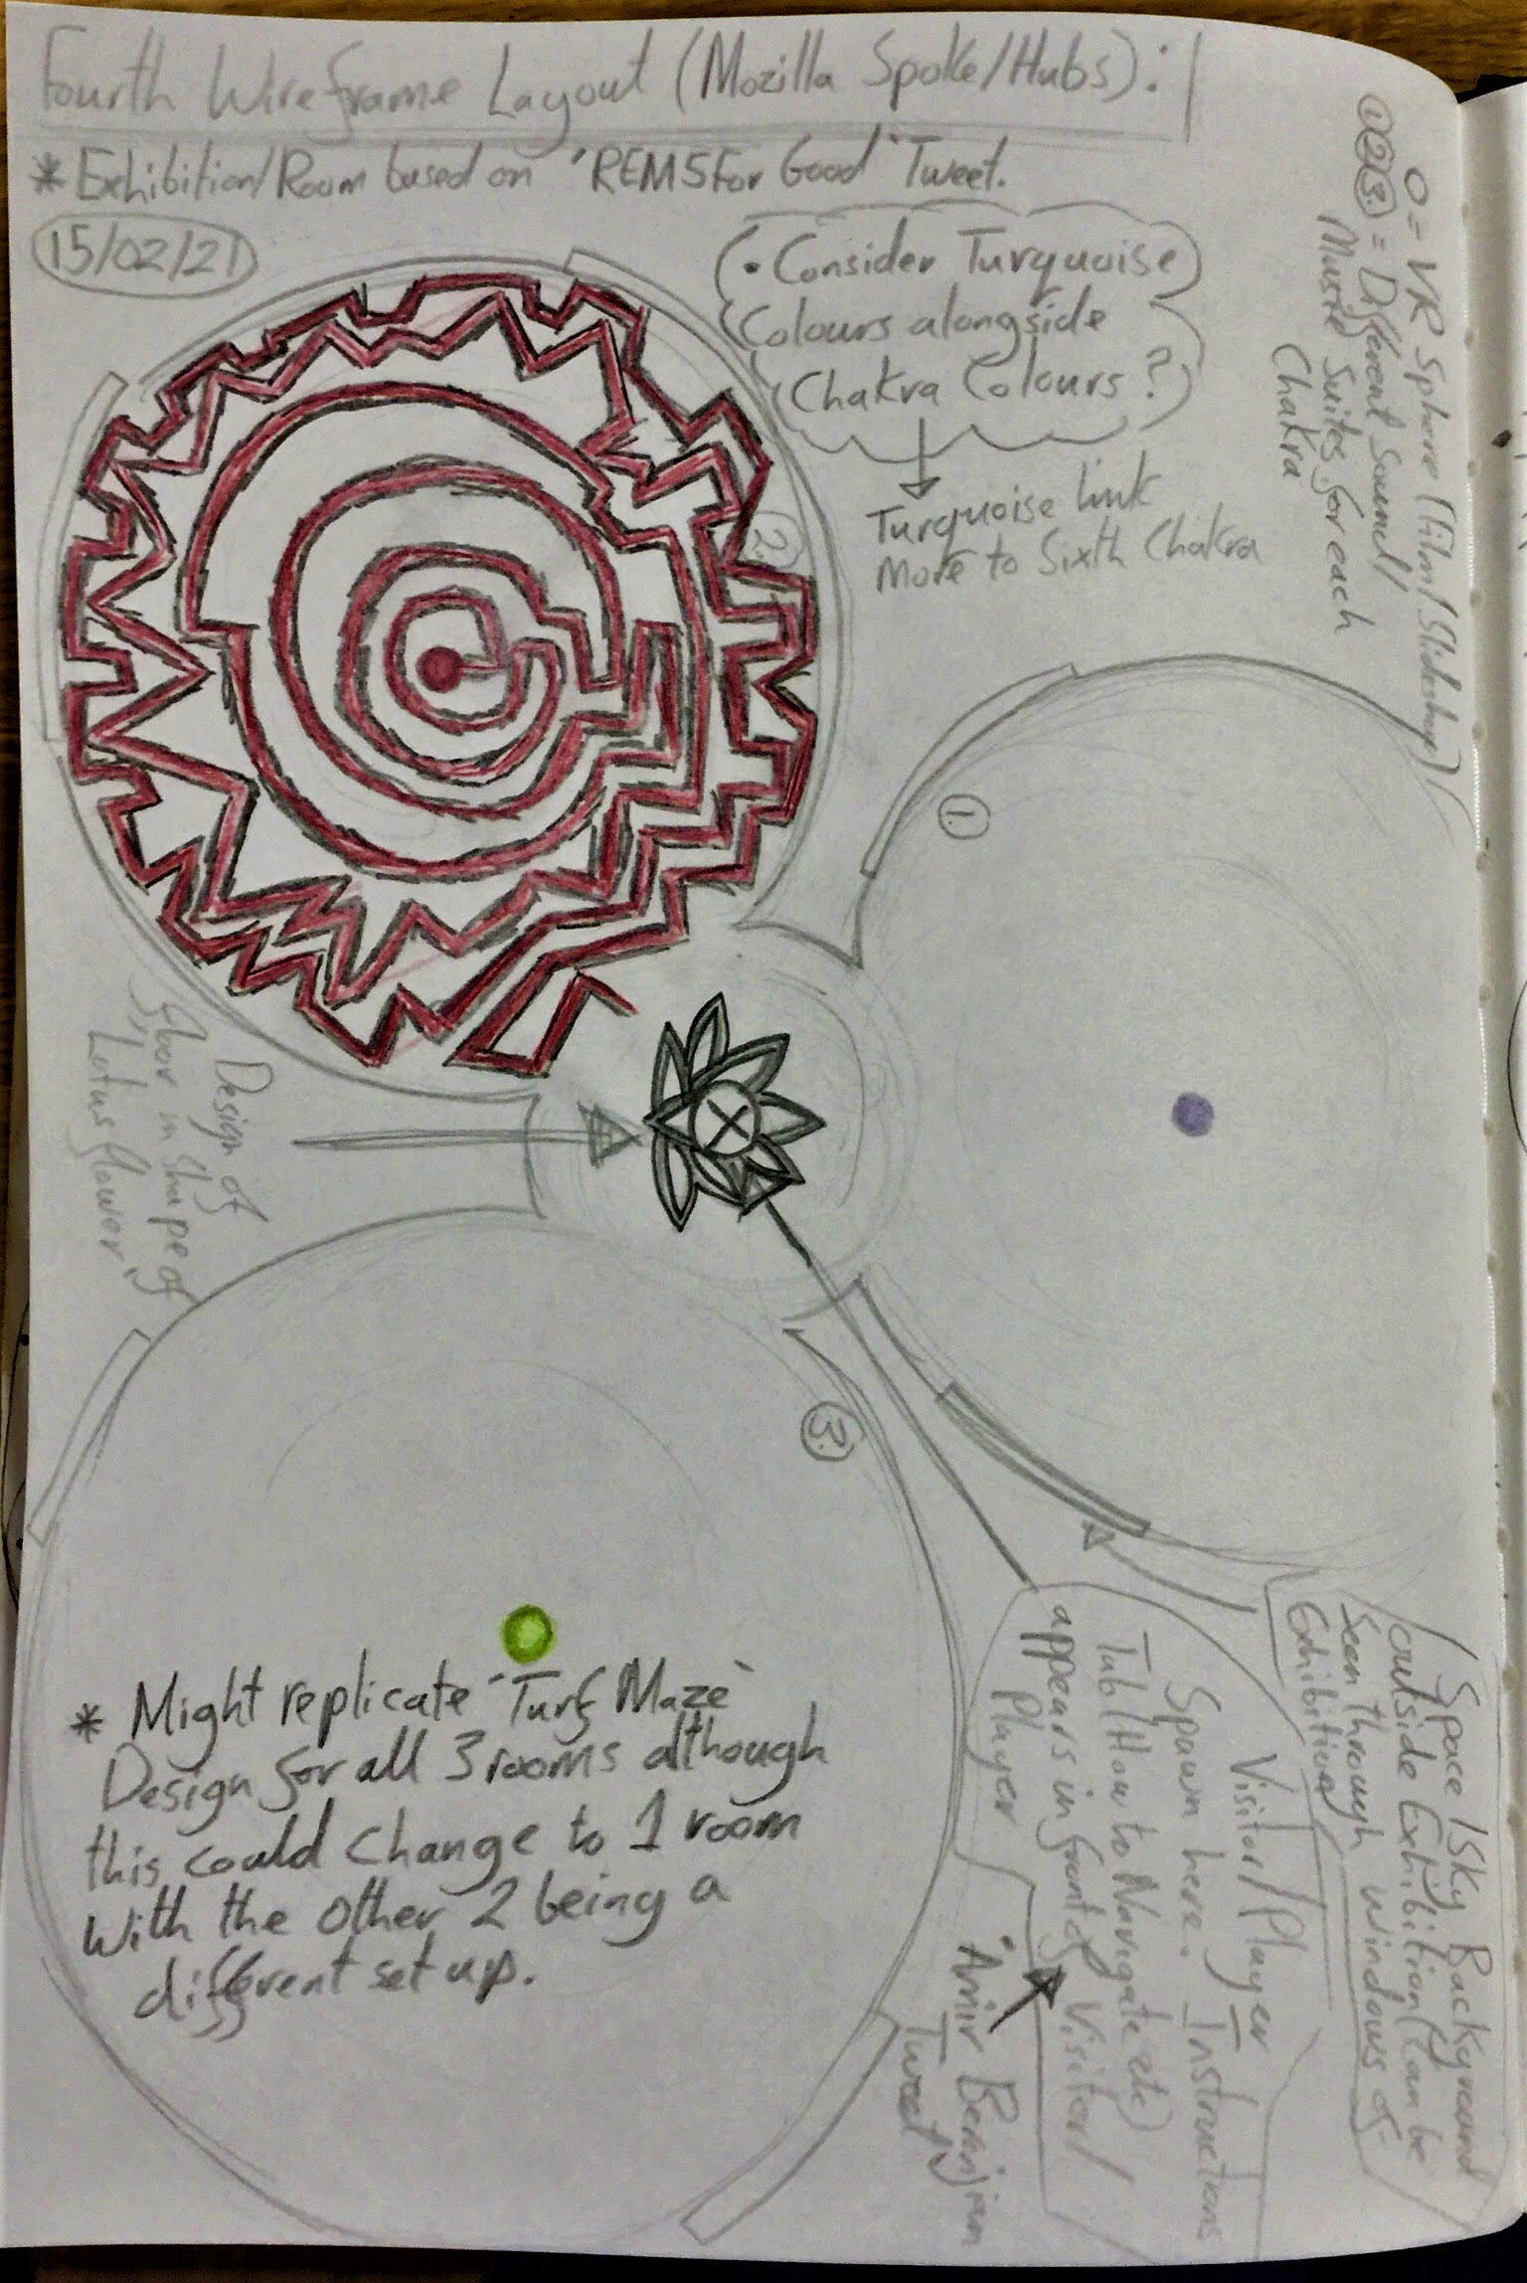
Fourth Wireframe Layout (Mozilla Spoke/Hubs). 15/02/21.

Slide 17
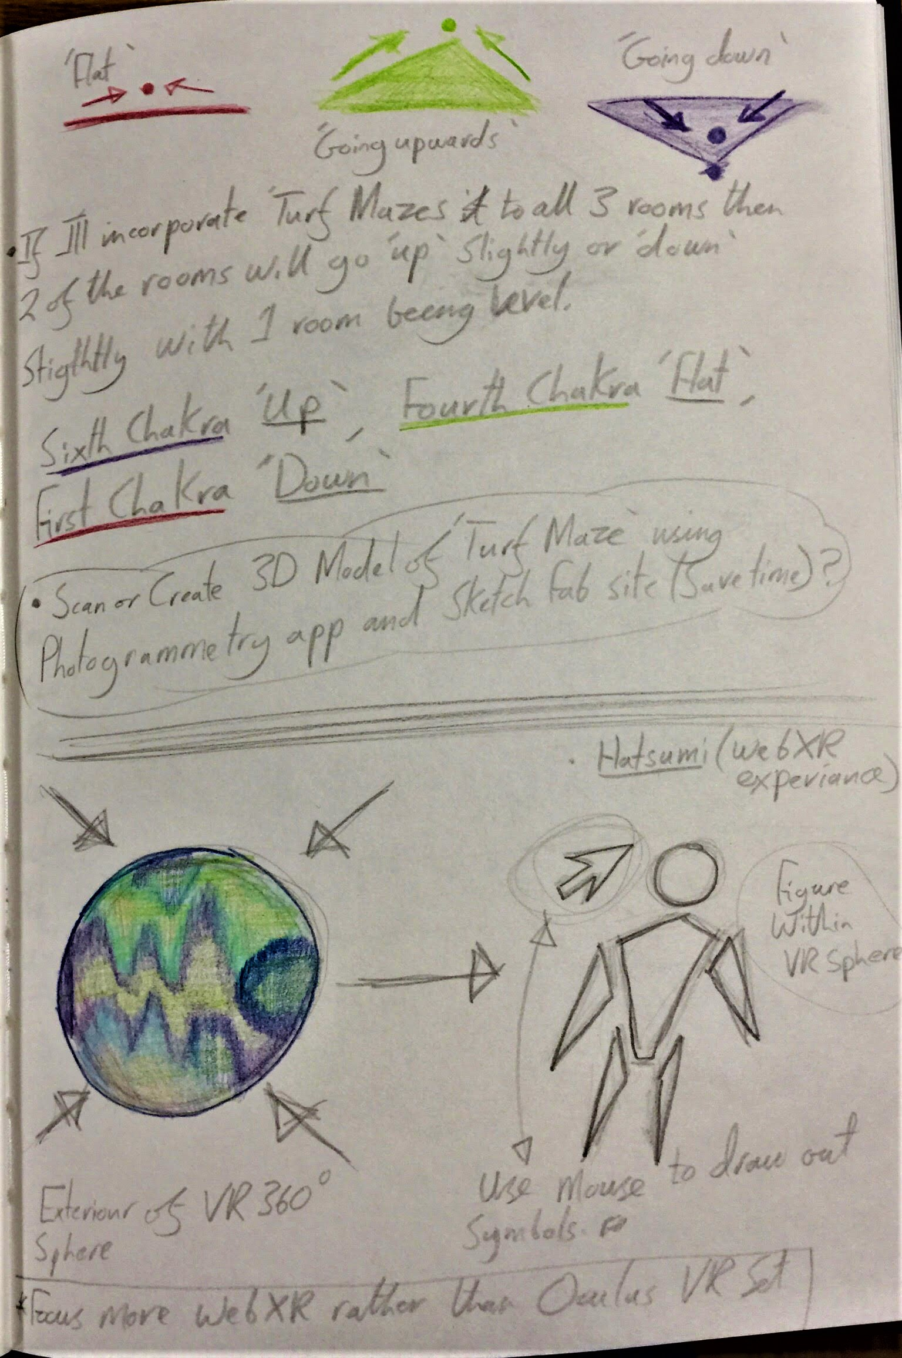
Further development on Mozilla Hubs/Spoke Environment and Hatsumi ‘WebXR Experience’ 1. 15/02/21.

Slide 18
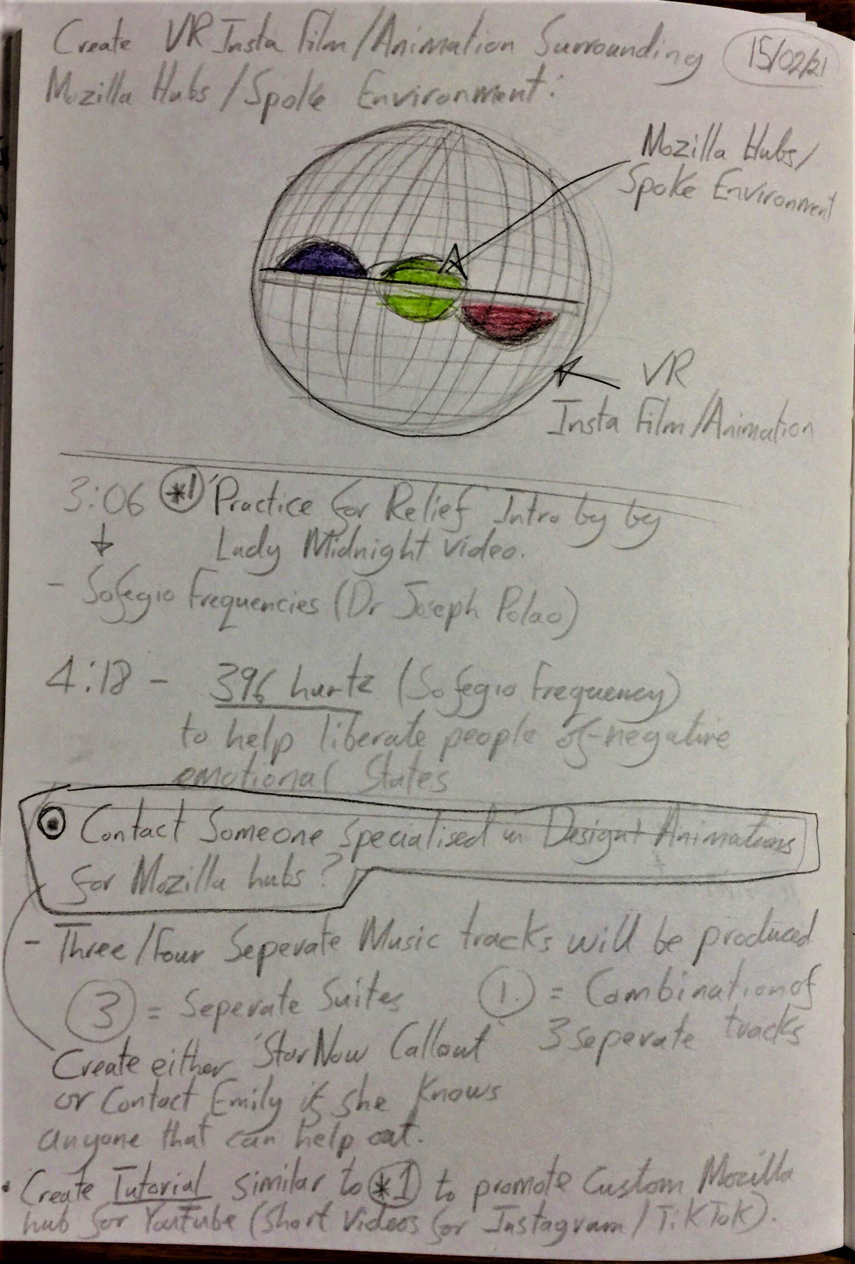
Further development on Mozilla Hubs/Spoke Environment and Hatsumi ‘WebXR Experience’ 2. 15/02/21.

Slide 19
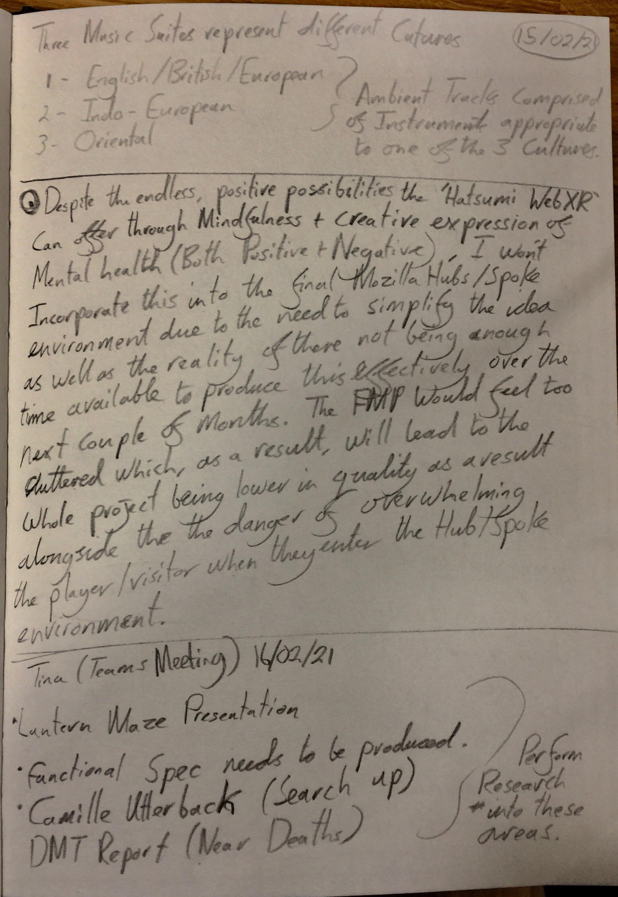
Extras notes on the Three Rooms Presentation, research in ‘Hatsumi WebXR’ and Tina’s suggested research into DMT Reports.
15/02/21 + 16/02/21

Slide 20
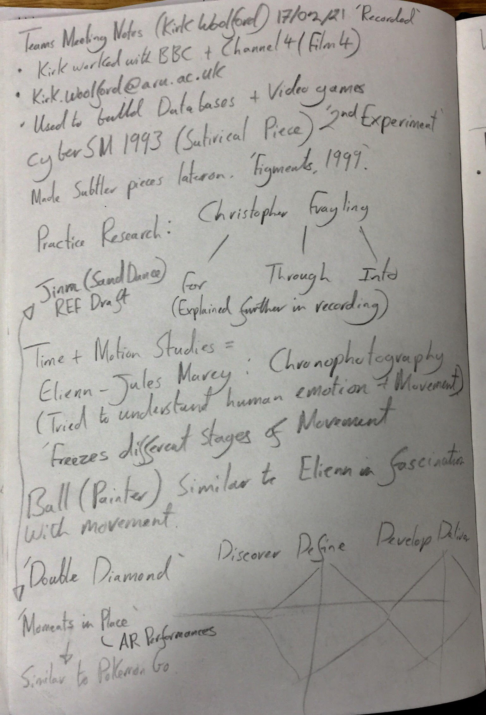
Notes taken during Zoom Event curated by ‘Kirk Woolford’. 17/02/21.

Slide 21
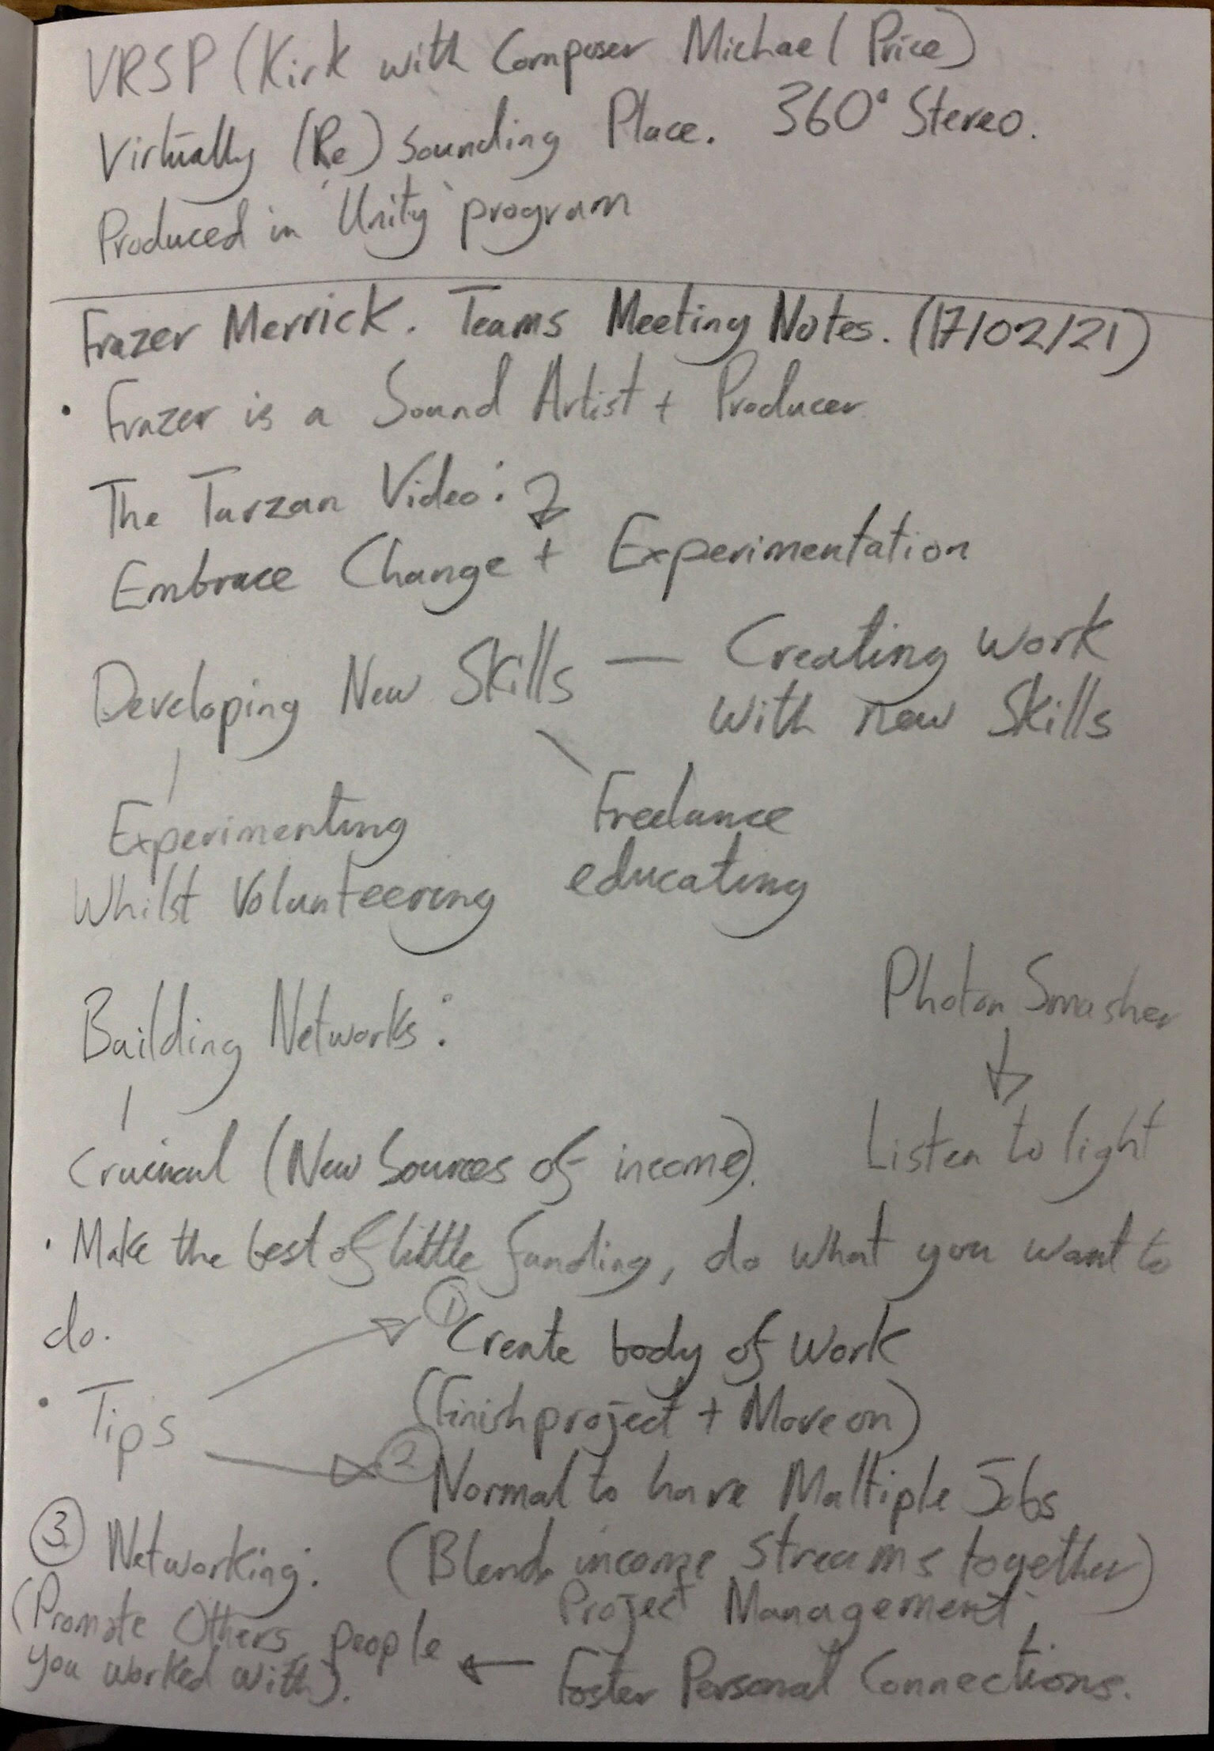
Notes written during teams Meeting with Frazer Merrick discussing steps on what to do after University. 17/02/21.

Slide 22
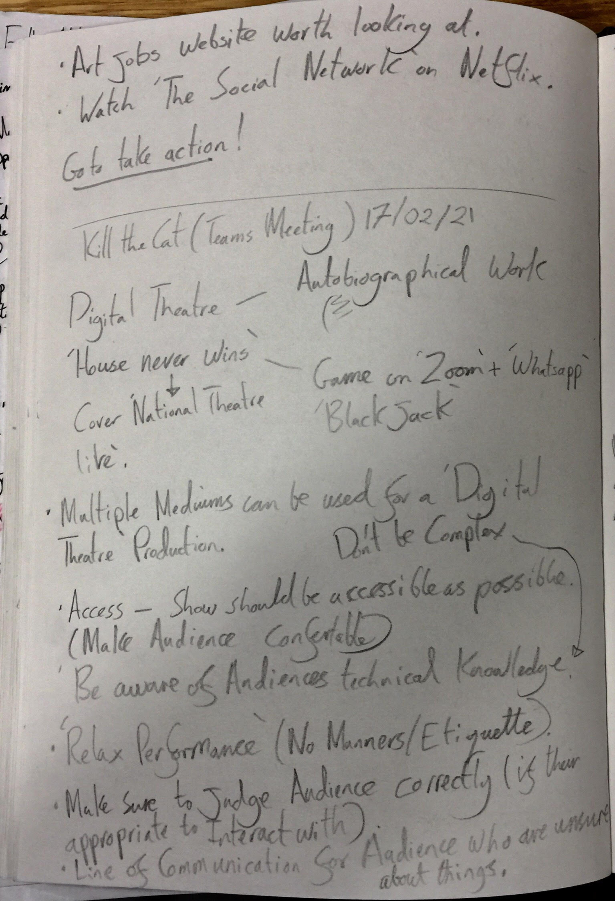
Notes written after Zoom Event with creators of the creative digital theatre production ‘Kill The Cat’. 17/02/21.

Slide 23
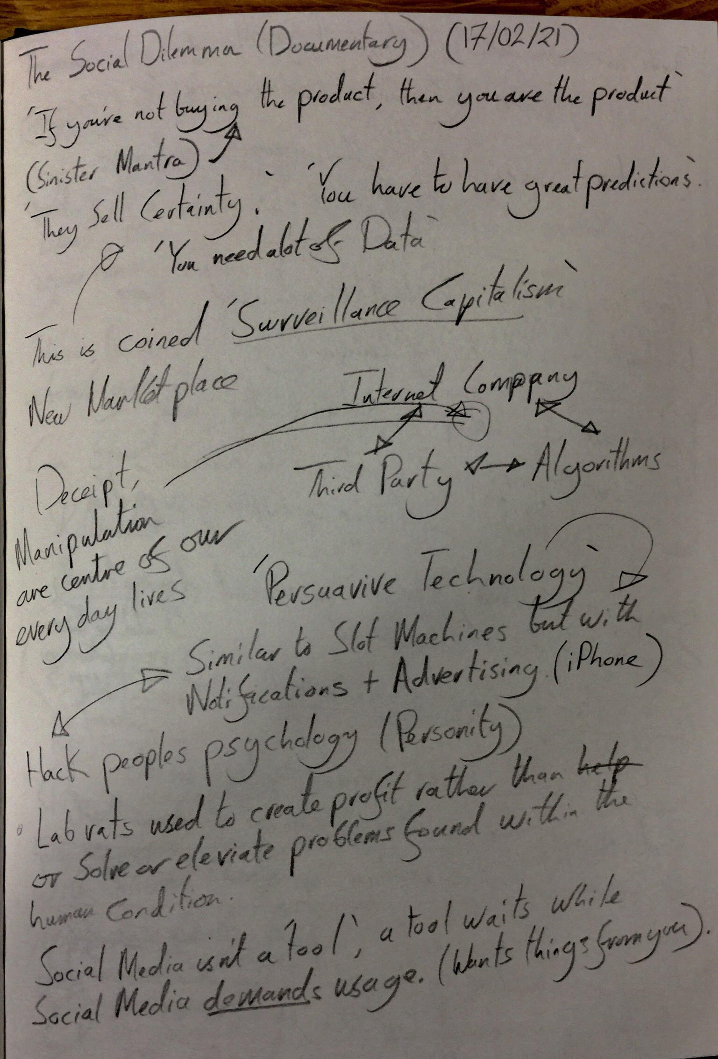
Notes written after watching ‘The Social Dilemma’ on Netflix in preparation for the Jesus College Zoom Event. Part 1. 17/02/21

Slide 24
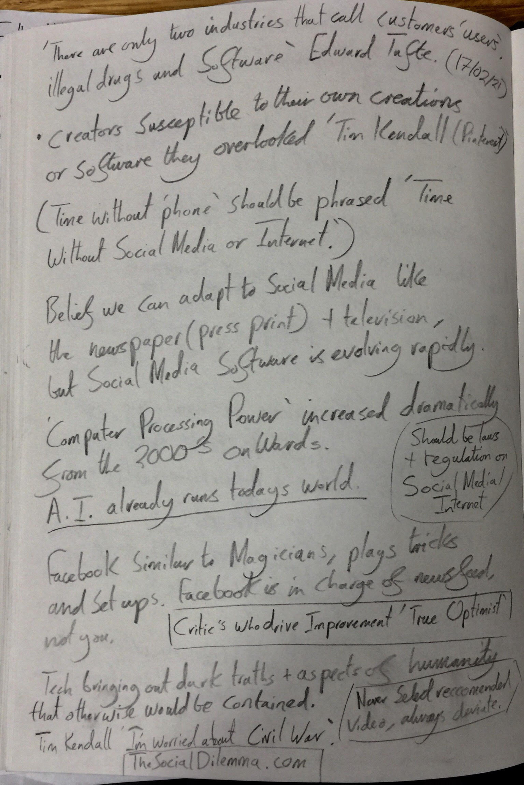
Notes written after watching ‘The Social Dilemma’ on Netflix in preparation for the Jesus College Zoom Event. Part 2. 17/02/21.

Slide 25
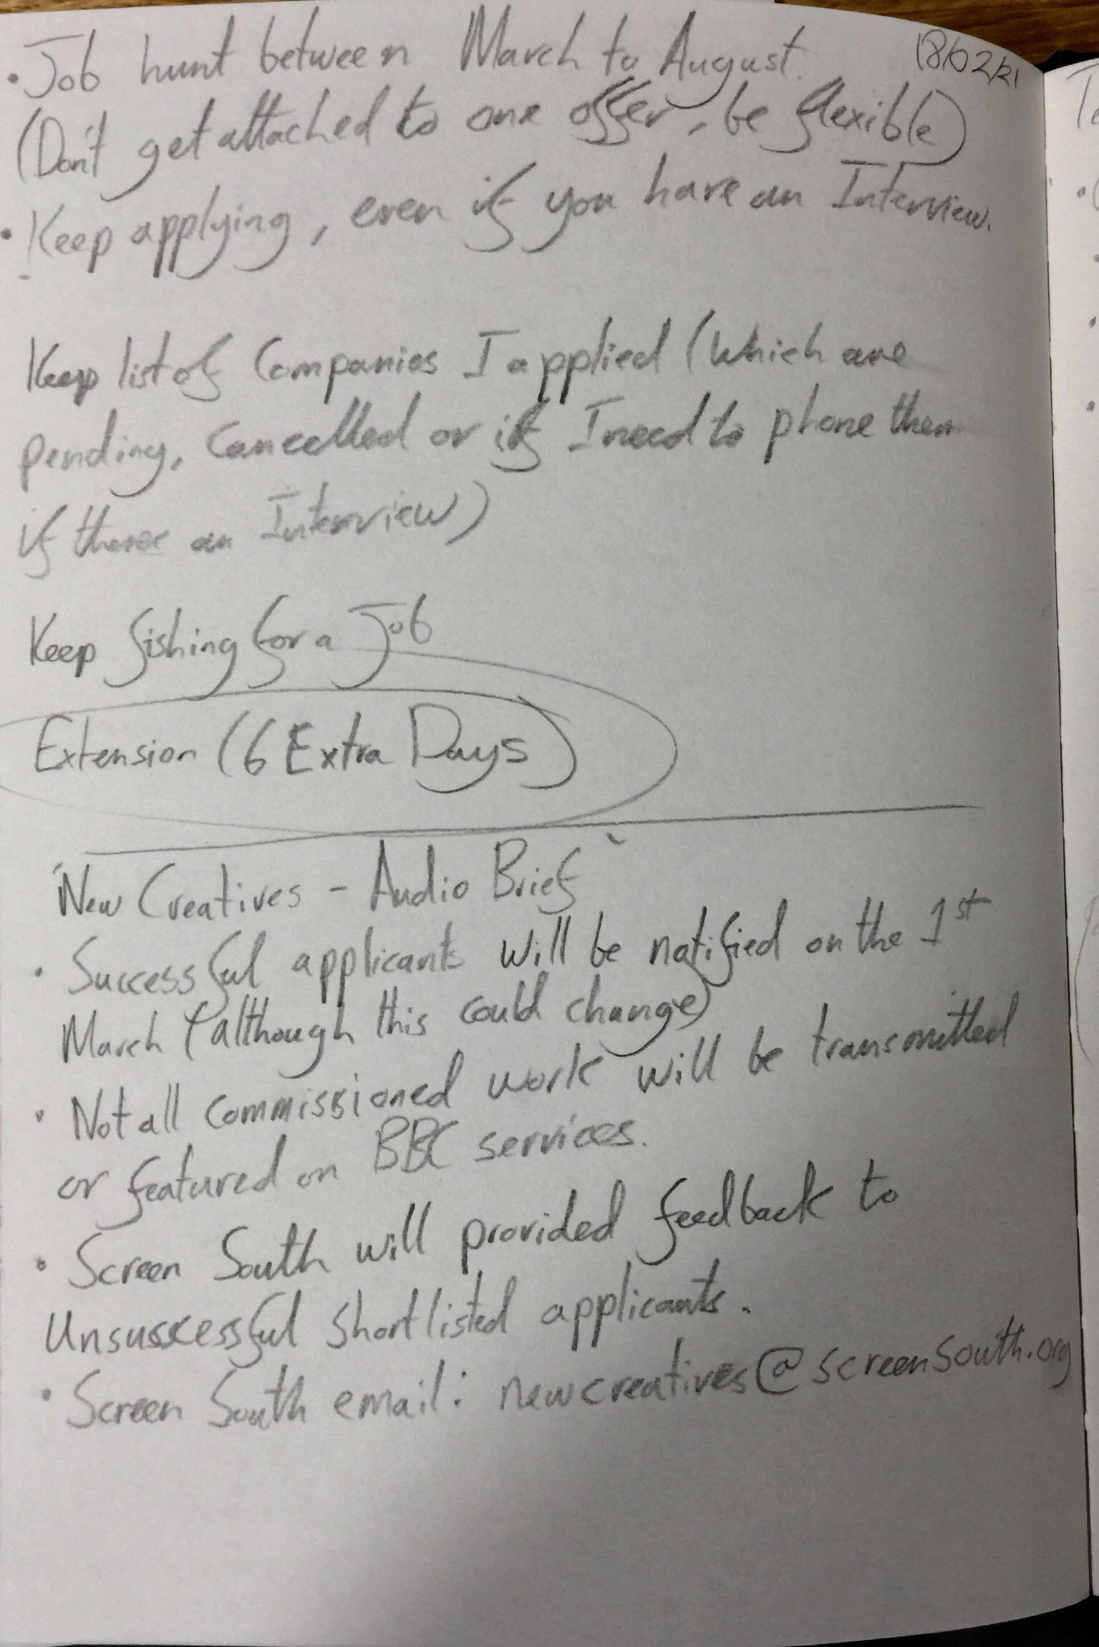
Notes on submission for ‘New Creatives – Audio Brief’ and a scheduled lesson during 18/02/21.

Slide 26
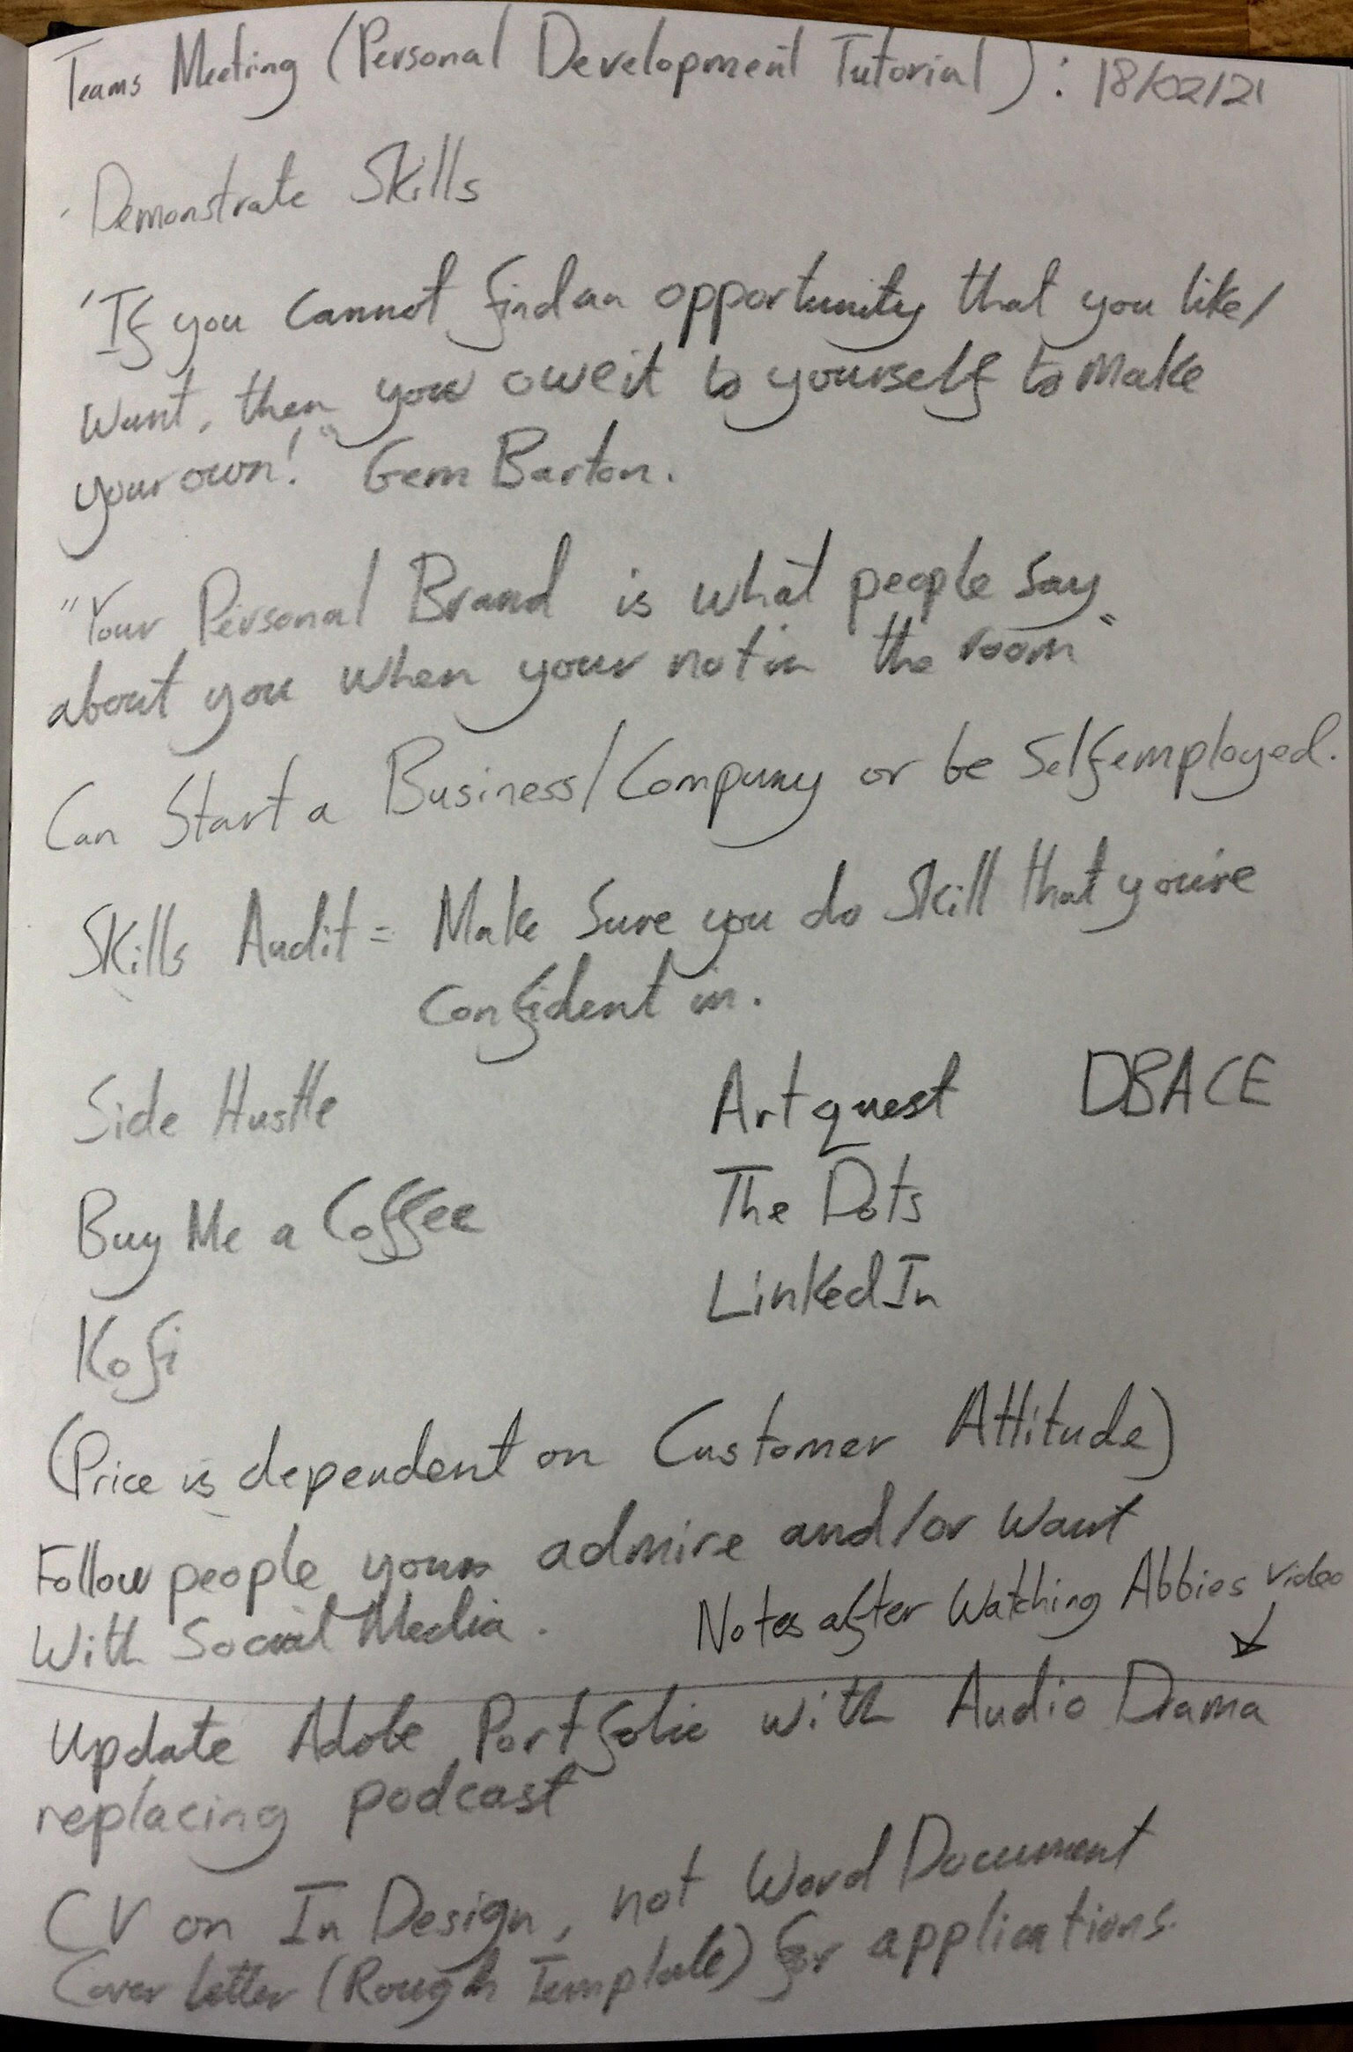
Notes written on ‘Personal Development Tutorial’ on 18/02/21.

Slide 27
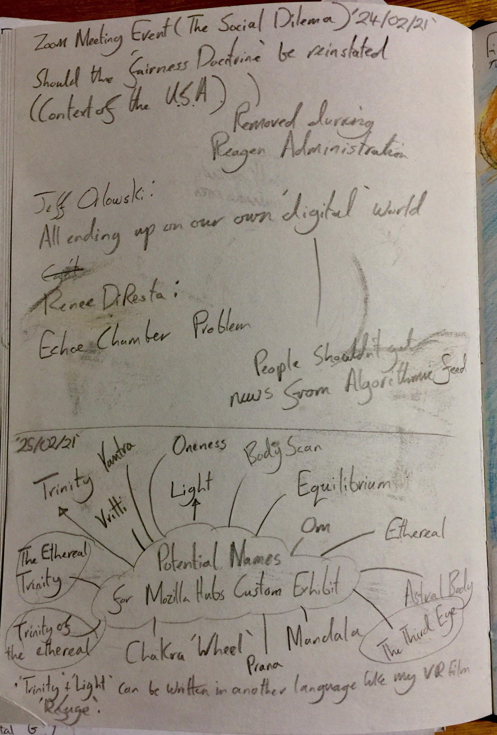
Notes from ‘The Social Dilemma’ Zoom Event and Major Project Name Development. 24/02/21. 25/02/21.

Slide 28
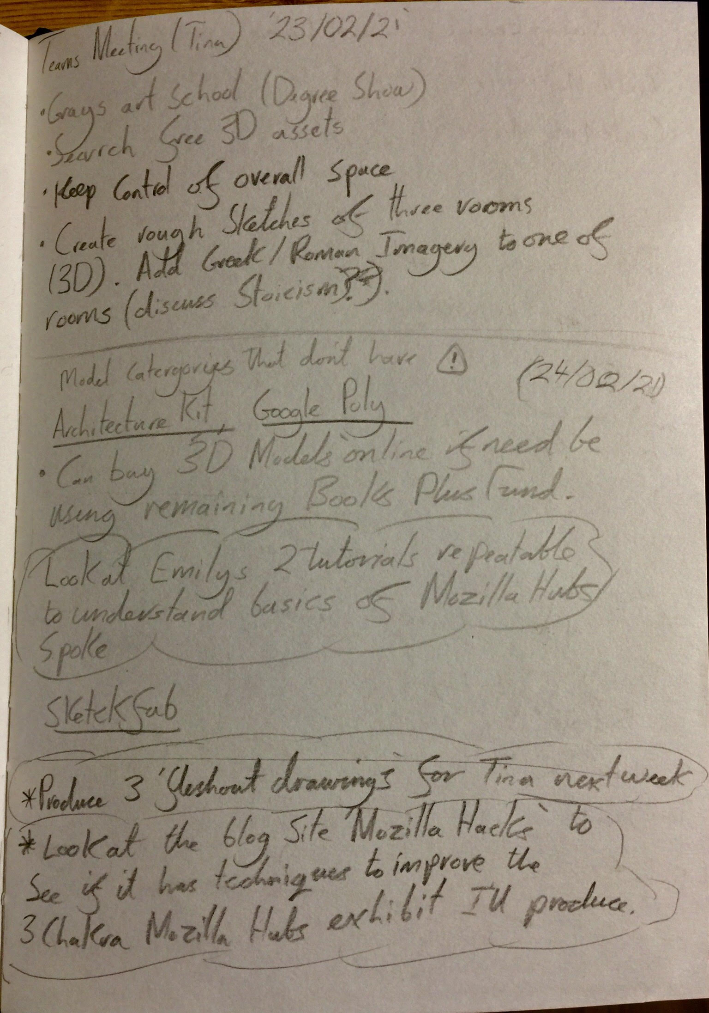
Notes with Tina (Teams Meeting) and research in Mozilla Hubs/Spoke. 25/02/21.

Slide 29
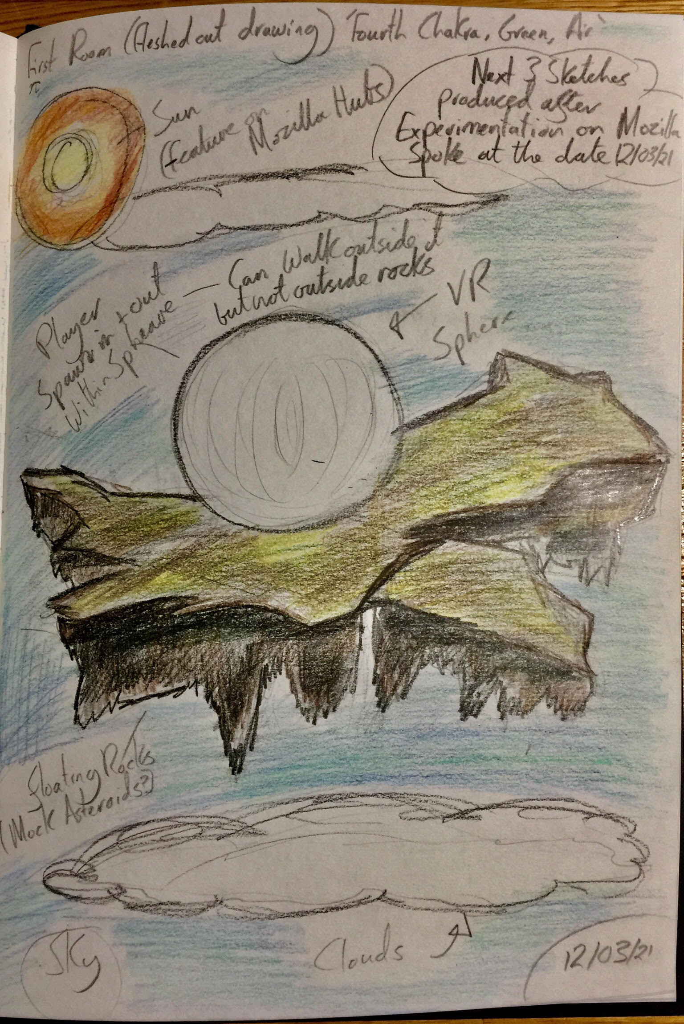
Custom Exhibit First Room Concept Drawing. 12/03/21.

Slide 30
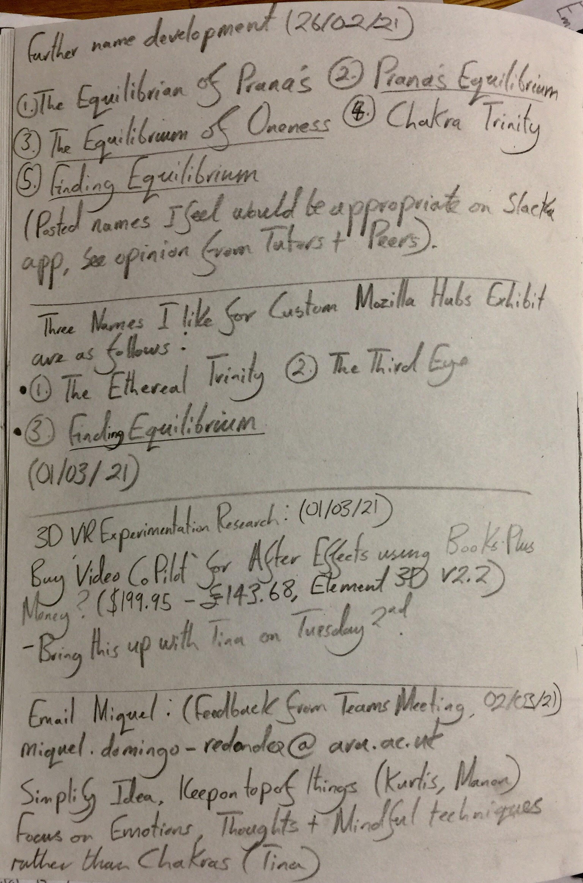
Major Project Name Development, VR Research and further notes from Teams Meeting with Emily. 26/02/21. 01/03/21. 02/03/21.

Slide 31
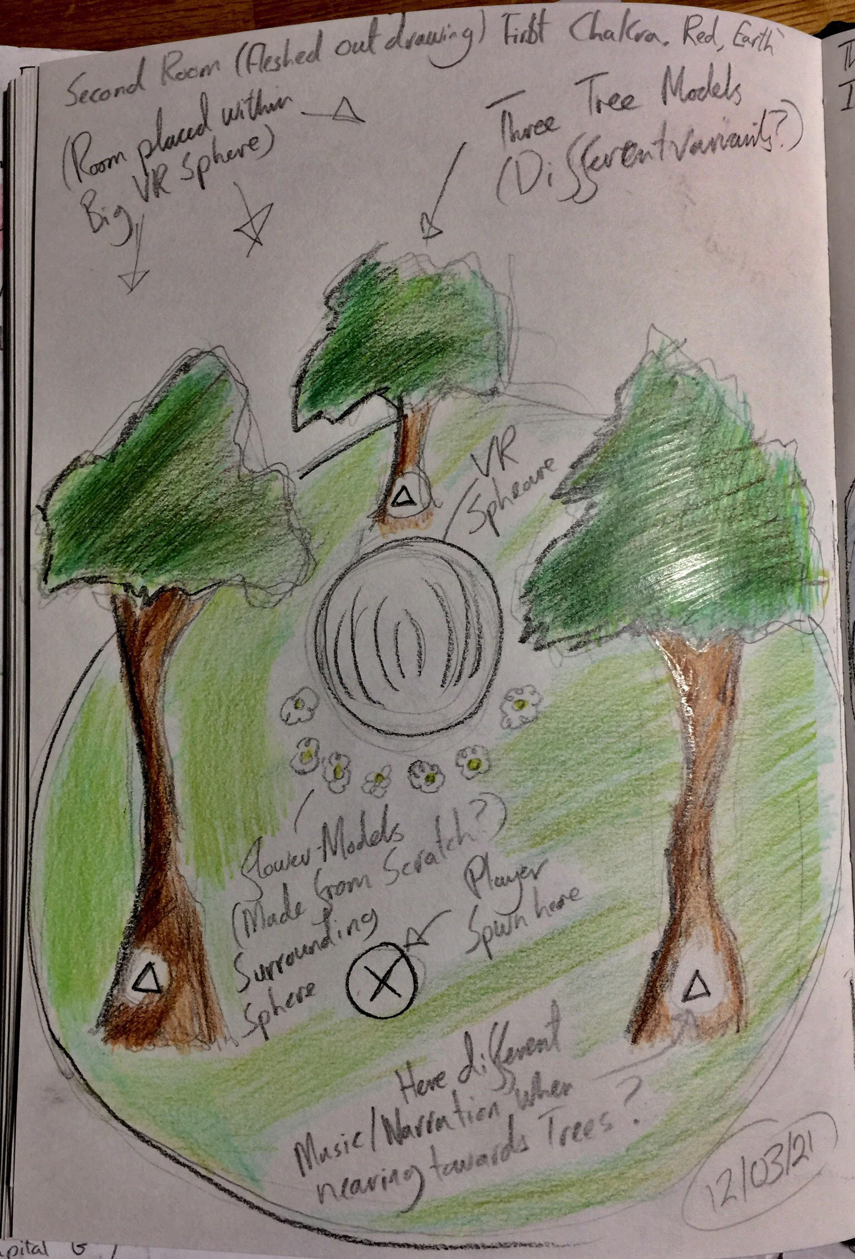
Custom Exhibit Second Room Concept Drawing. 12/03/21.

Slide 32
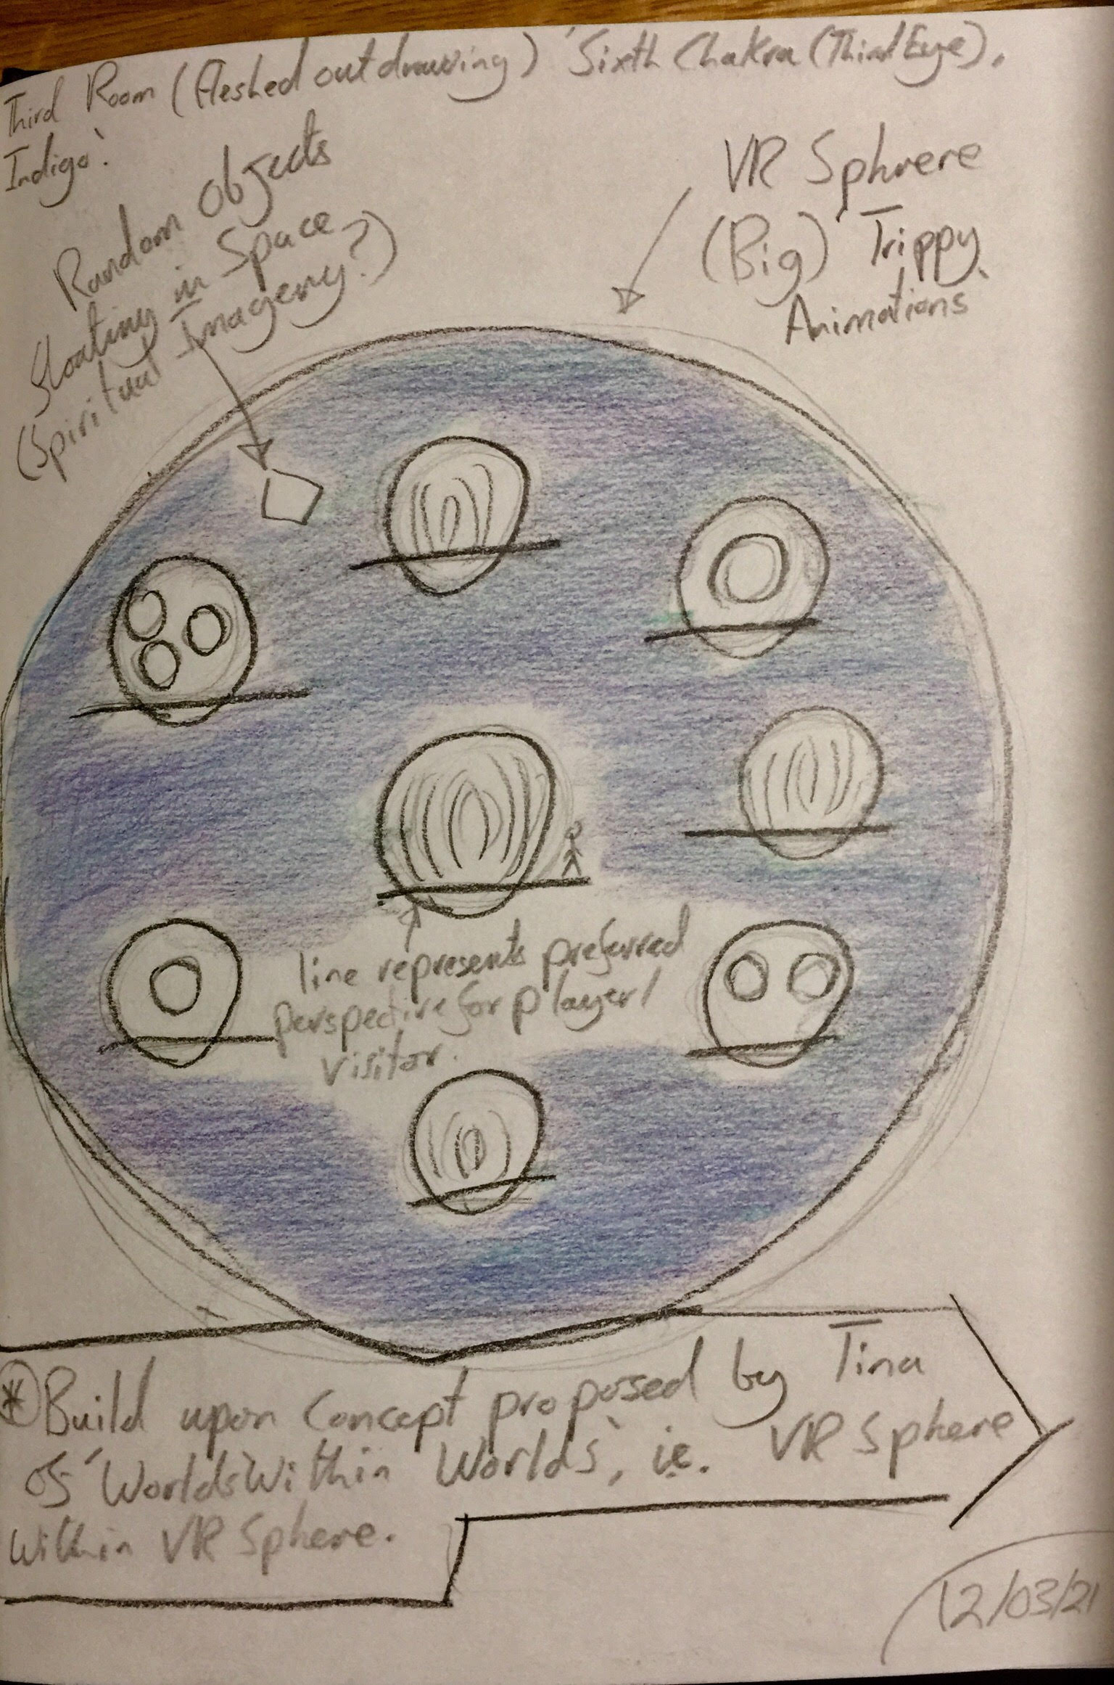
Custom Exhibit Third Room Concept Drawing. 12/03/21.

Slide 33
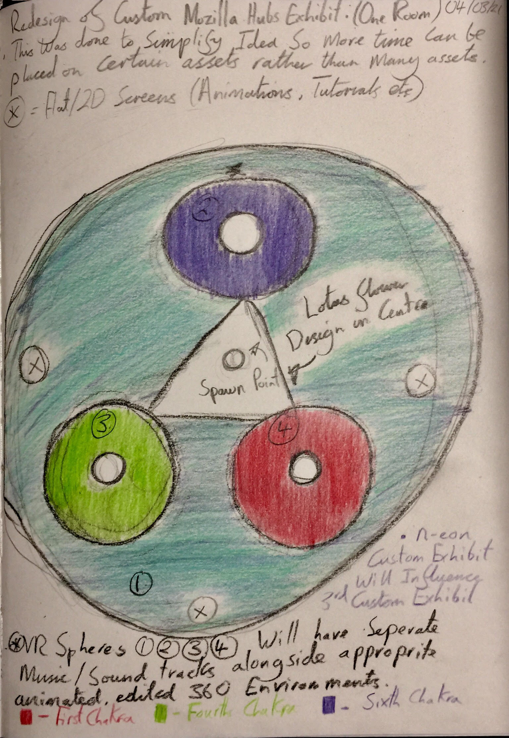
Redesign of possible Third Custom Mozilla Hubs Exhibit. 04/03/21. 12/03/21.

Slide 34
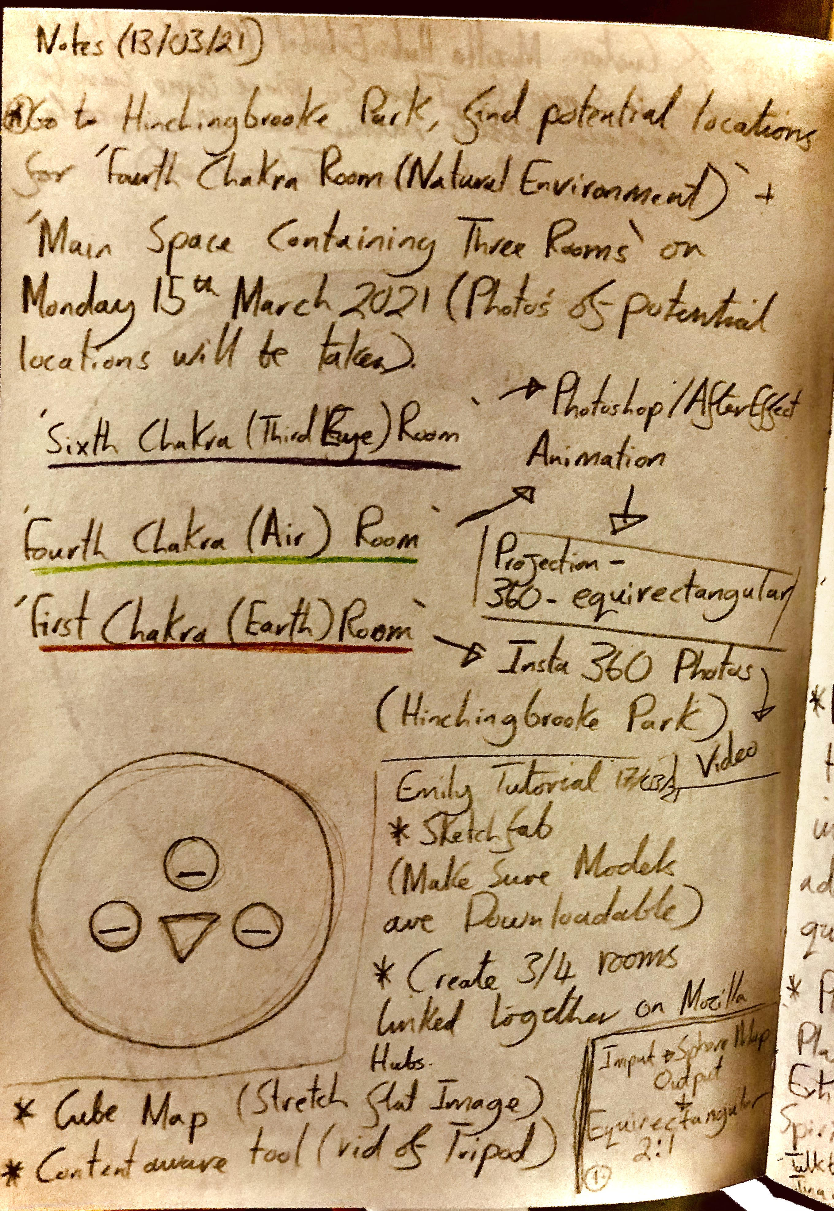
(13/03/21) This page expands on the final planning for the ‘Finding Equilibrium’ exhibit alongside notes taken from a tutorial with Emily (Tutor)

Slide 35
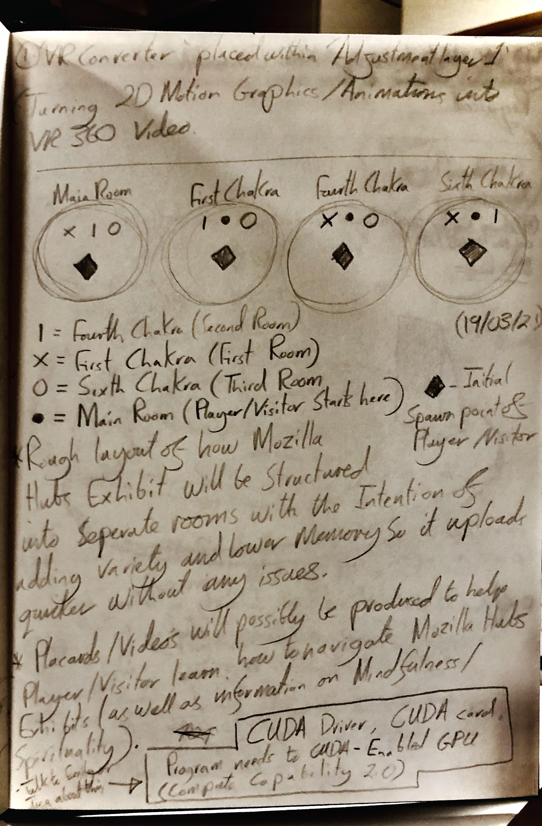
(19/03/21) Further Development on exhibit layout planned for Mozilla Hubs alongside written research.

Slide 36
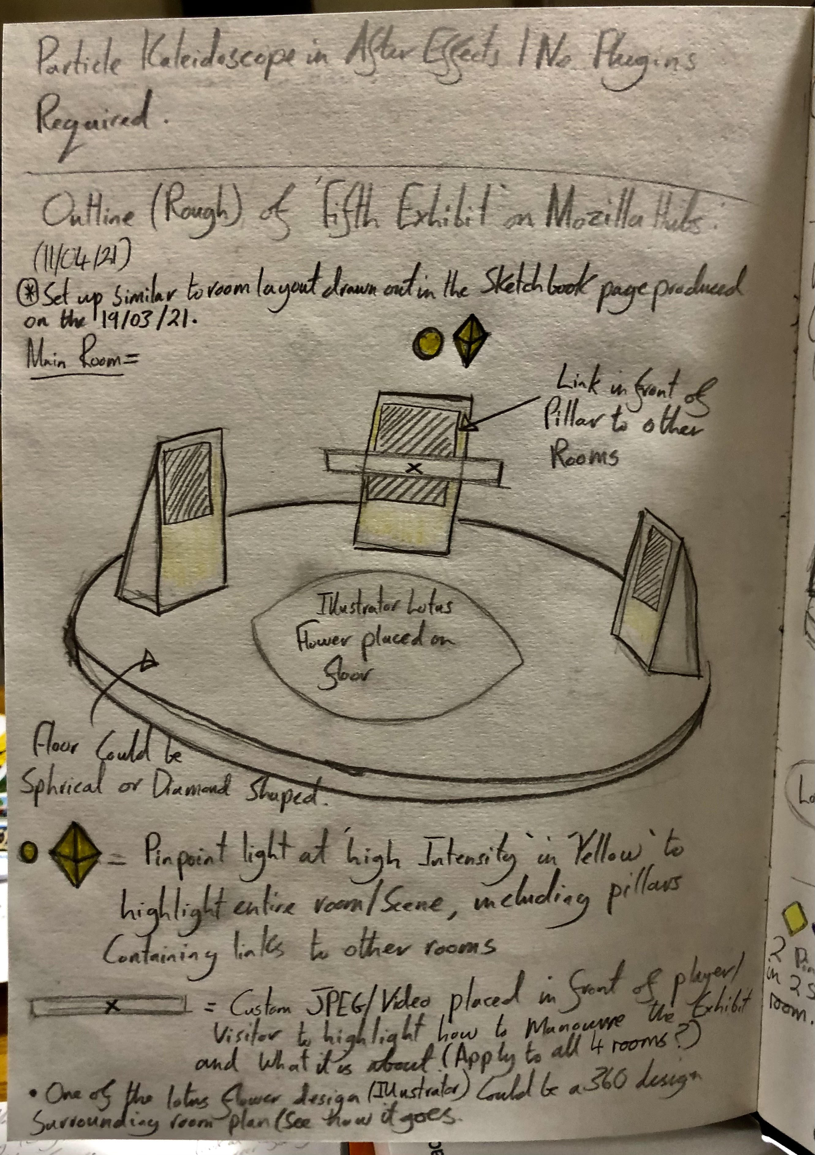
(11/04/21) Rough Sketch plan for ‘Main Room’ within ‘Finding Equilibrium’ exhibit.

Slide 37
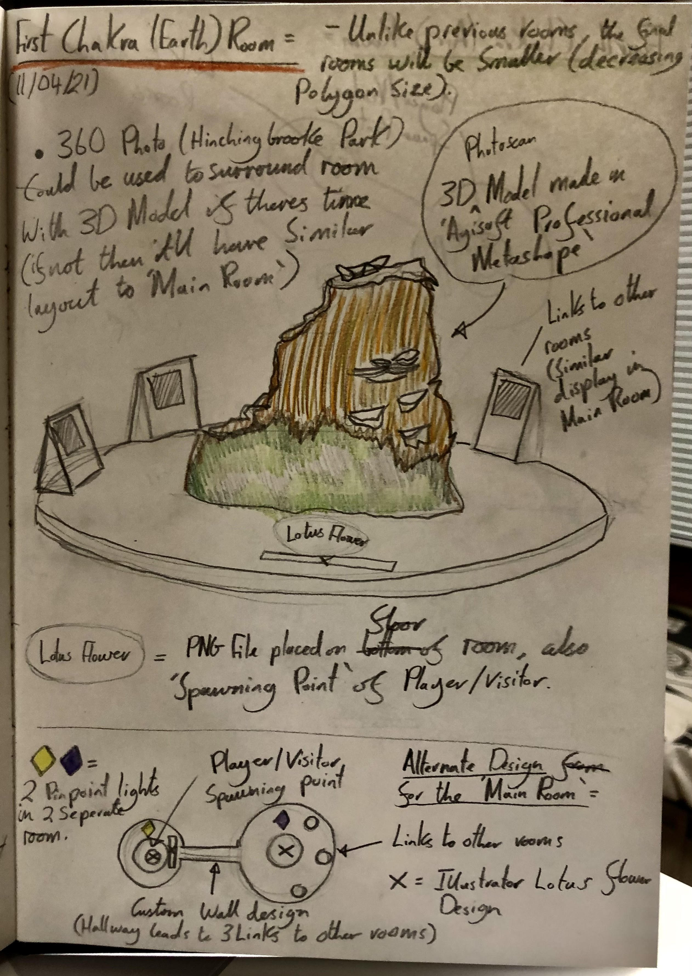
(11/04/21) Rough Sketch plan for ‘First Chakra (Earth) Room’ within ‘Finding Equilibrium’ exhibit.

Slide 38
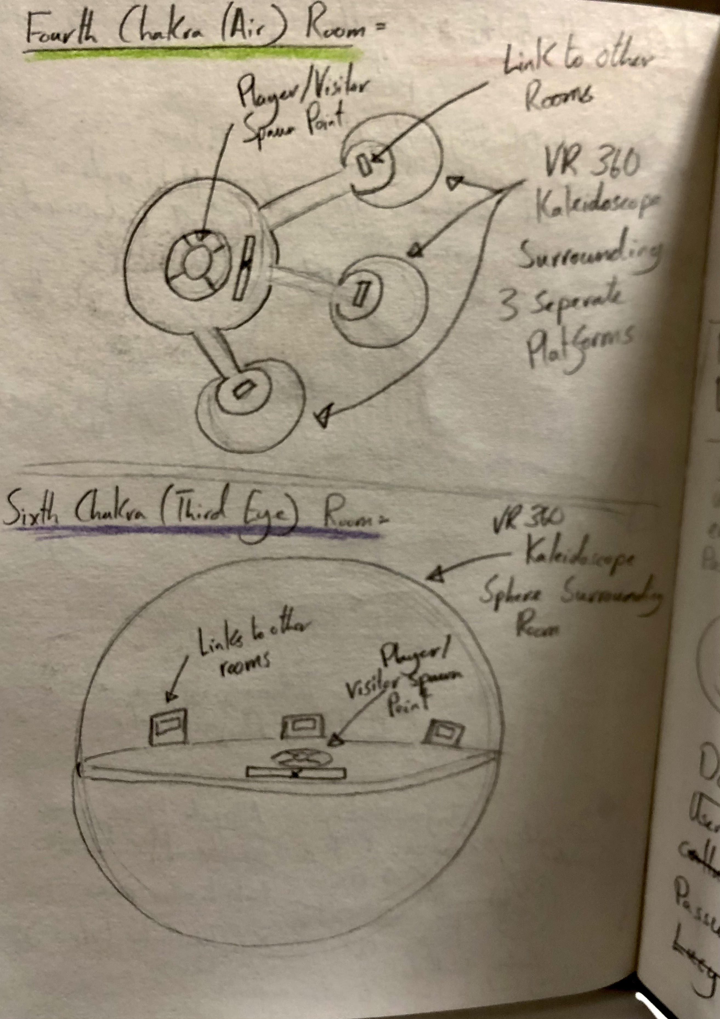
(11/04/21) Rough Sketch plans for ‘Fourth (Air) and Sixth (Third Eye) Rooms within ‘Finding Equilibrium’ exhibit.

Slide 39
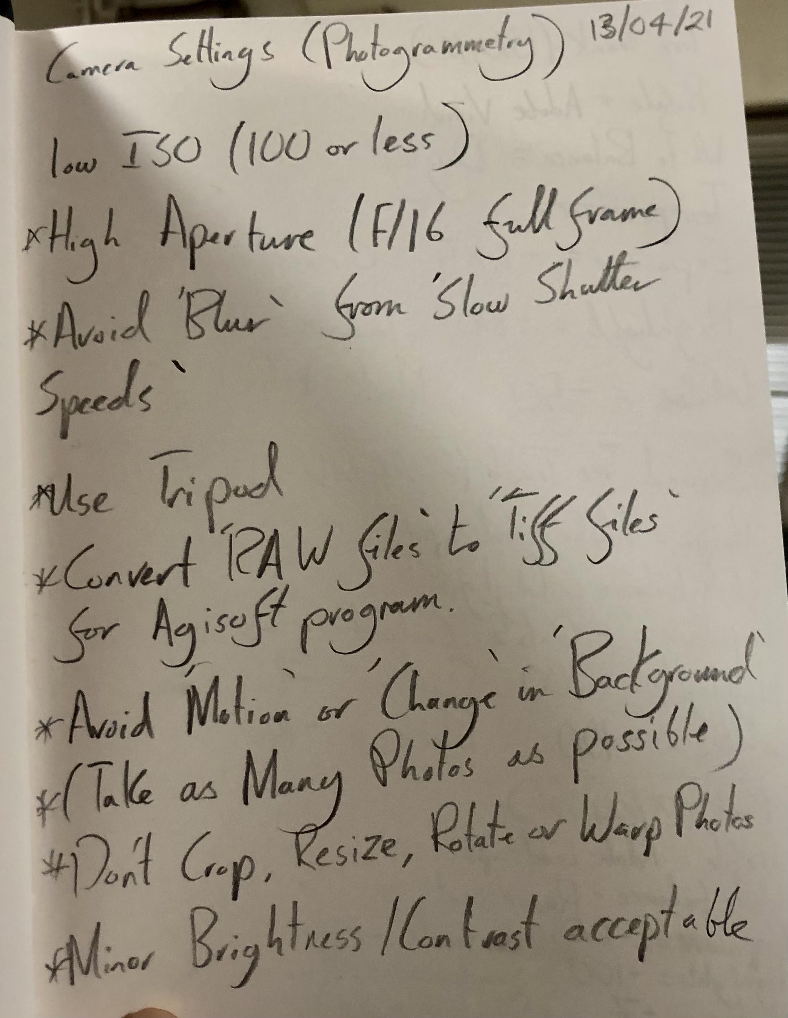
(13/04/21) Notes/Research performed after watching LYNDA Tutorials for ‘Agisoft Metashape Professional’ Program in relation to taken initial photographs for final model.

Slide 40
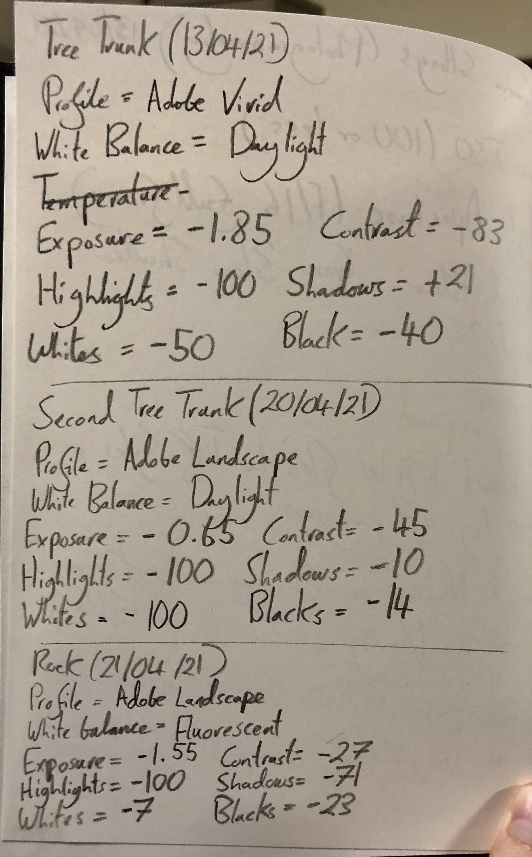
(13/04/21) (20/04/21) (21/04/21) Notes depicting added tweaks to photographs which were used to create the ‘Tree Trunk’, ‘Rock’ and ‘Second Tree Trunk’ Models seen in earlier experiments within Mozilla Hubs/Spoke.

Slide 41
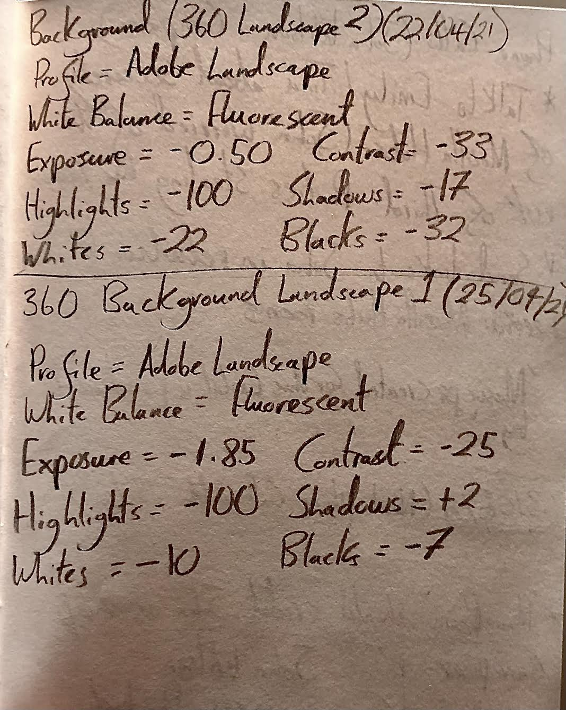
(22/04/21) (25/04/21)Notes depicting added tweaks to photographs which were used to create both 360 Background Landscape 1 and 2.

Slide 42
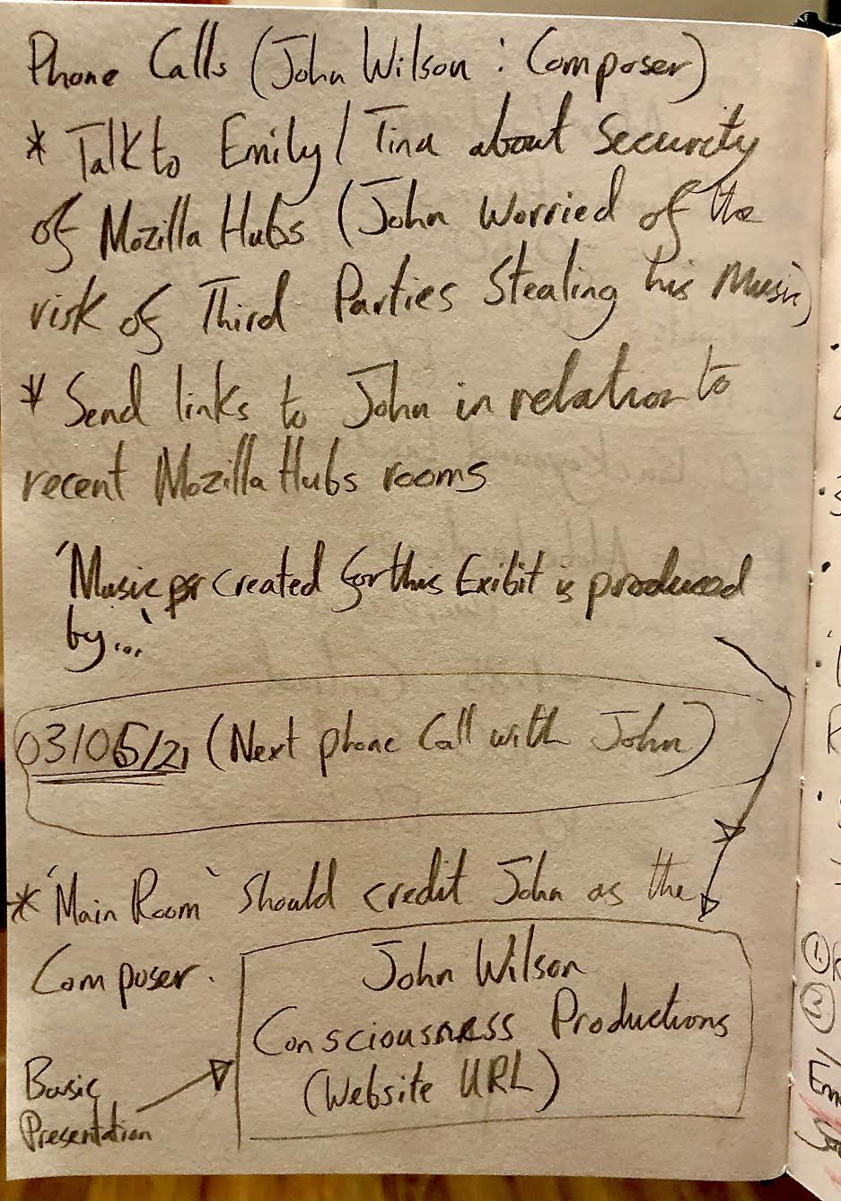
Notes after talking to Composer ‘John Wilson’ who was shortlisted from the StarNow Callout. 26/04/21.

Slide 43
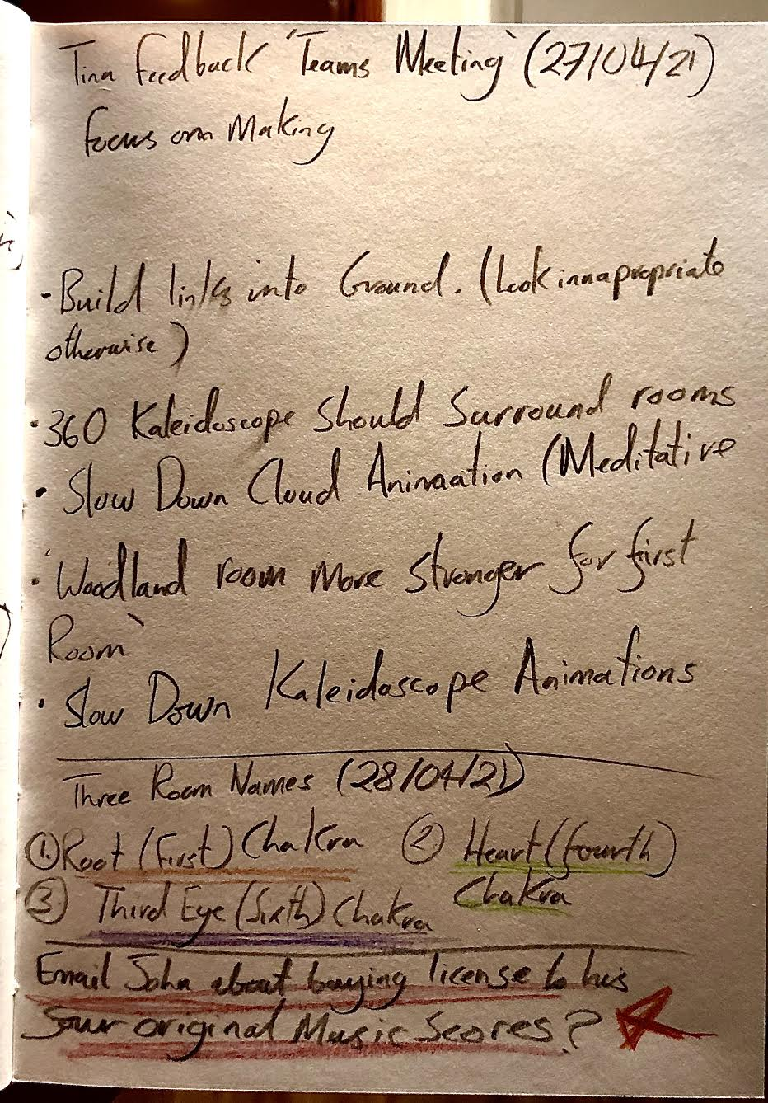
Notes written after talking to Tina via Teams Meetings. 27/04/21.

Slide 44
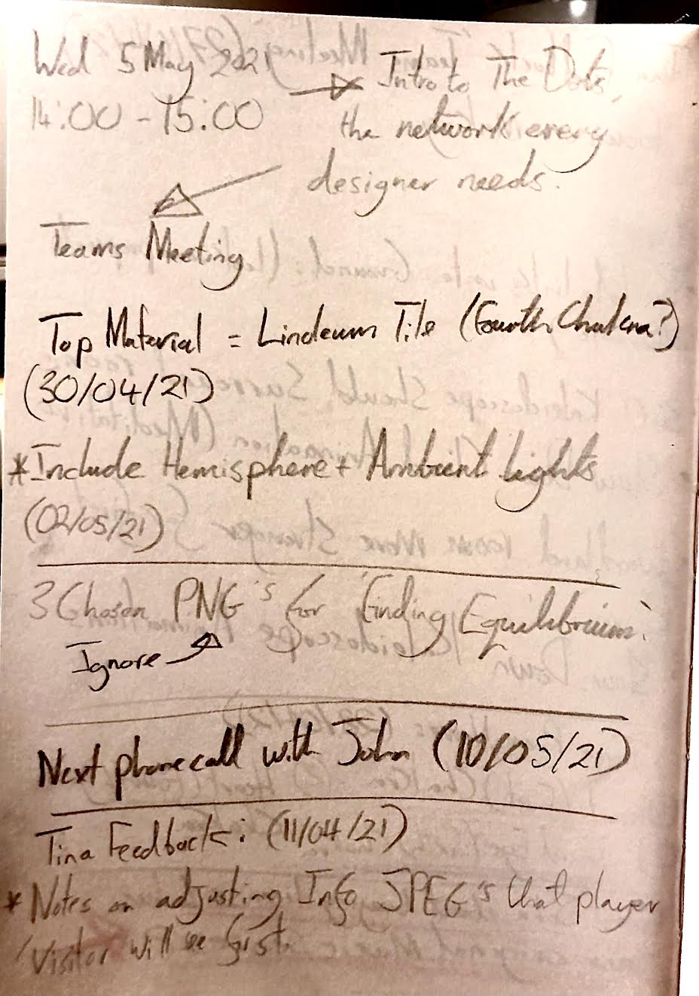
Notes on Mozilla Hubs development alongside feedback from Tina after a Teams Meeting.
(14/05/21).

Slide 45
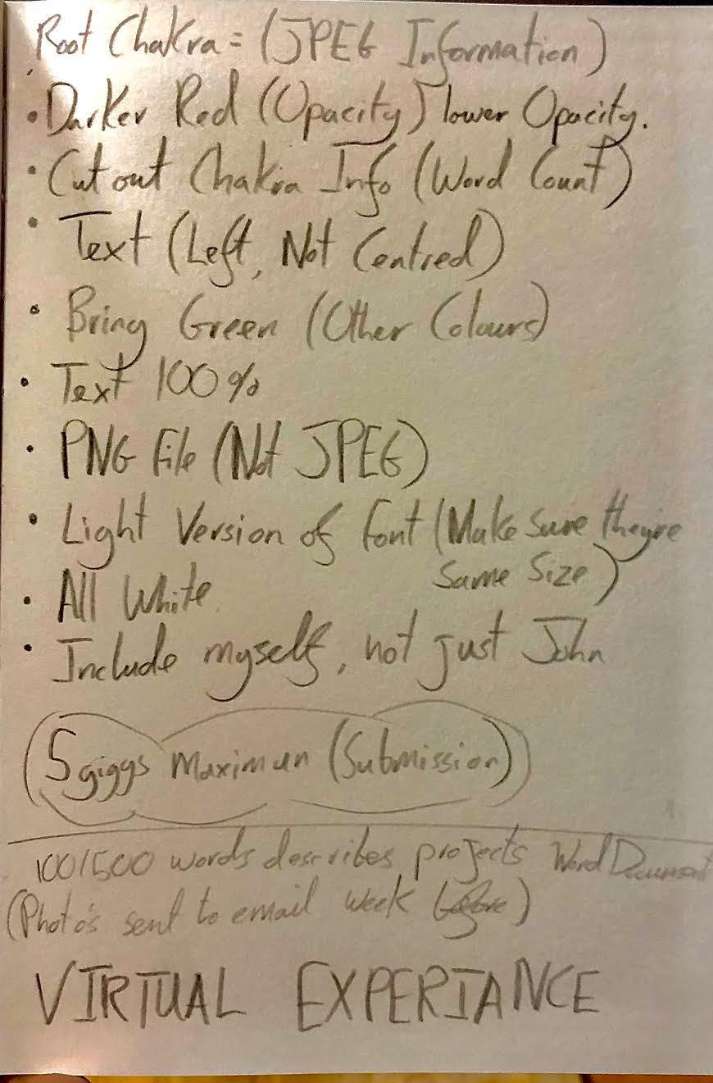
Further Feedback from Tina in relation to Information PNG Files. (14/05/21).

