Slide 1
Email Exchanges.
Final Major Project.

Slide 2
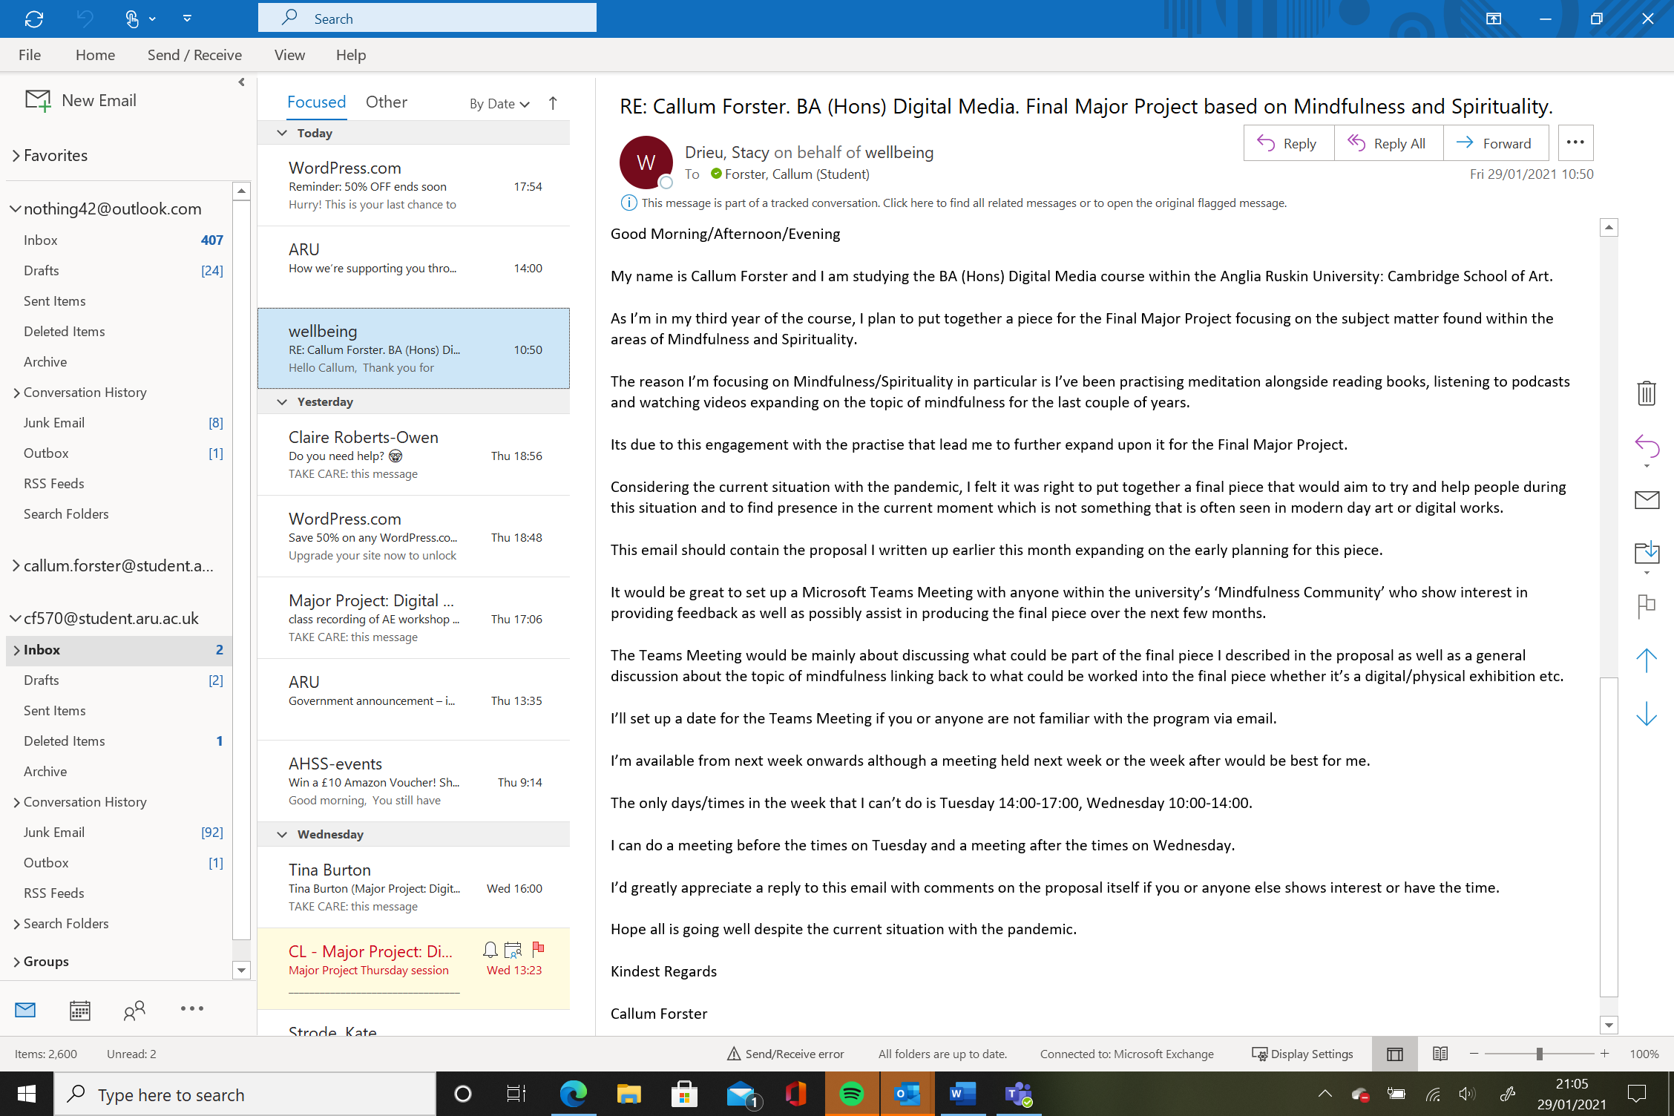
Email I sent to ‘Wellbeing’ group in Aru. 29/01/21.

Slide 3
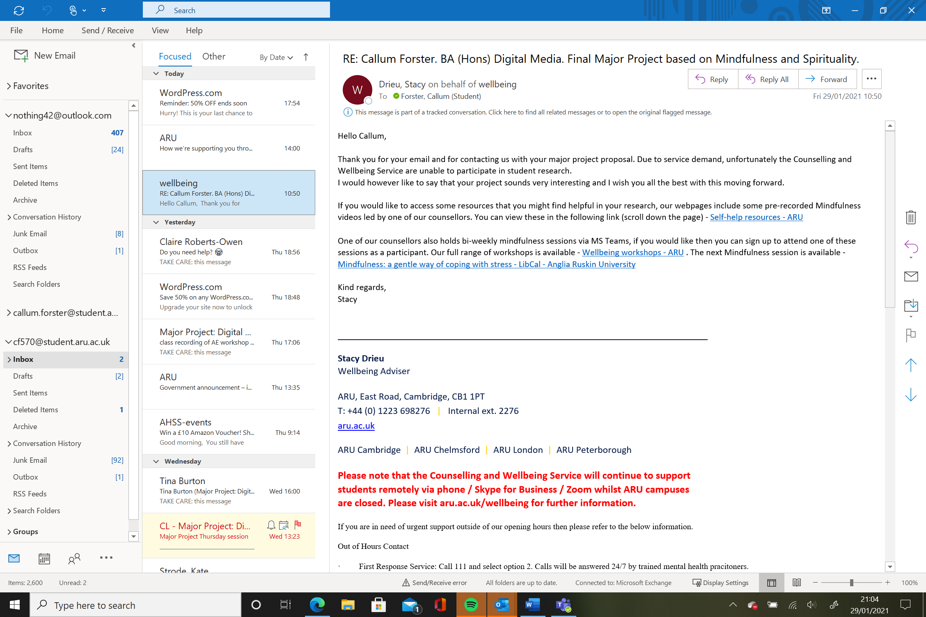
Reply from ‘wellbeing’ group, confirming they’re not able to participate in major project. 29/01/21.

Slide 4
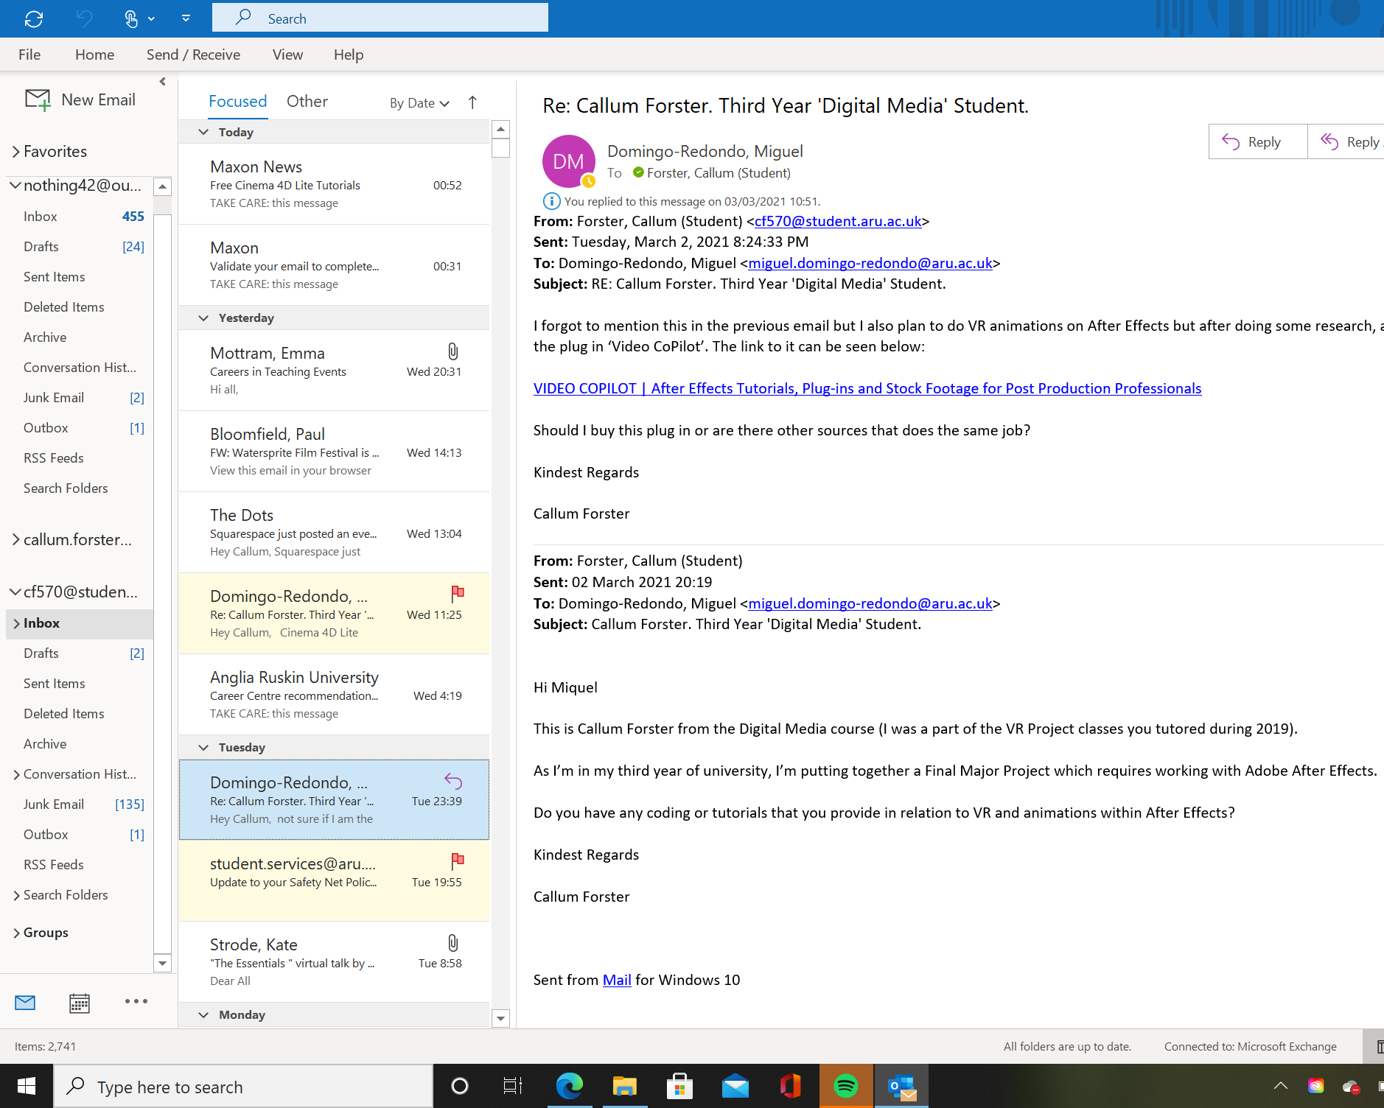
Email Exchange between myself and Miquel in relation in Cinema 4D/Cineware. 1. (04/03/21).

Slide 5
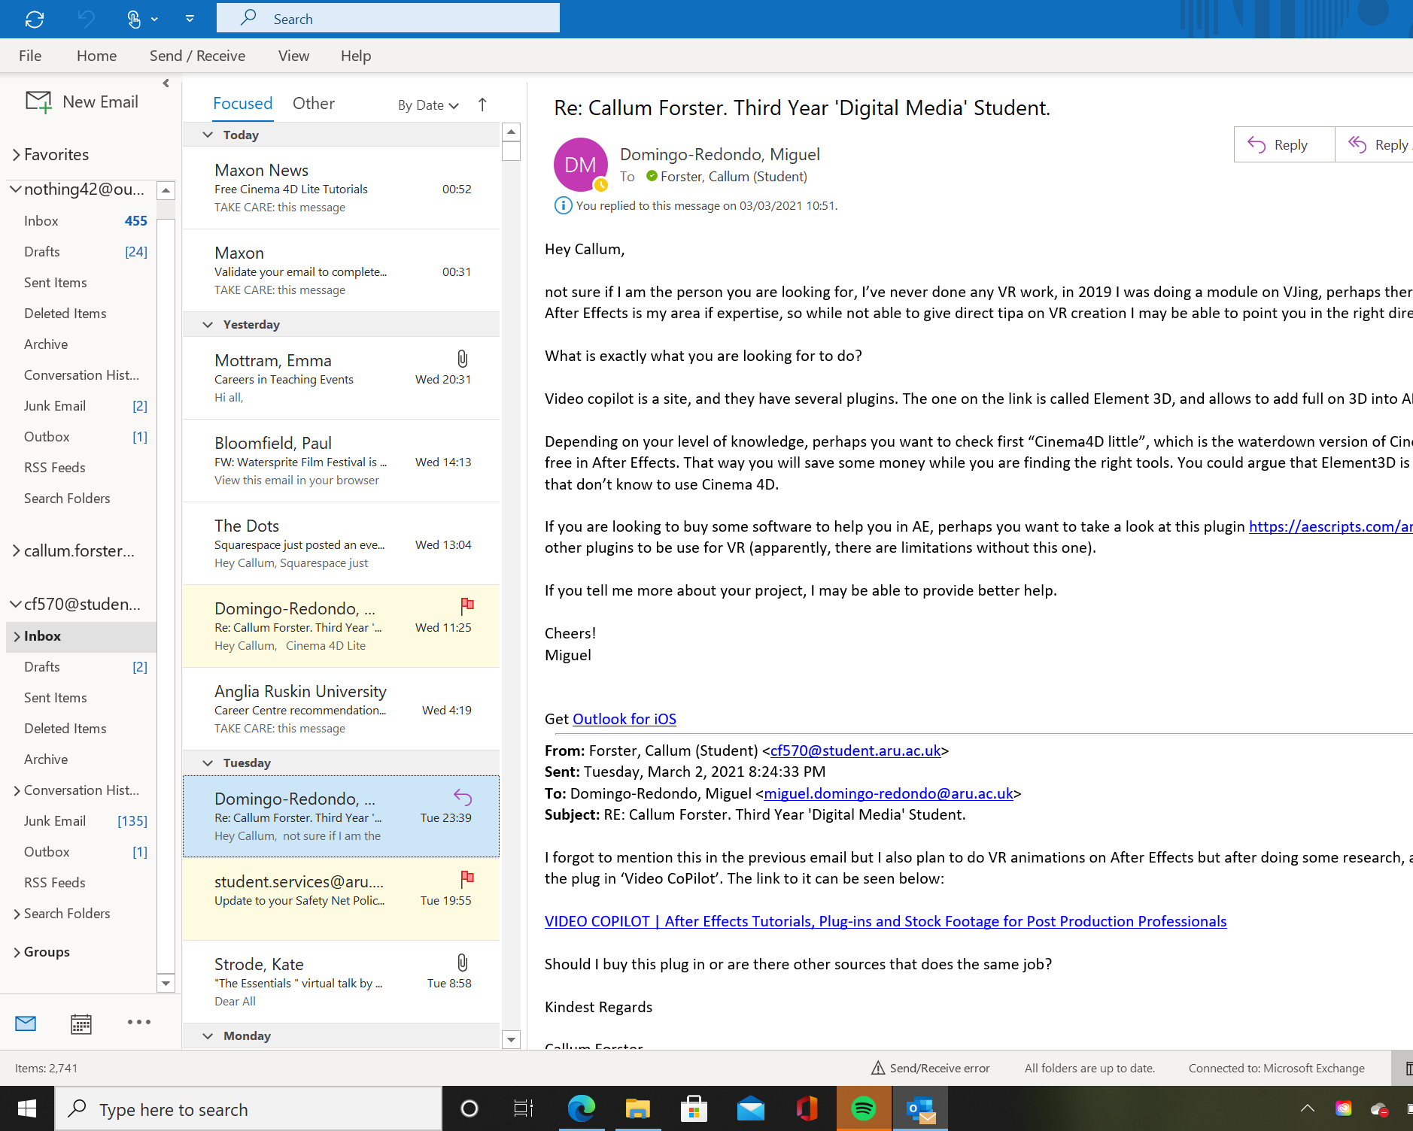
Email Exchange between myself and Miquel in relation in Cinema 4D/Cineware. 1. (04/03/21).

Slide 6
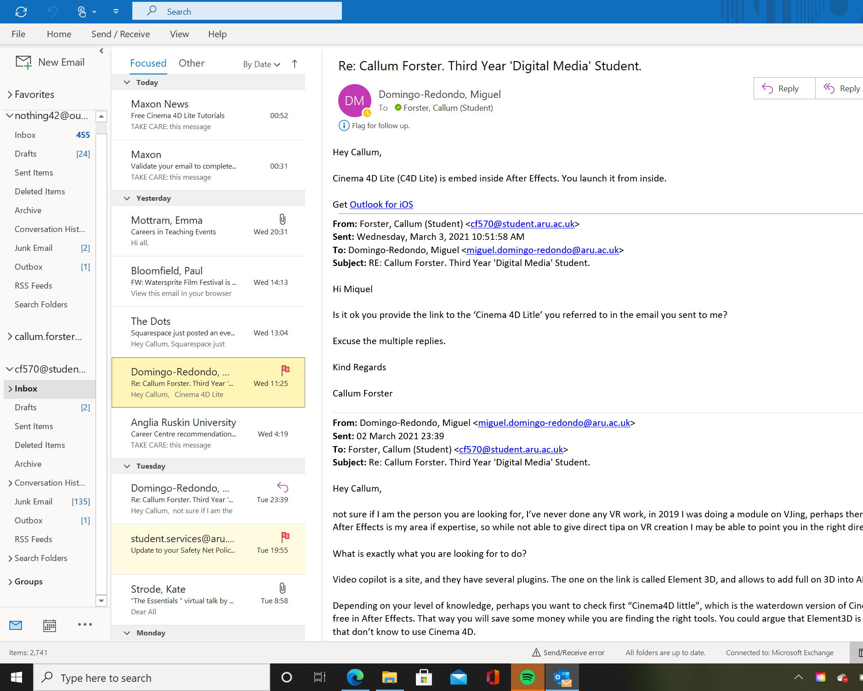
Email Exchange between myself and Miquel in relation in Cinema 4D/Cineware. 3. (04/03/21).

