Slide 1
Meshroom 2019-2-0 Program Experimentation (25/03/21)
The next three slides expand upon the initial development of a 3D Model using original photographs before the error occurred stopping the process. This was due to my desktop not having enough storage/GPU. As a result of this I won’t be further using the ‘meshroom’ program for this final major project.

Slide 2
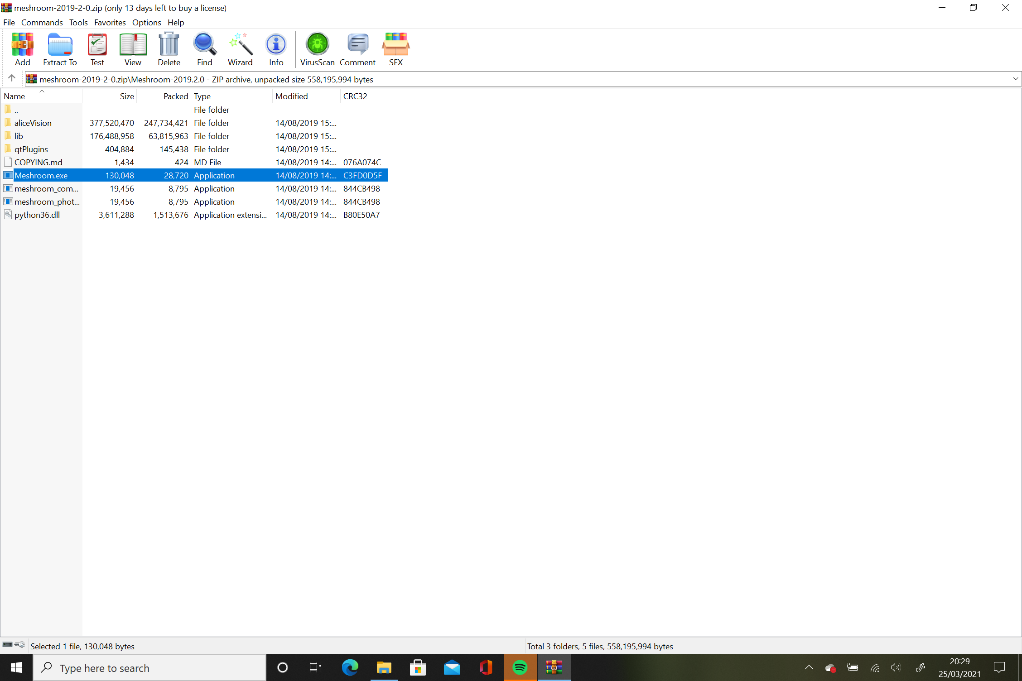
Home page on download folder before opening main program

Slide 3
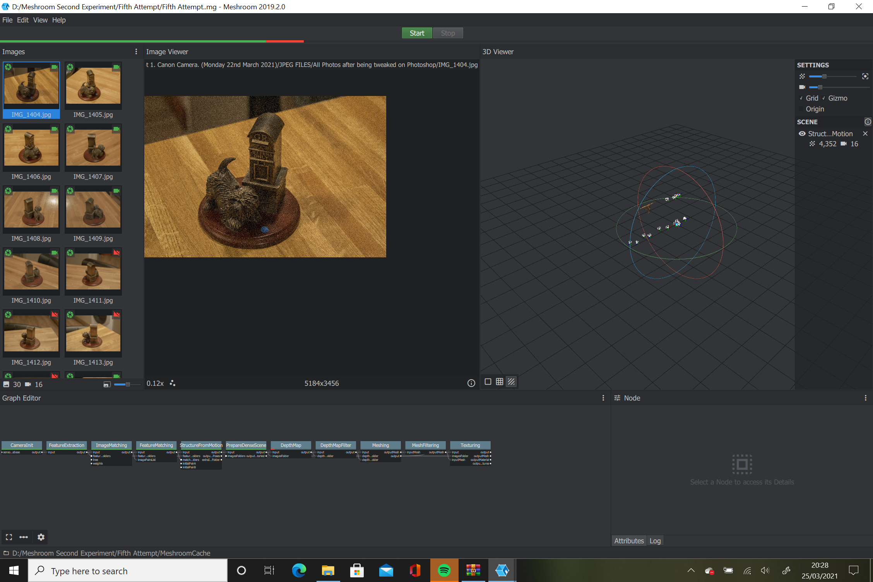
Main program with original photographs showcasing the error that appeared during the loading period of converting the photos to a digital 3D model.

Slide 4
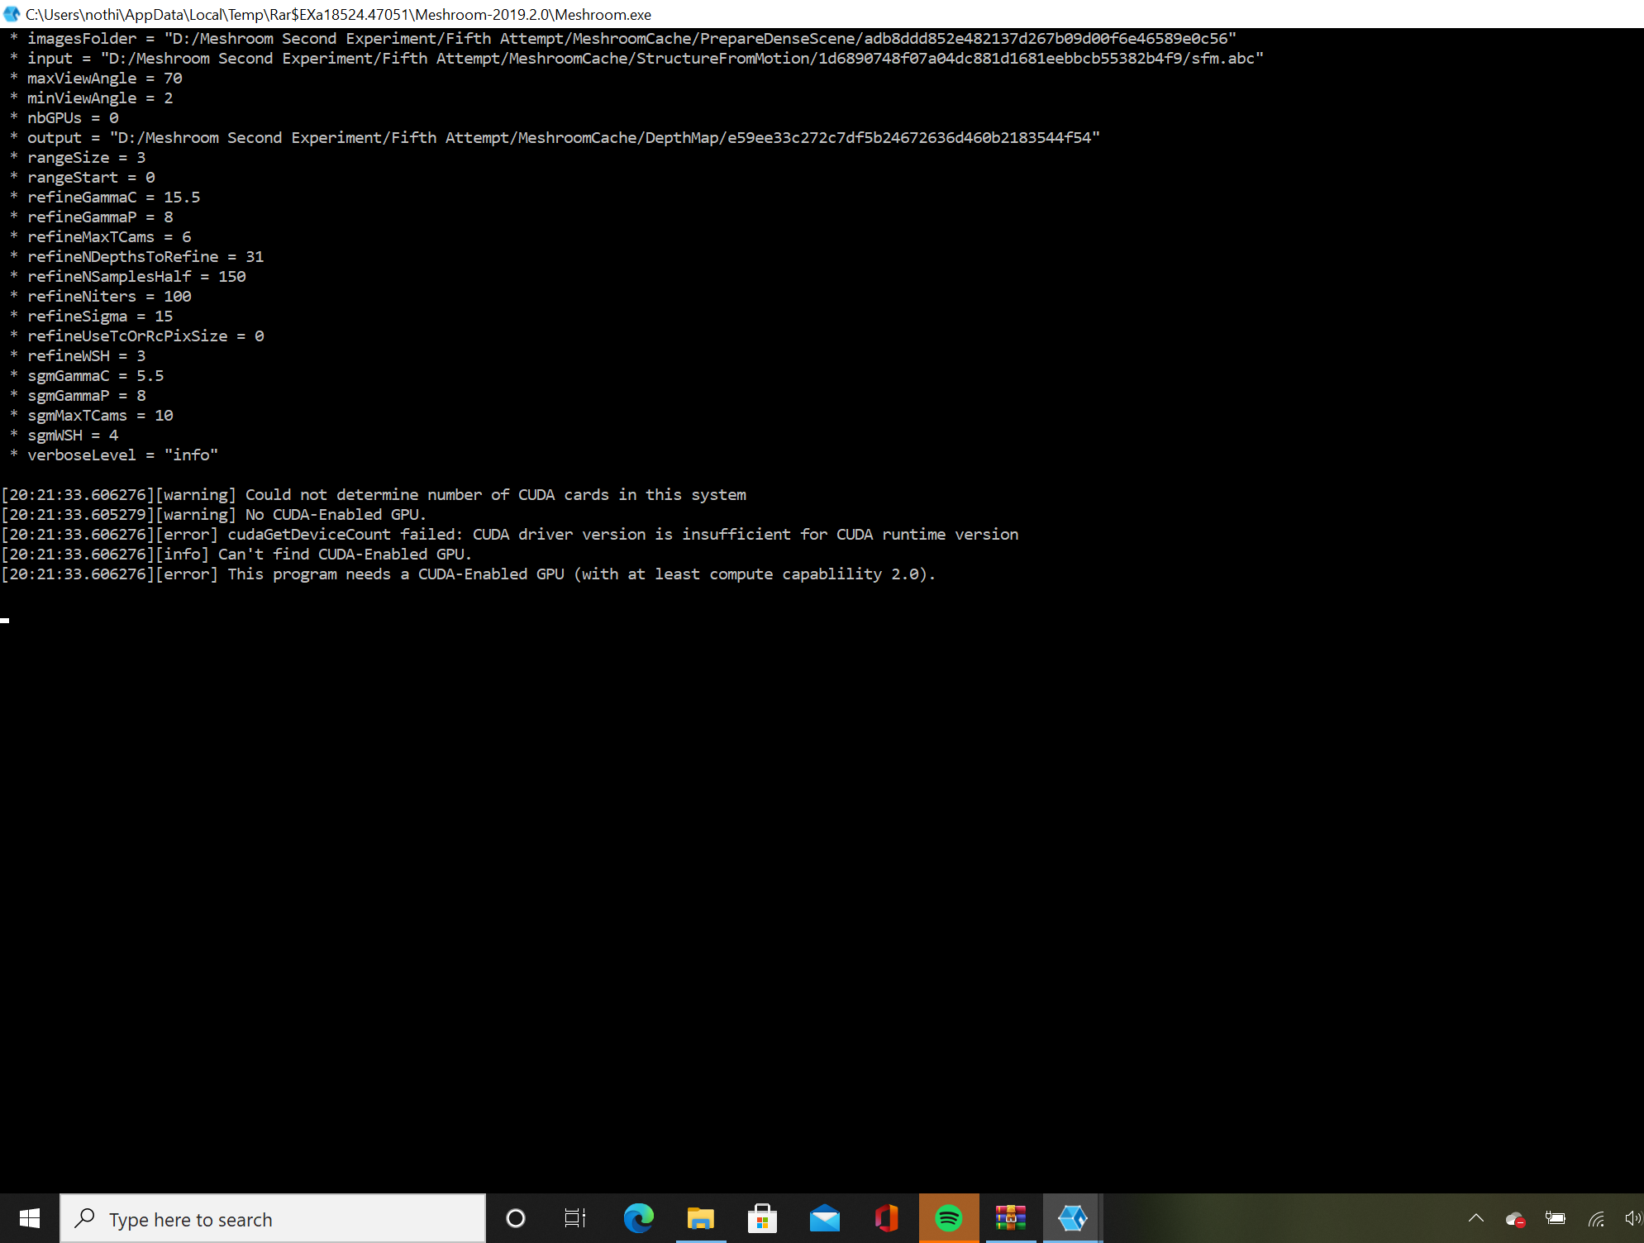
Coding panel alongside the main program highlighting the cause of the errors and what needs to be rectified.

