Slide 1
Glass Flower Experimentation 'Cinema 4D Lite'. Final Major Project (Finding Equilibrium).
The following screenshots depict the rendered appearance of the Cinema 4d model in motion which I couldn’t achieve to the ‘Cinema 4d Lite’ program being incapable of exporting the final model without having to pay for the ‘cinema 4d’ program.

Slide 2
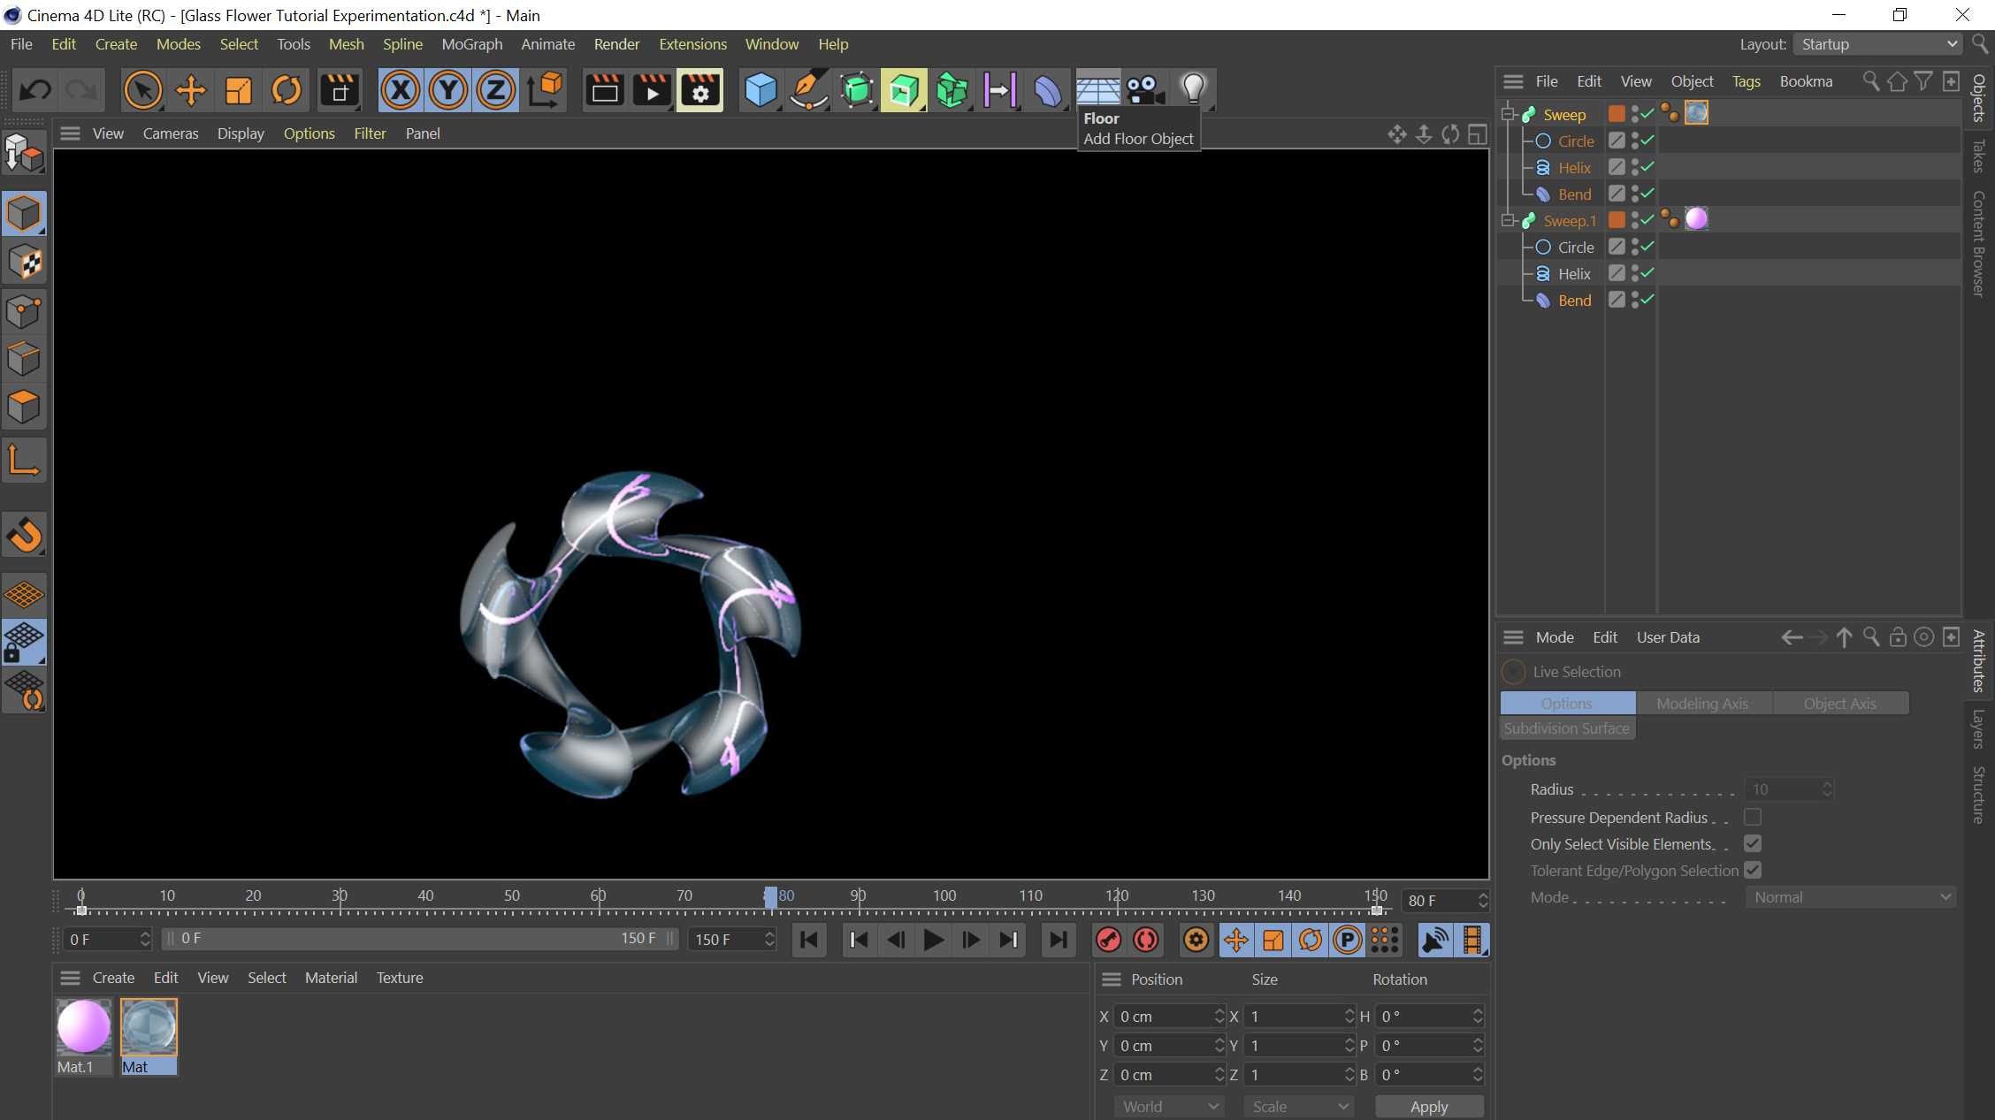

Slide 3
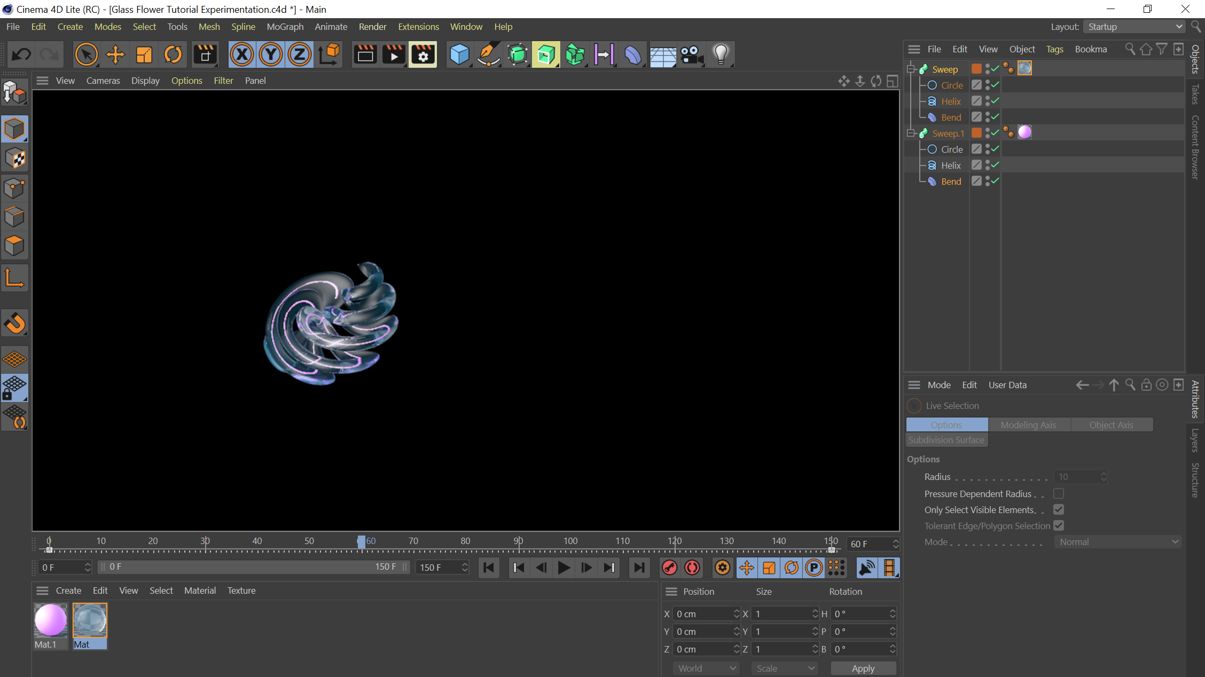

Slide 4
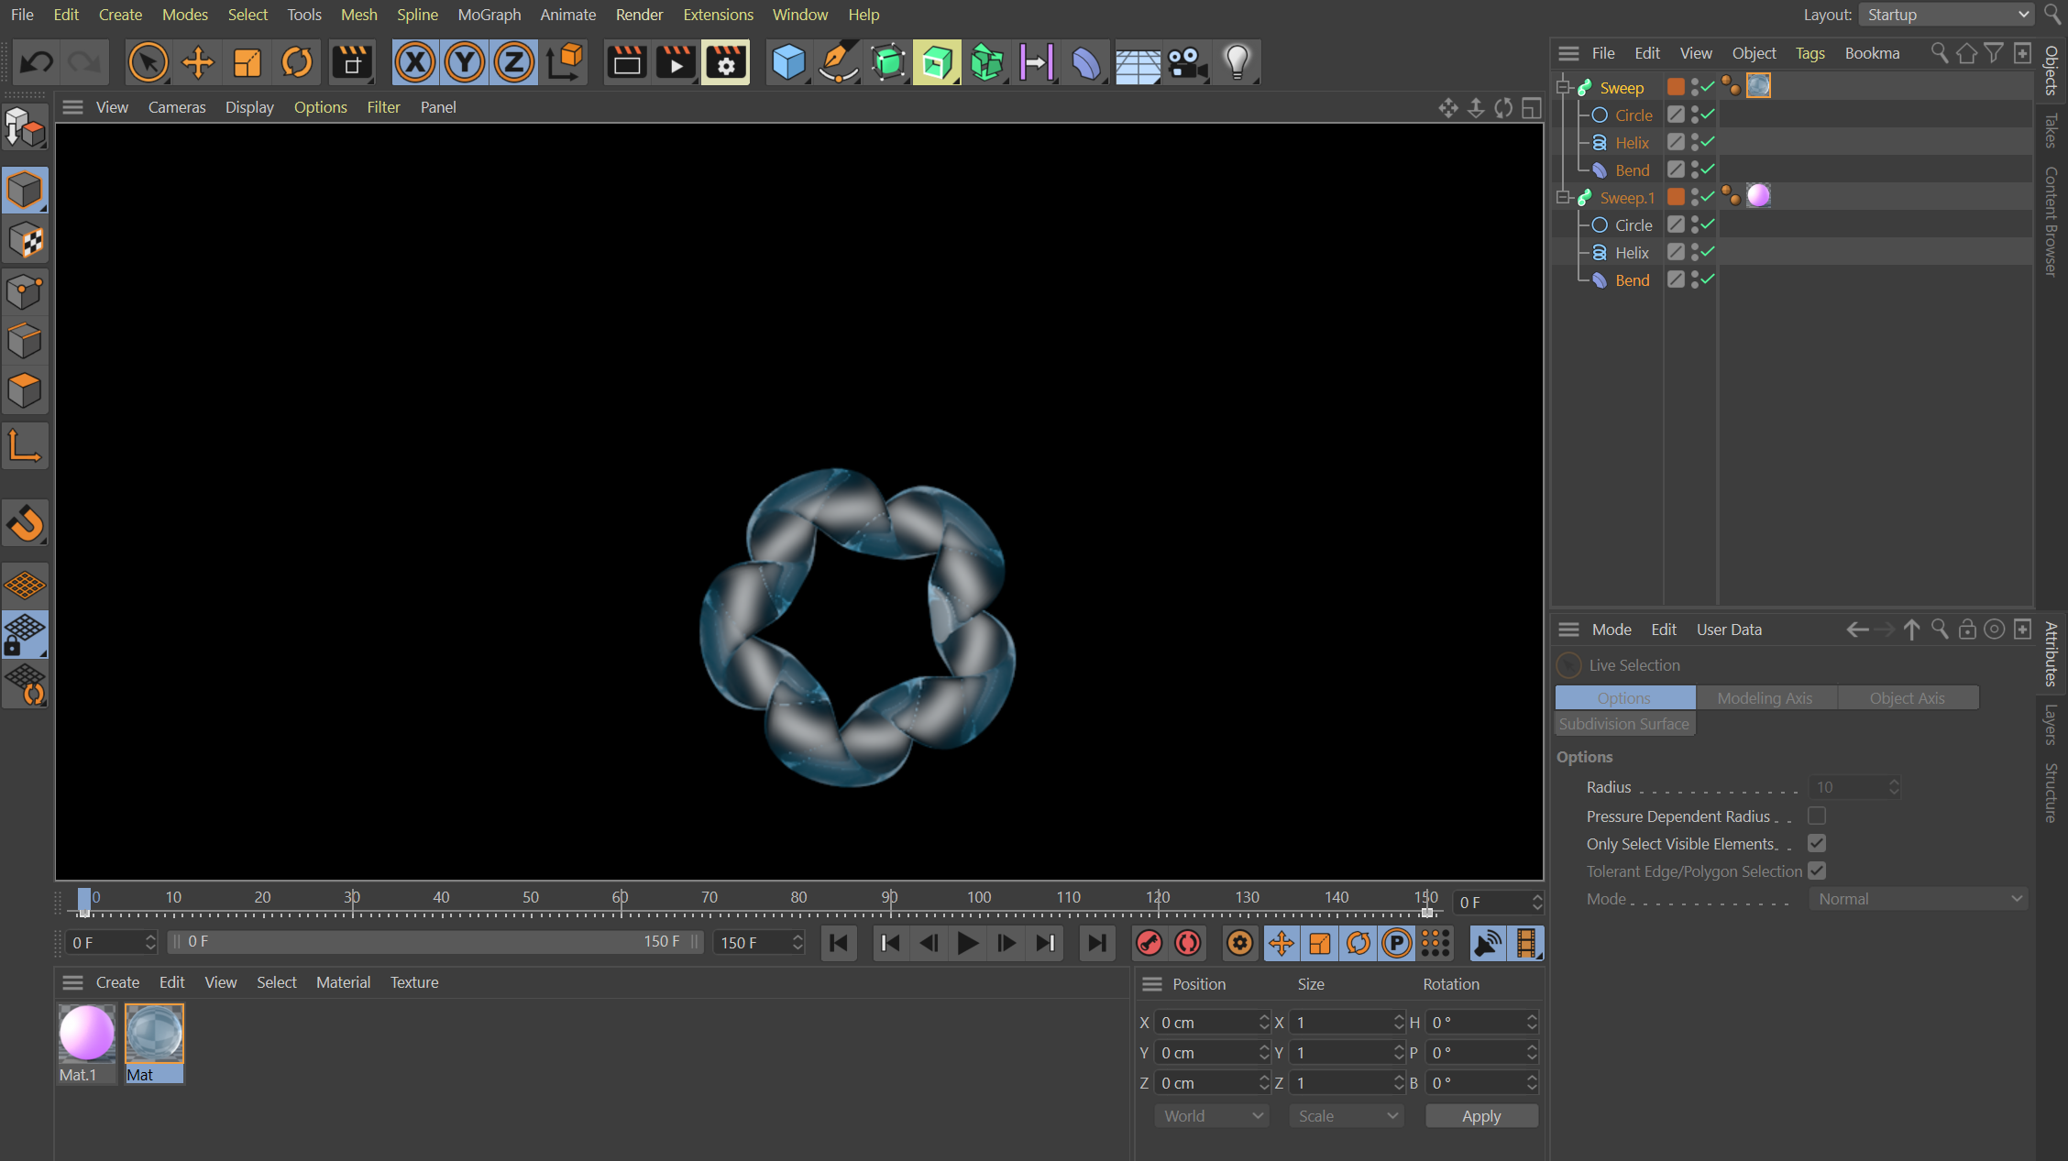

Slide 5
