Slide 1
SketchFab, Skulpfab and Mozilla Hubs development
27/02/21. This powerpoint presentation showcases the early research performed (with added screenshots) into creating and uploading 3d models in Mozilla hubs

Slide 2
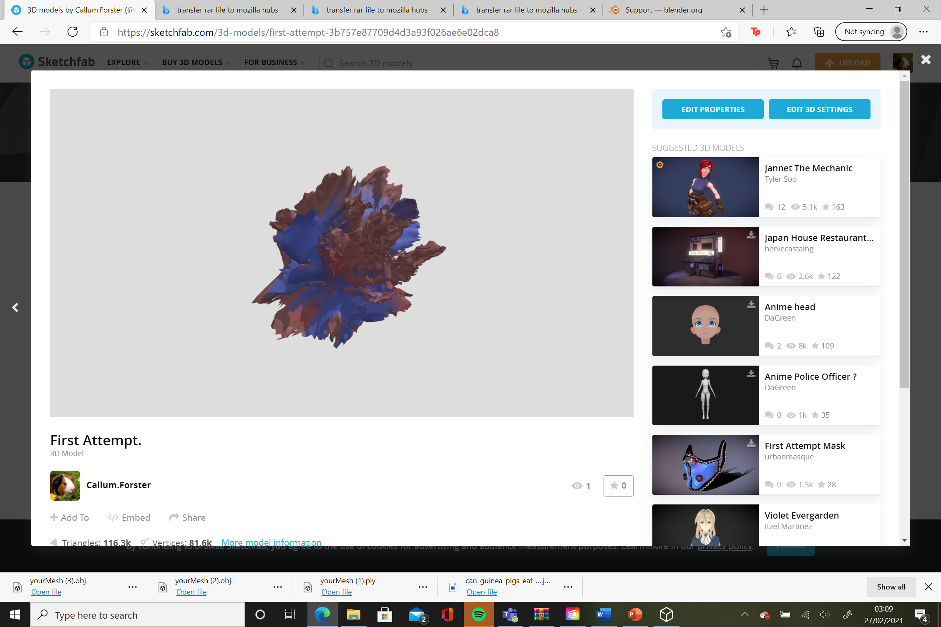
First Experiment through sculptfab published on Sketchfab account. 26/02/21.

Slide 3
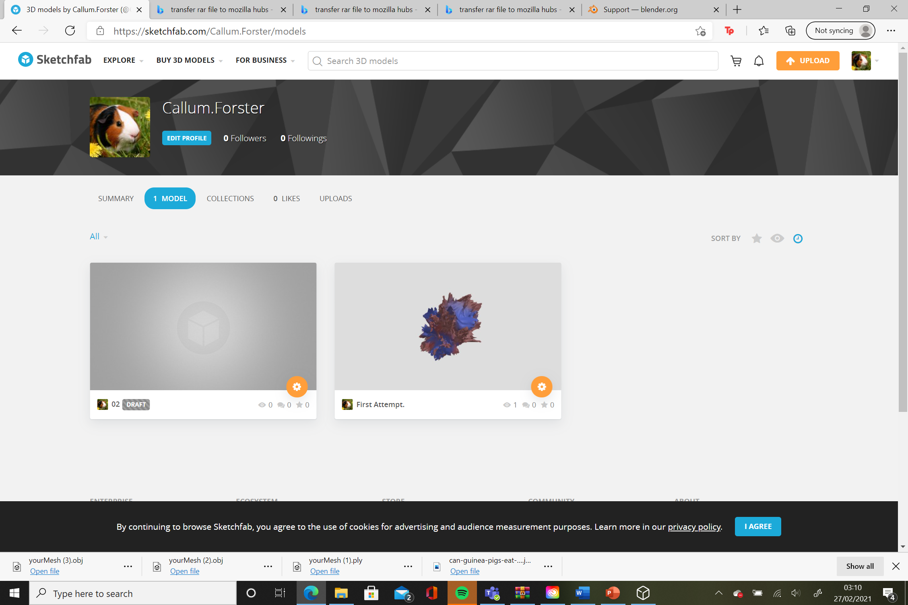
Sketchfab Personal homepage. 26/02/21.

Slide 4
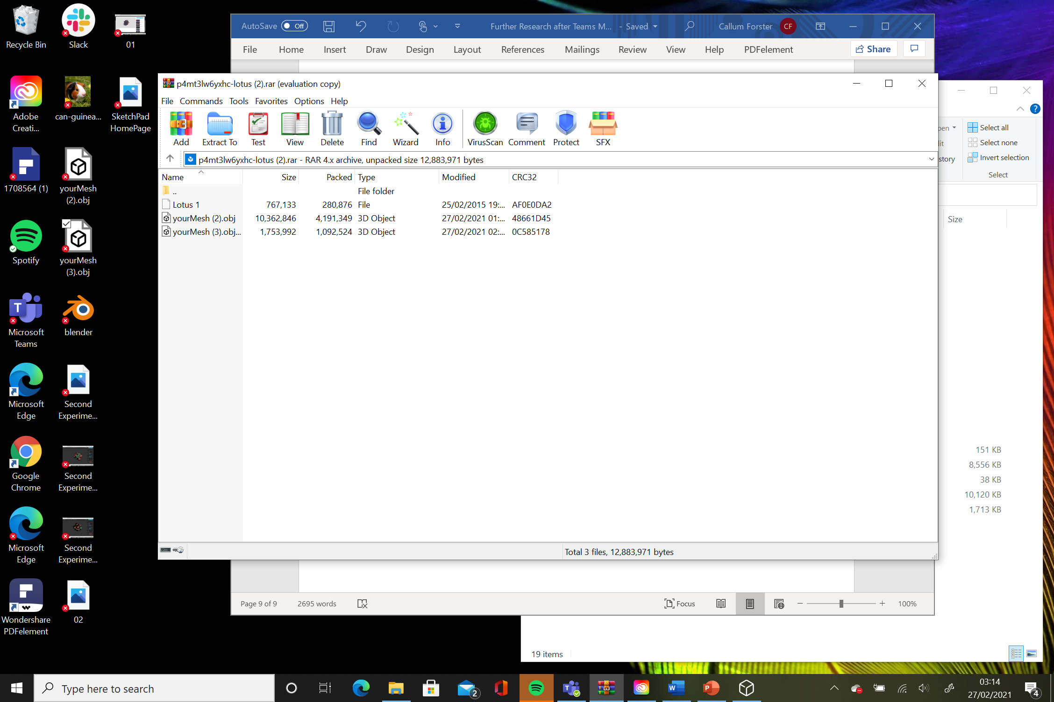
Two ‘obj’ files of the experiments performed on Skulptfab. Both files placed in winrar app. 26/02/21.

Slide 5
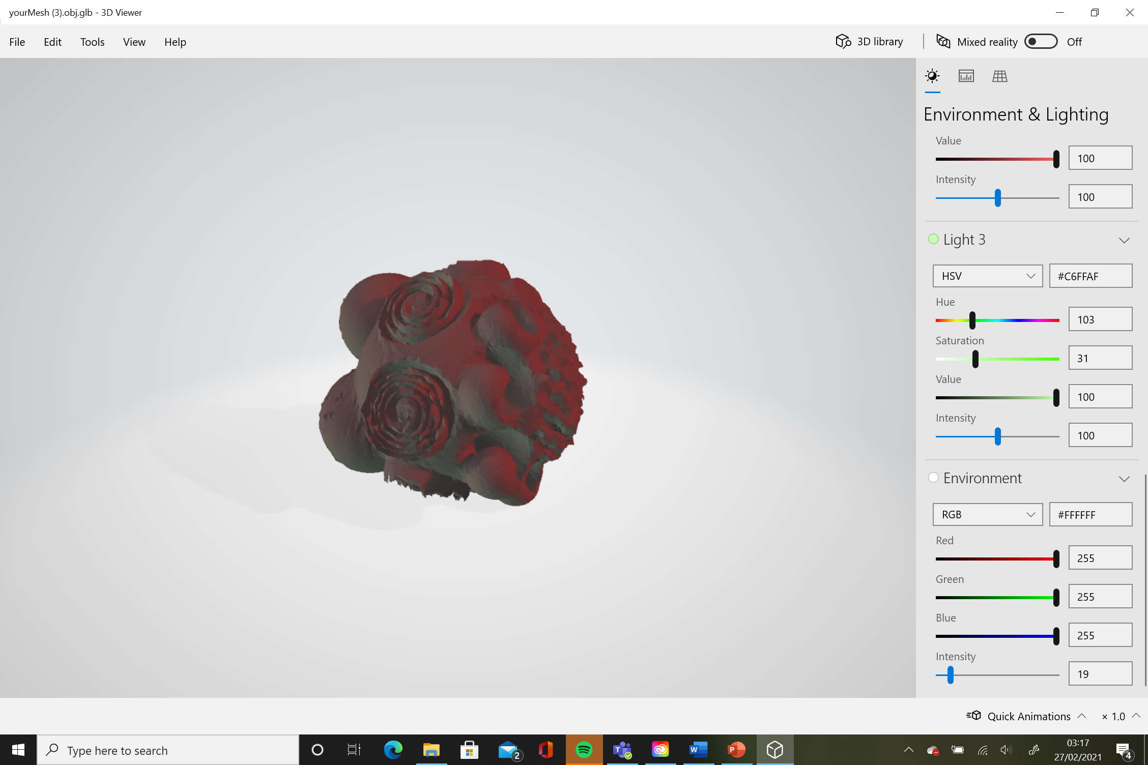
Experiment 2 via opened ‘obj’ file. 26/02/21.

Slide 6
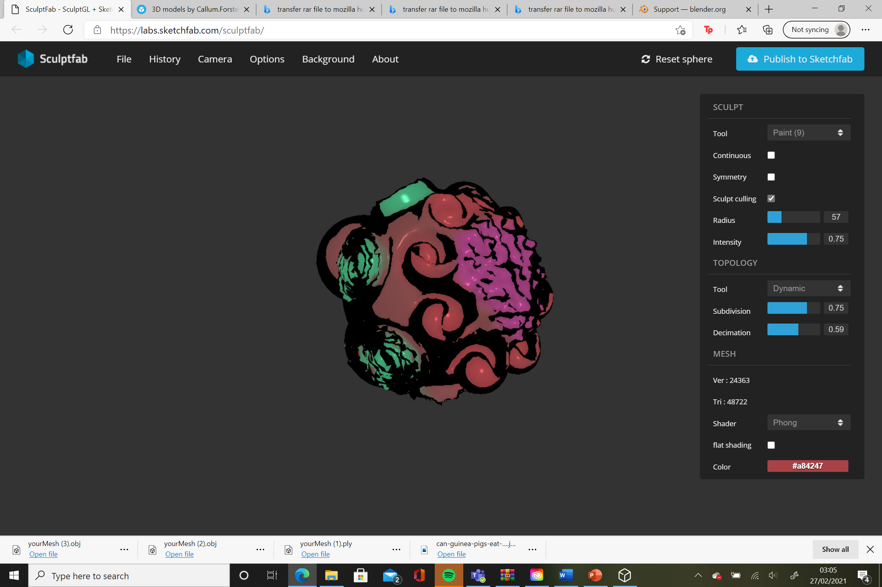
Experiment 2 originally presented on Sculptfab. 26/02/21. 1.

Slide 7
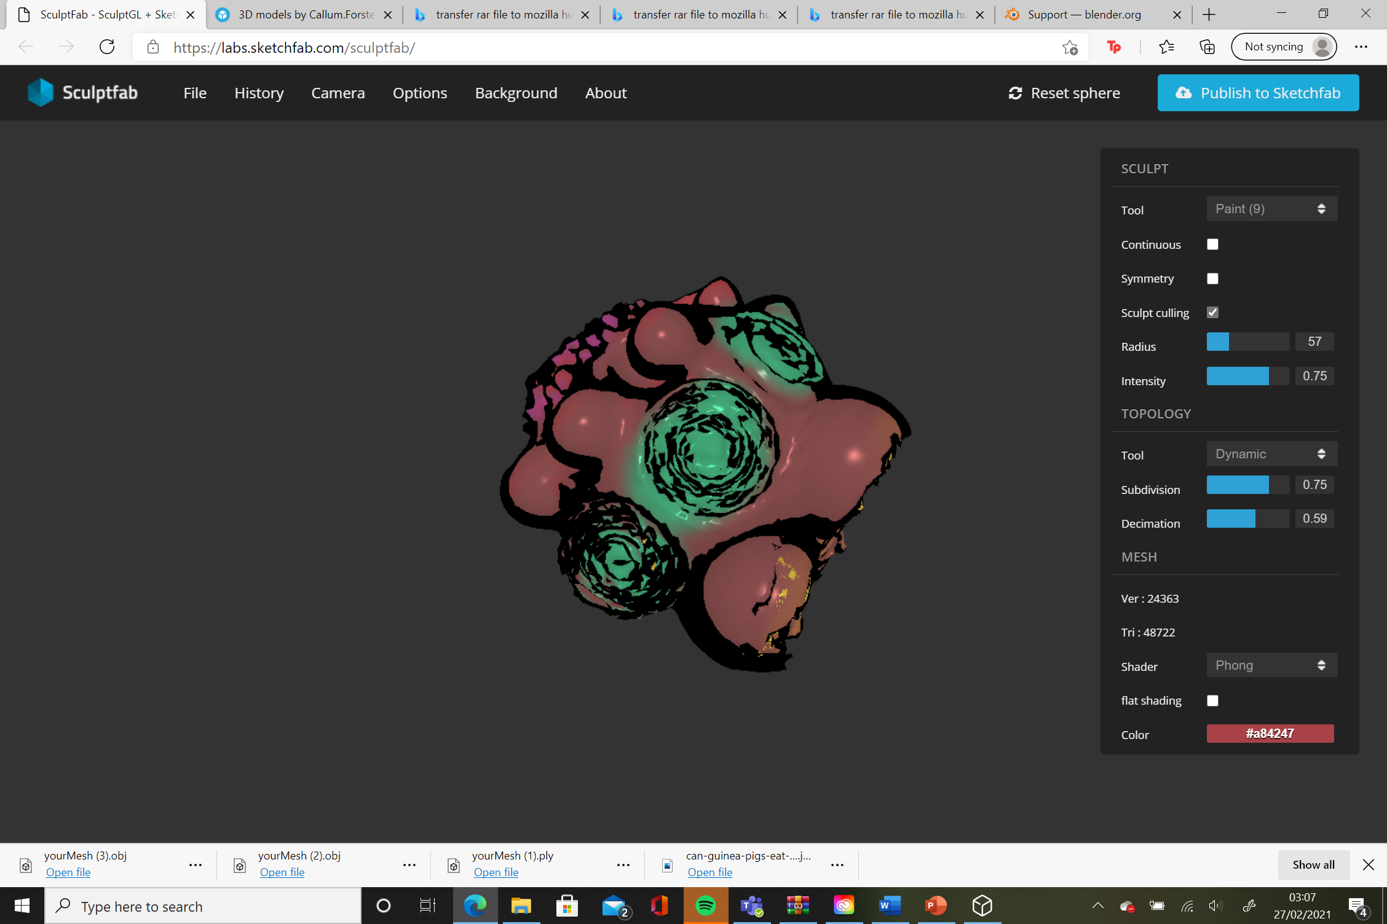
Experiment 2 originally presented on Sculptfab. 26/02/21. 2.

Slide 8
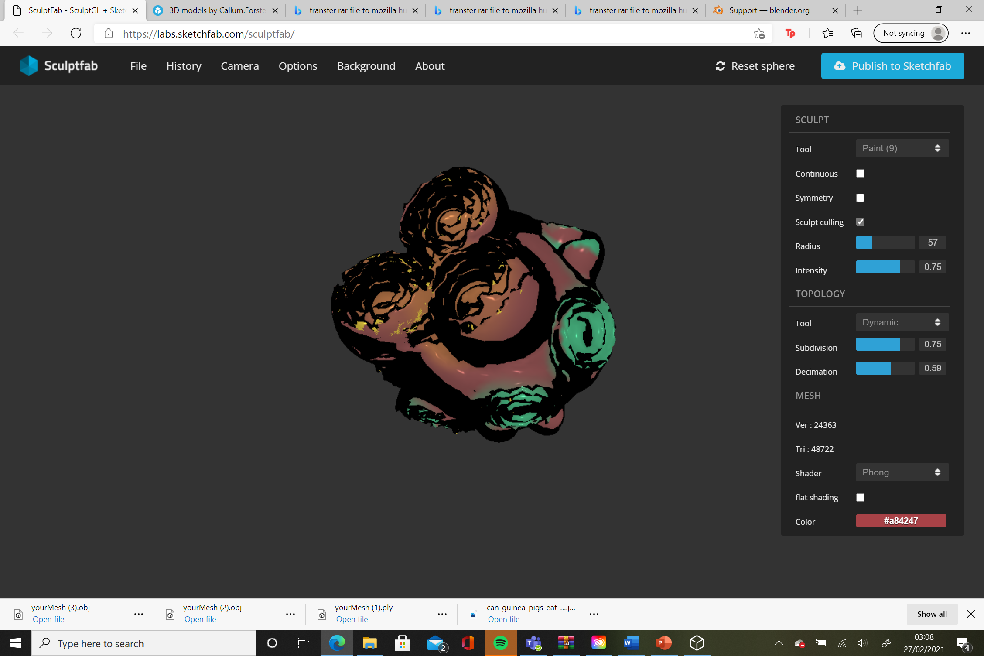
Experiment 2 originally presented on Sculptfab. 26/02/21. 3.

Slide 9
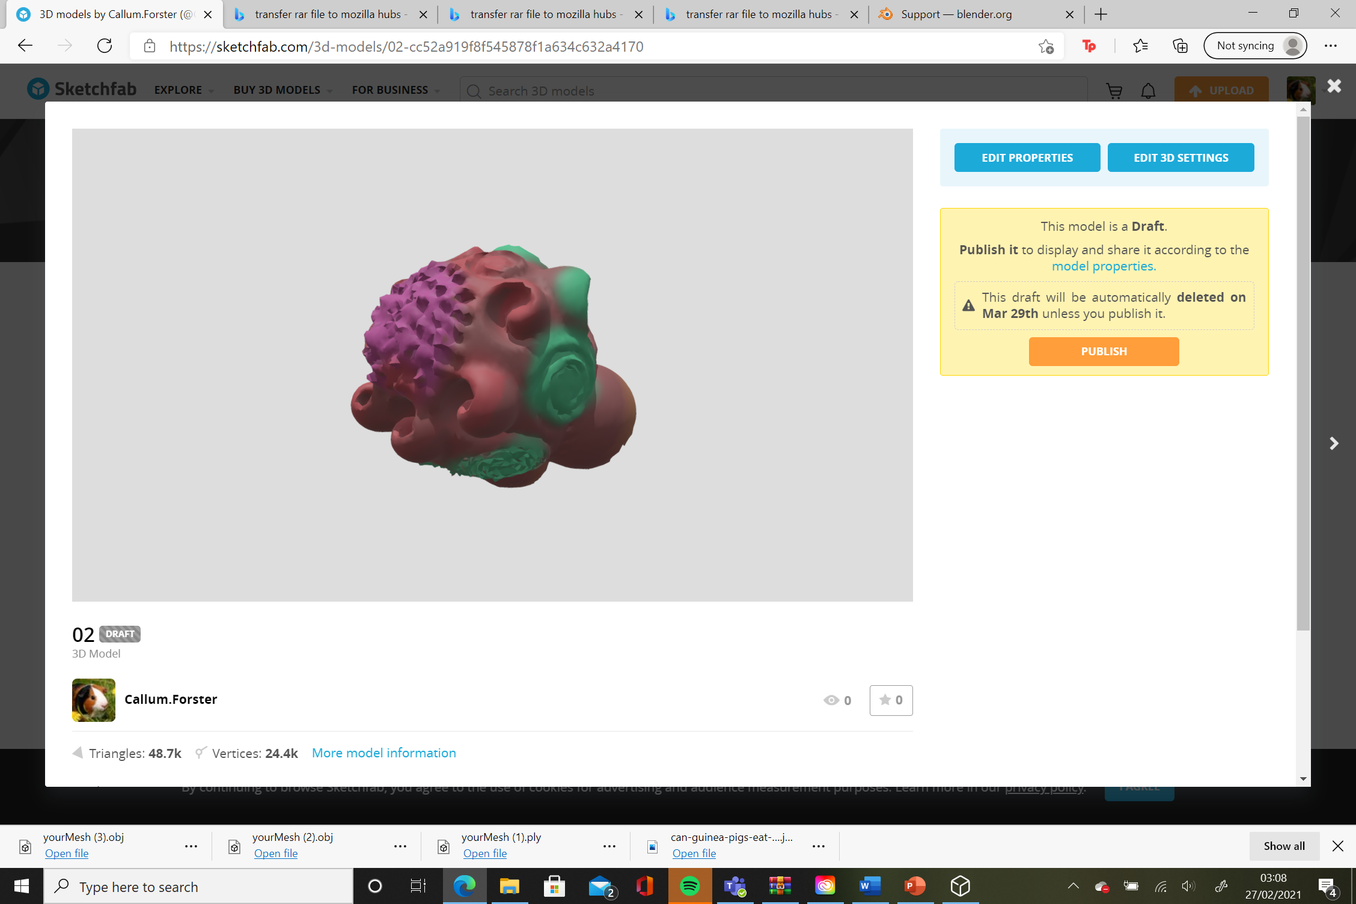
Second Experiment through sculptfab published on Sketchfab account. 26/02/21.

