Slide 1
Sketchbook Pages
Final Major Project Proposal development

Slide 2
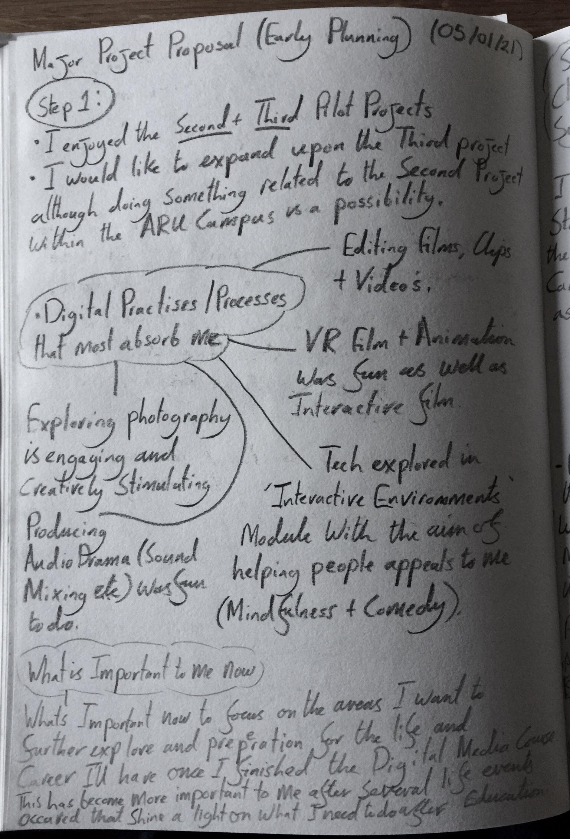
Major Project Proposal ‘How to Guide’. (Initial Notes).
Step 1 (Part 1)

Slide 3
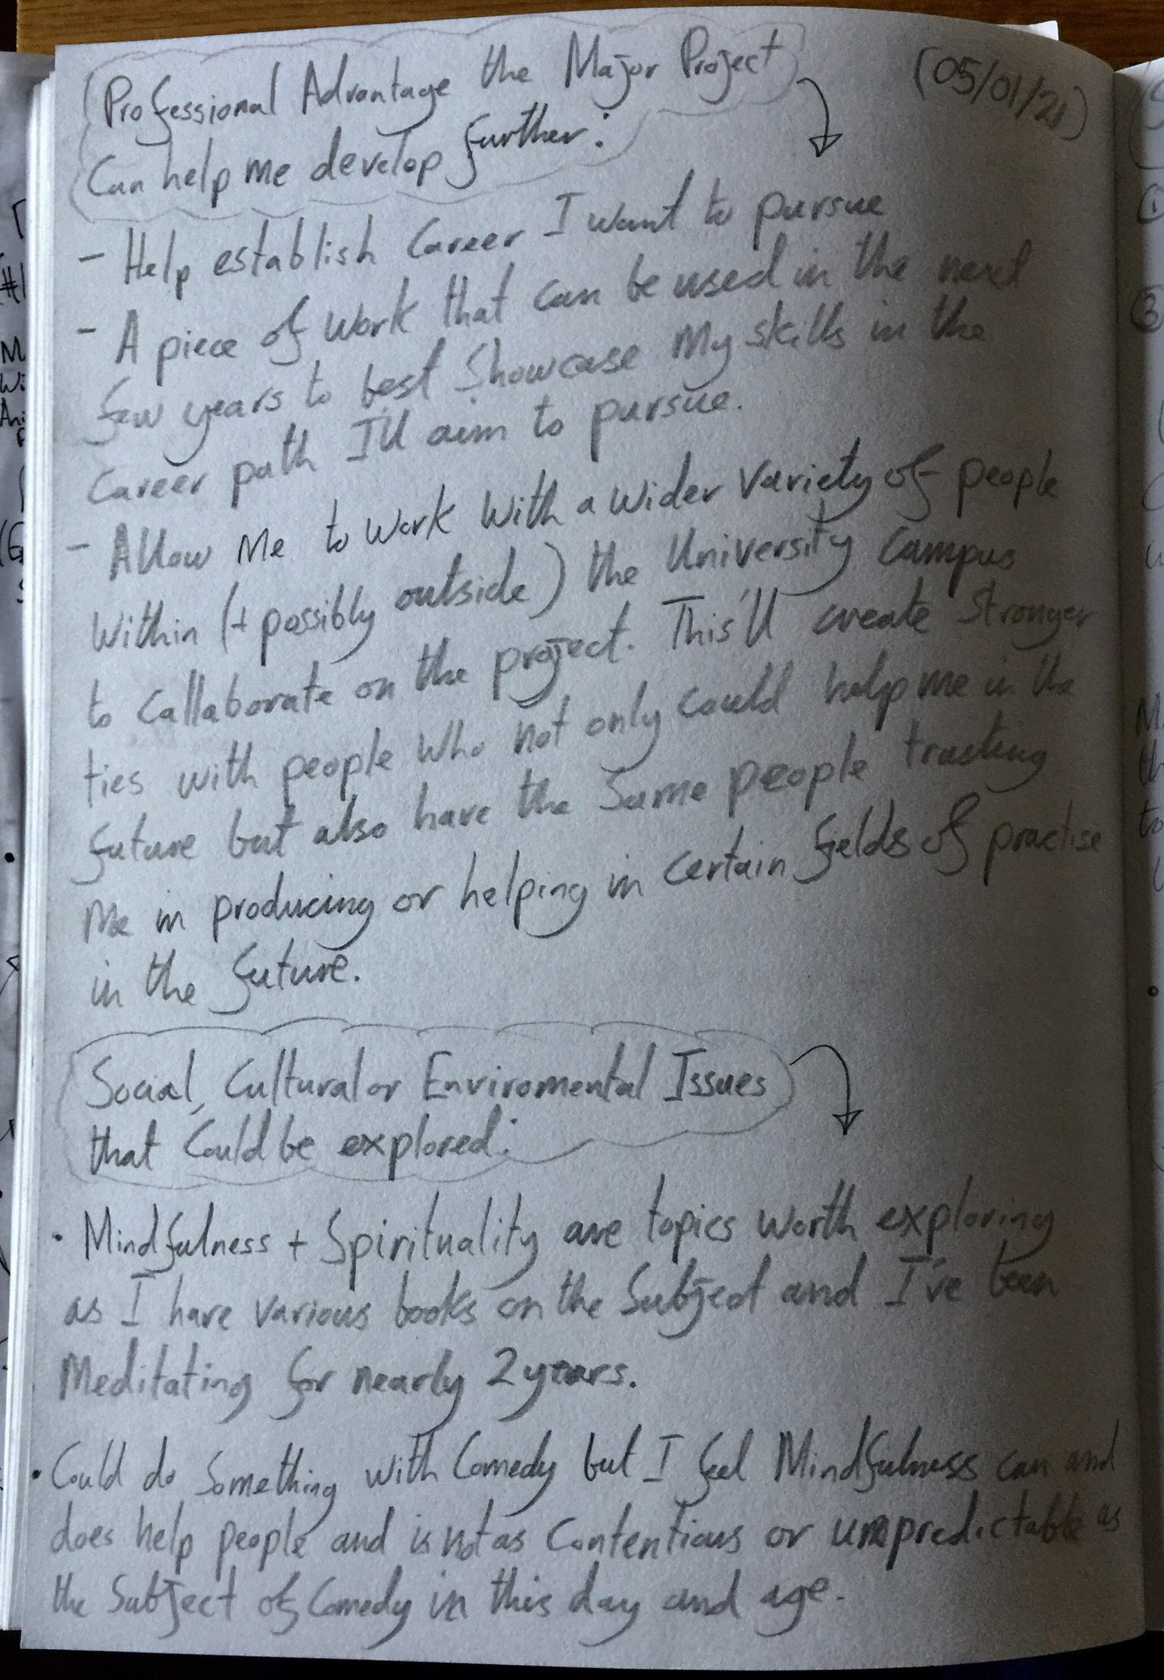
Major Project Proposal ‘How to Guide.’ (Initial Notes).
Step 1 (Part 2)

Slide 4
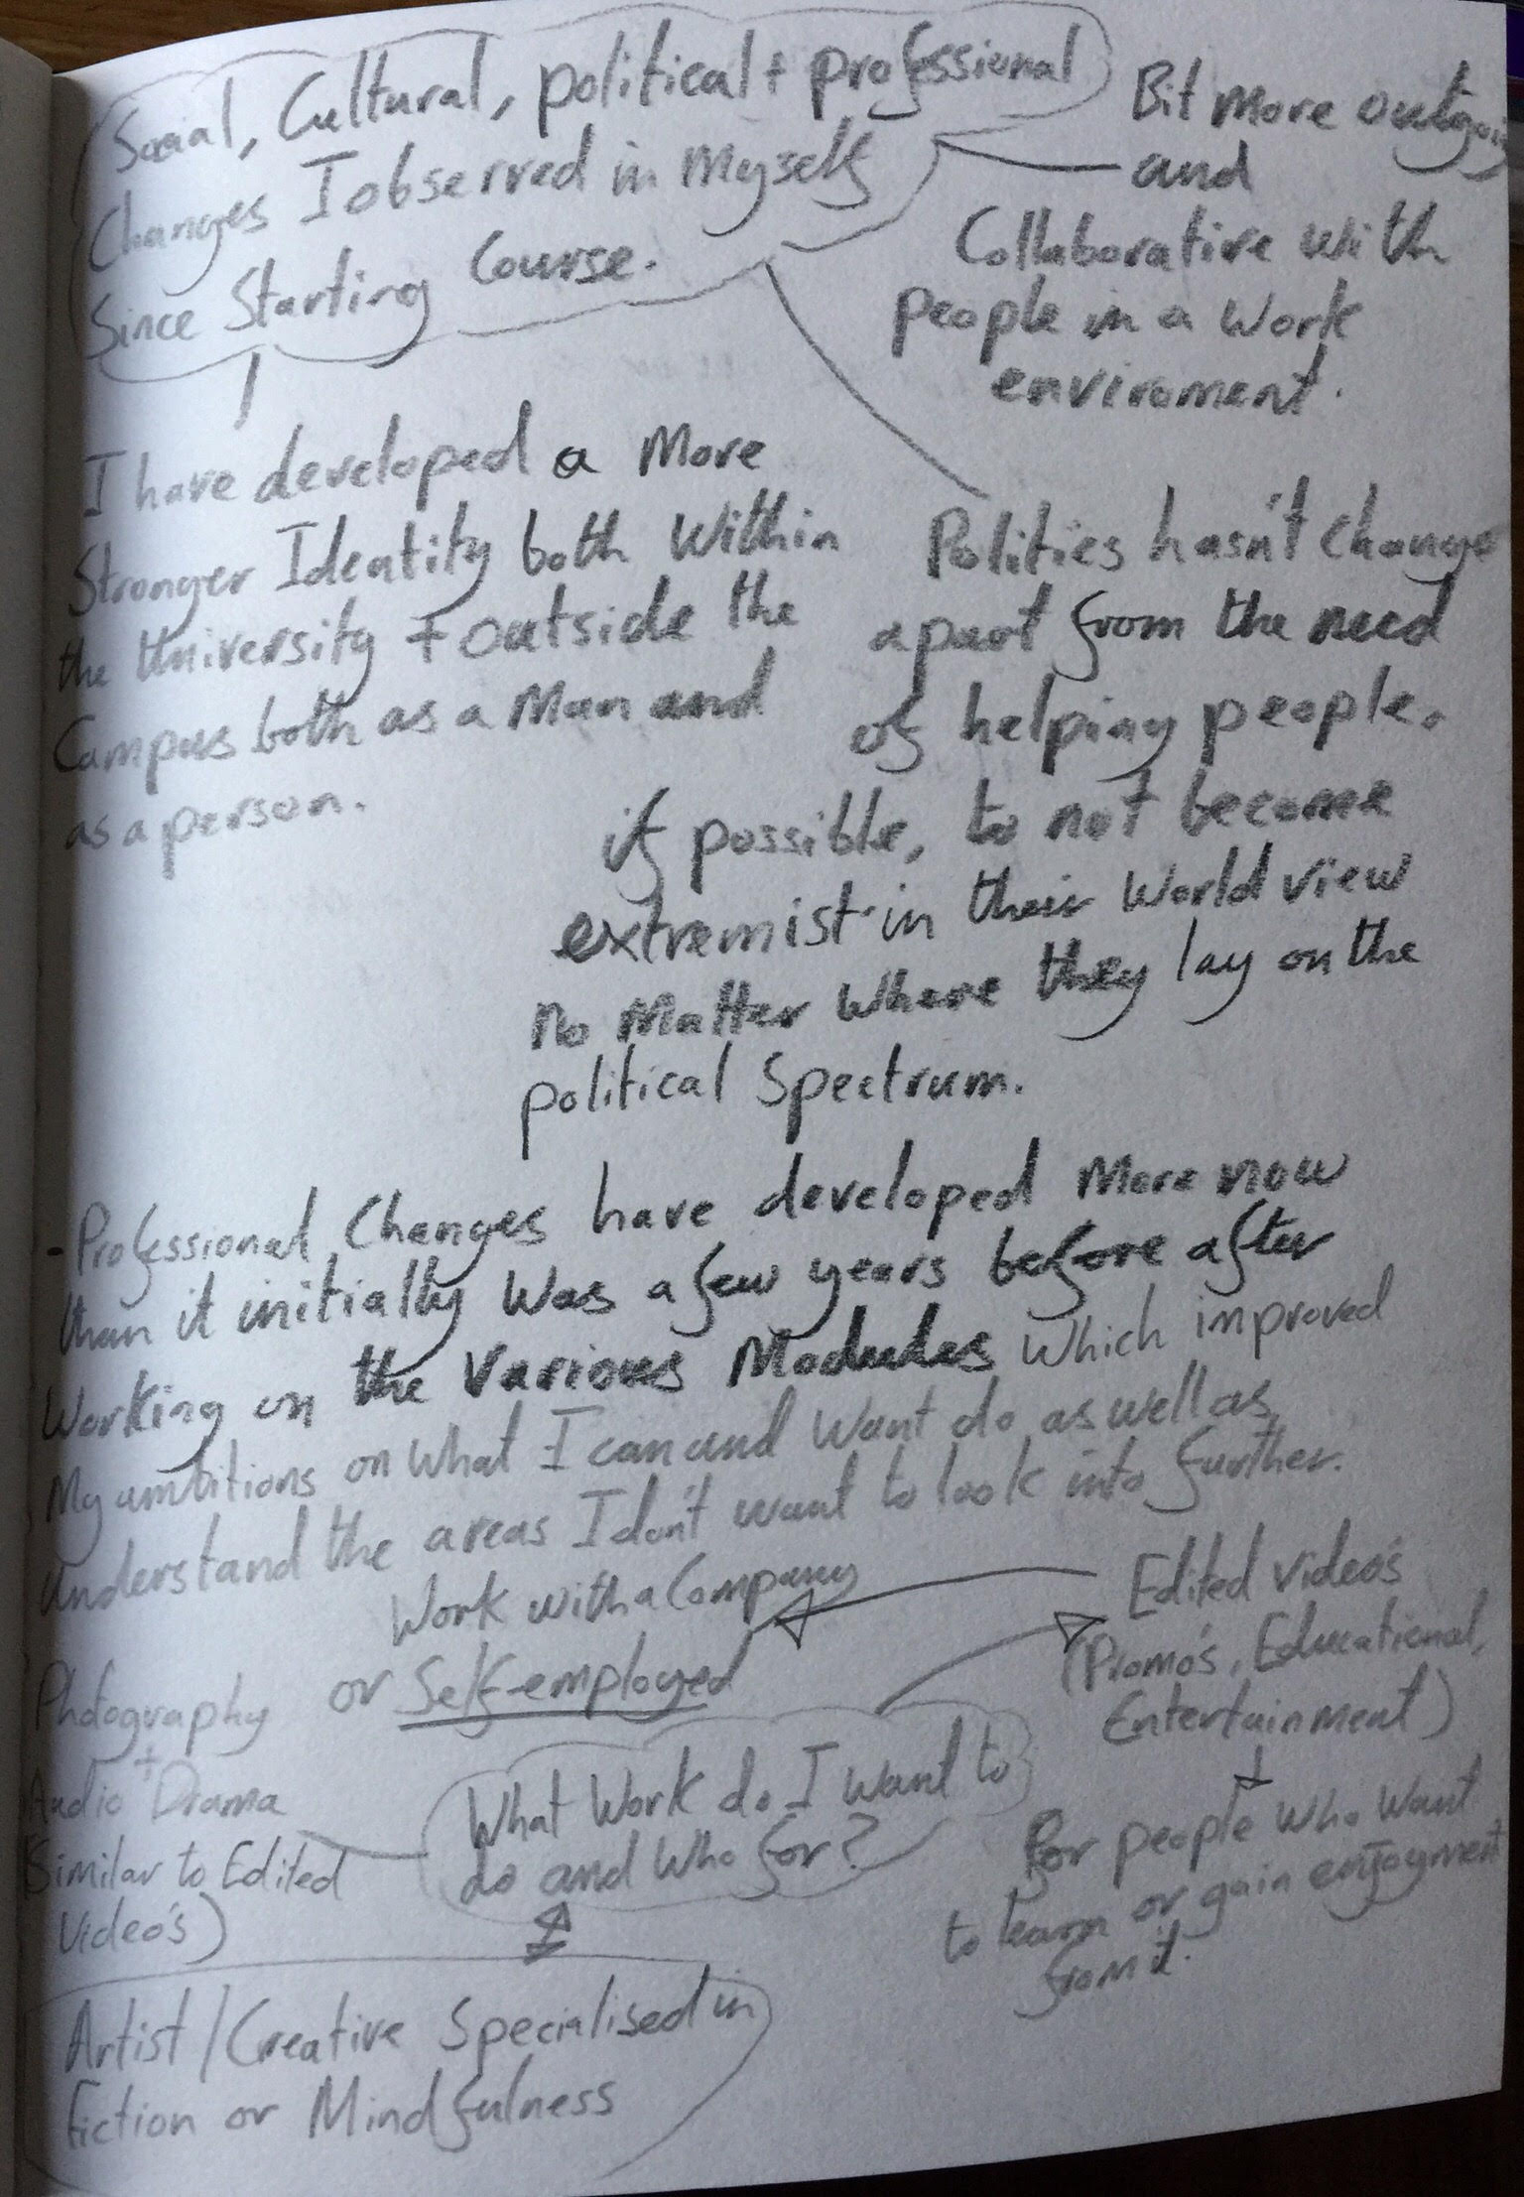
Major Project Proposal ‘How to Guide’. (Initial Notes).
Step 1 (Part 3)

Slide 5
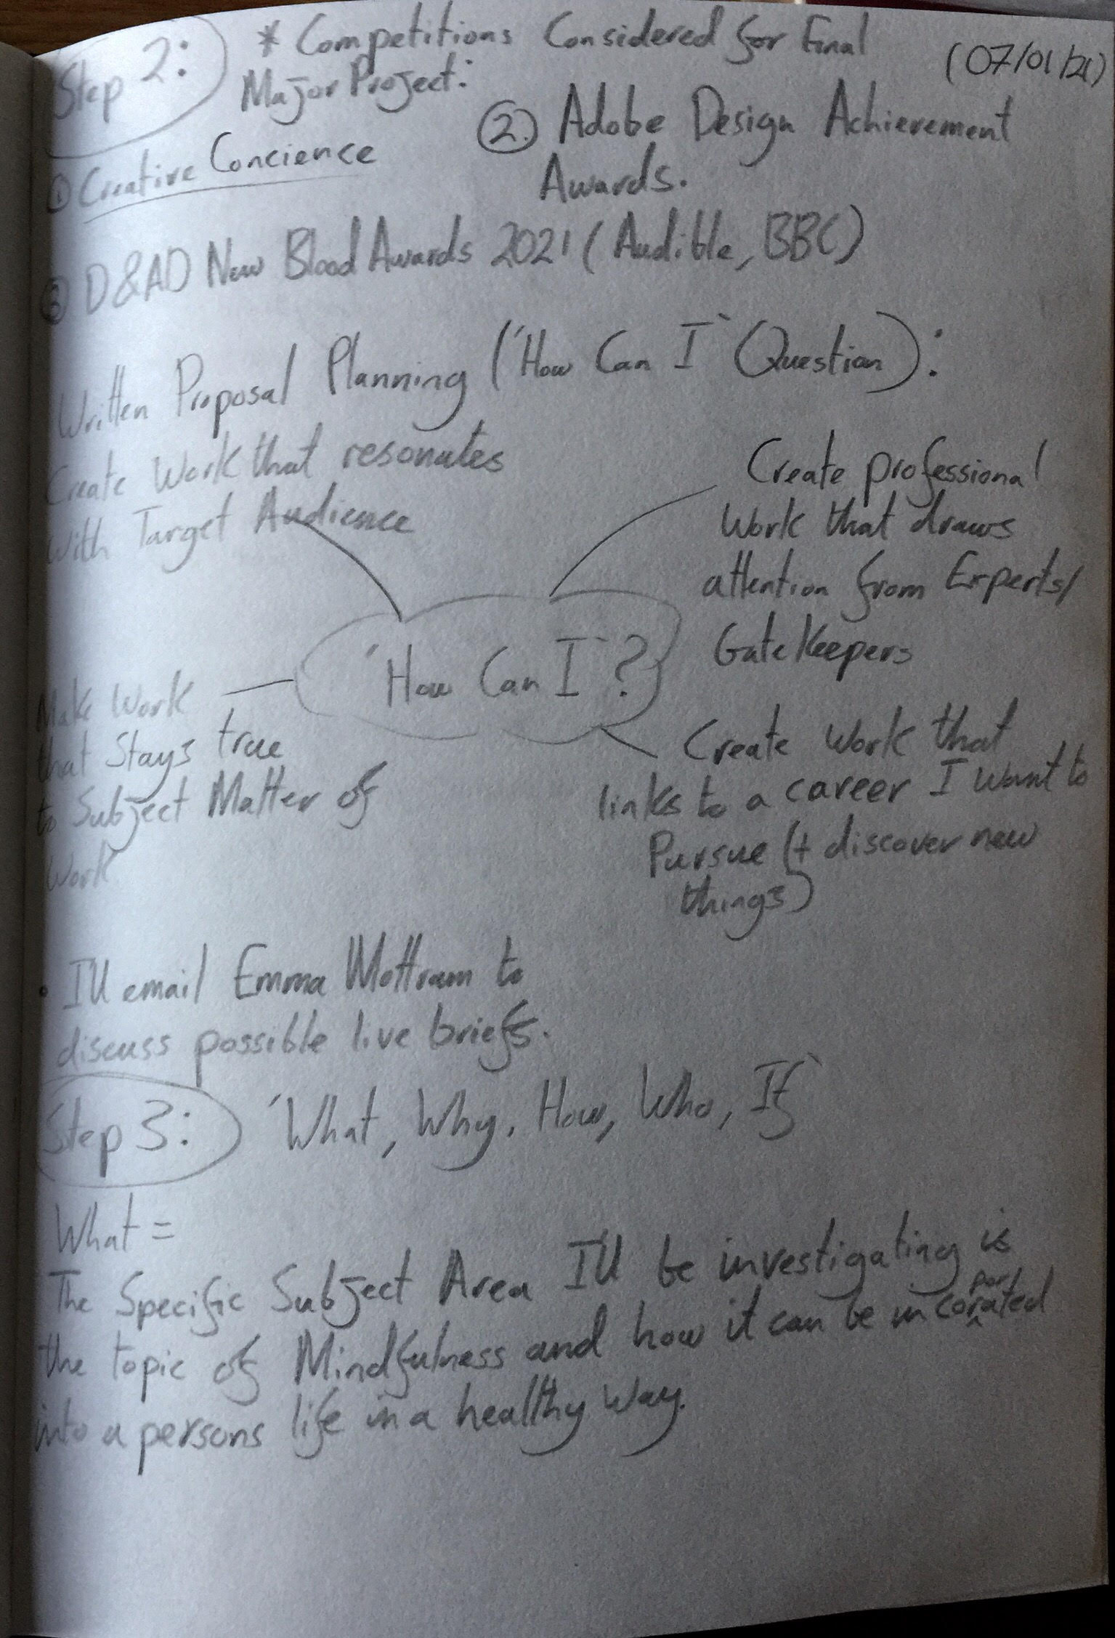
Major Project Proposal ‘How to Guide’. (Initial Notes).
Step 2 and Step 3.

Slide 6
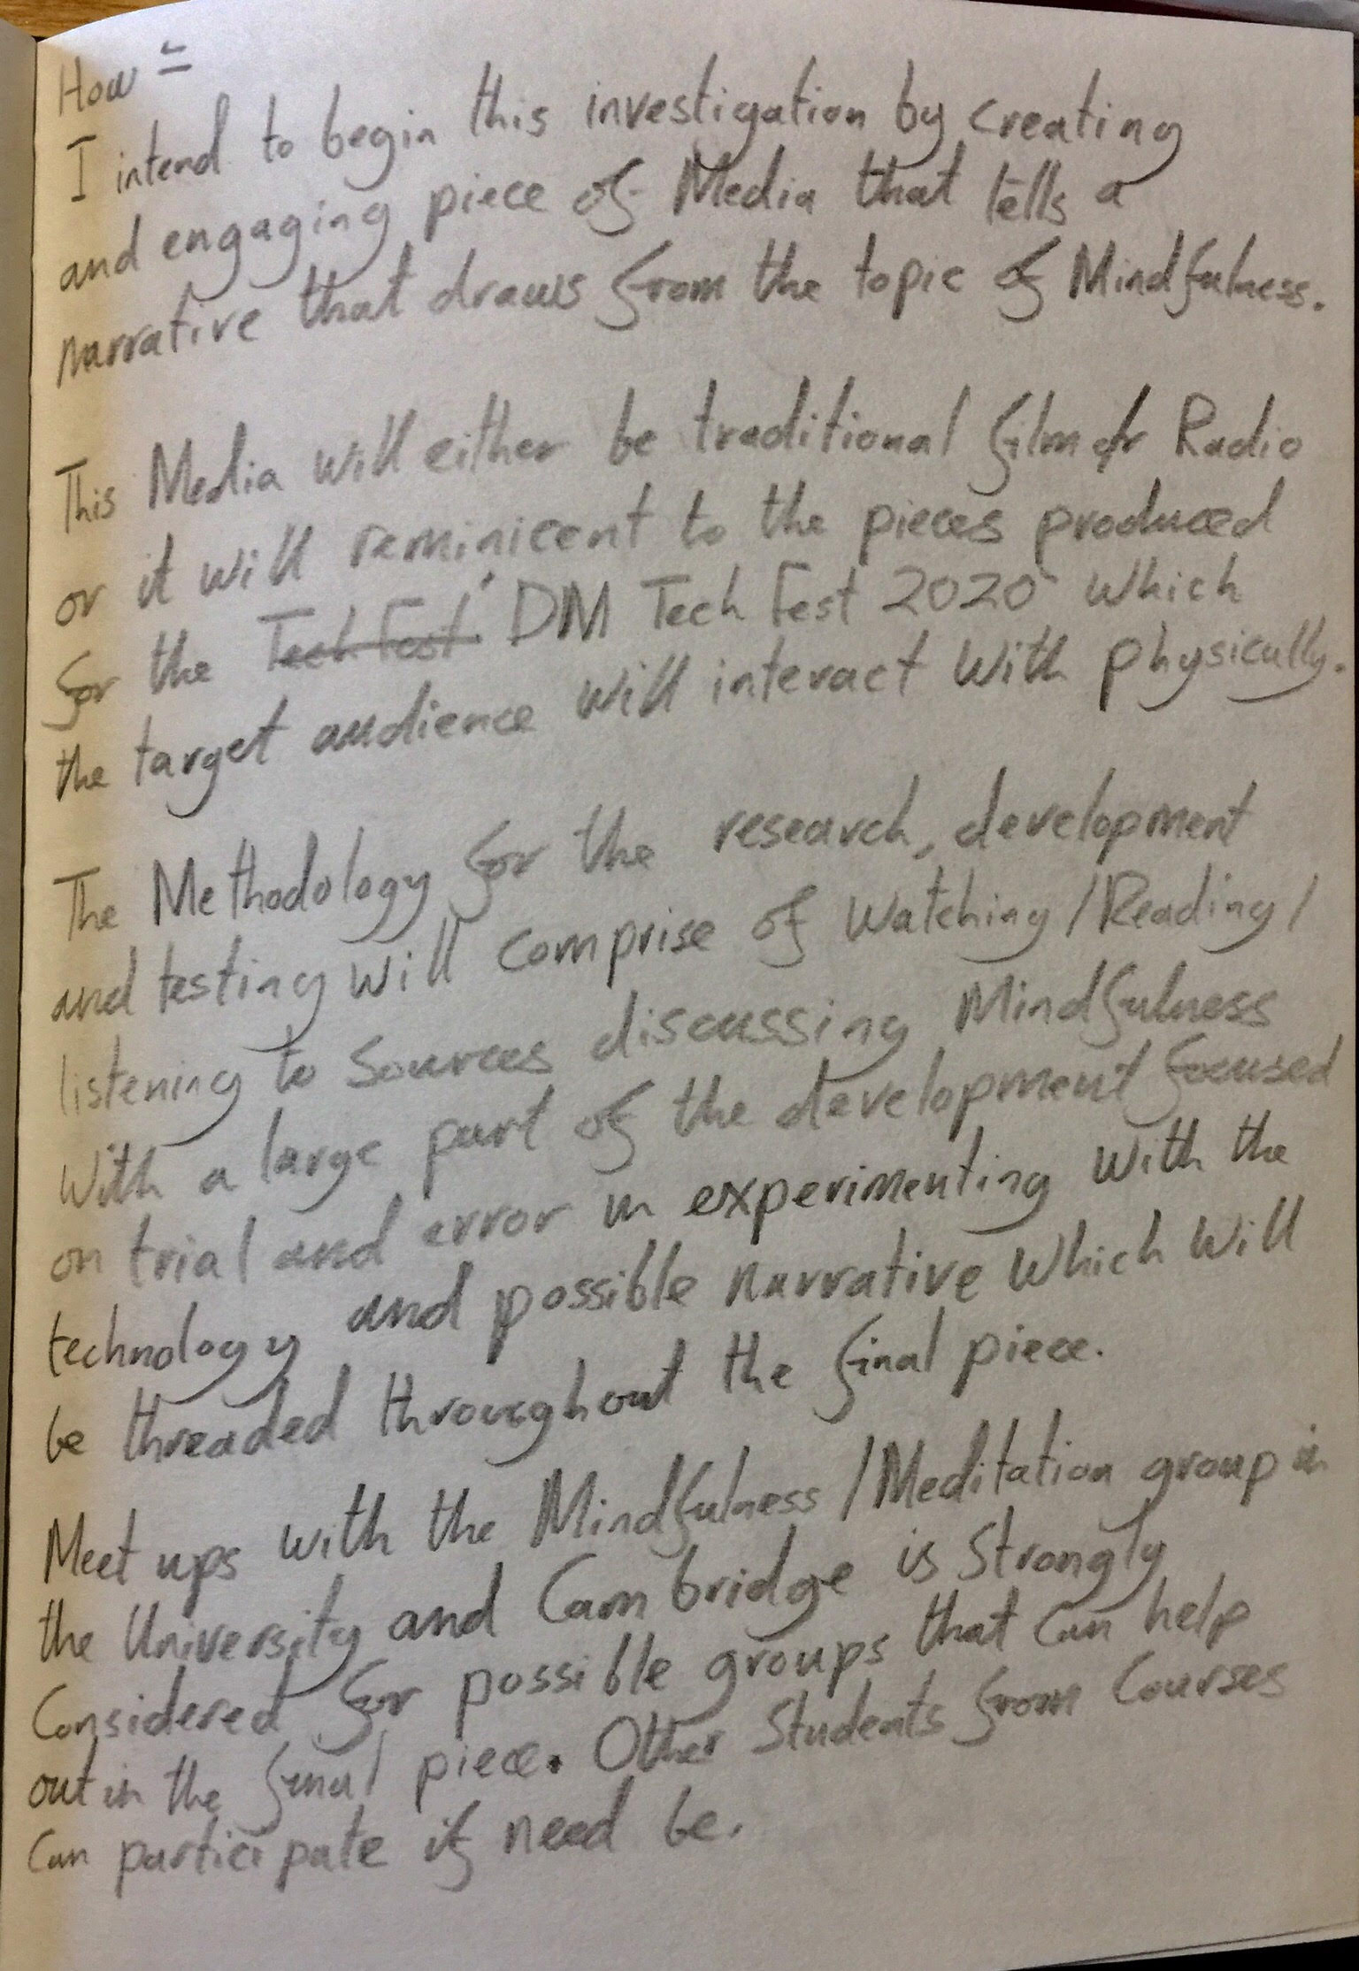
Major Project Proposal ‘How to Guide’. (Initial Notes).
Step 3 (Part 2)

Slide 7
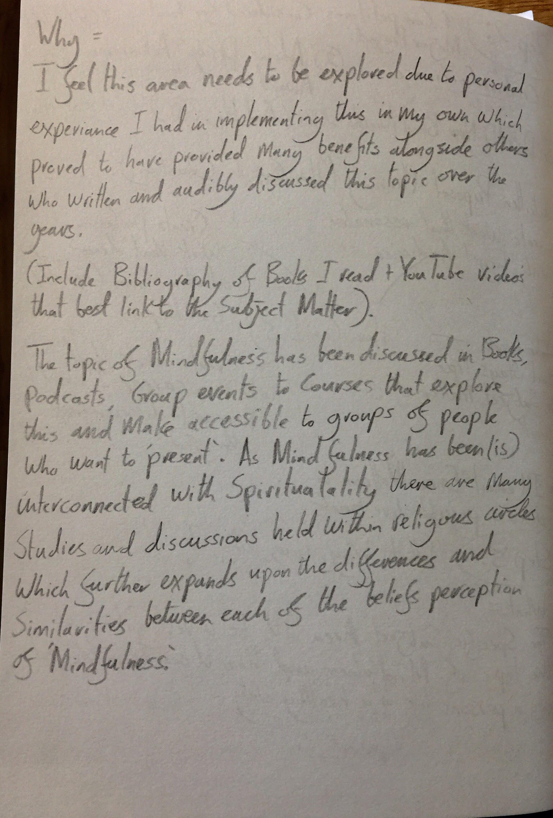
Major Project Proposal ‘How to Guide’. (Initial Notes).
Step 3 (Part 3)

Slide 8
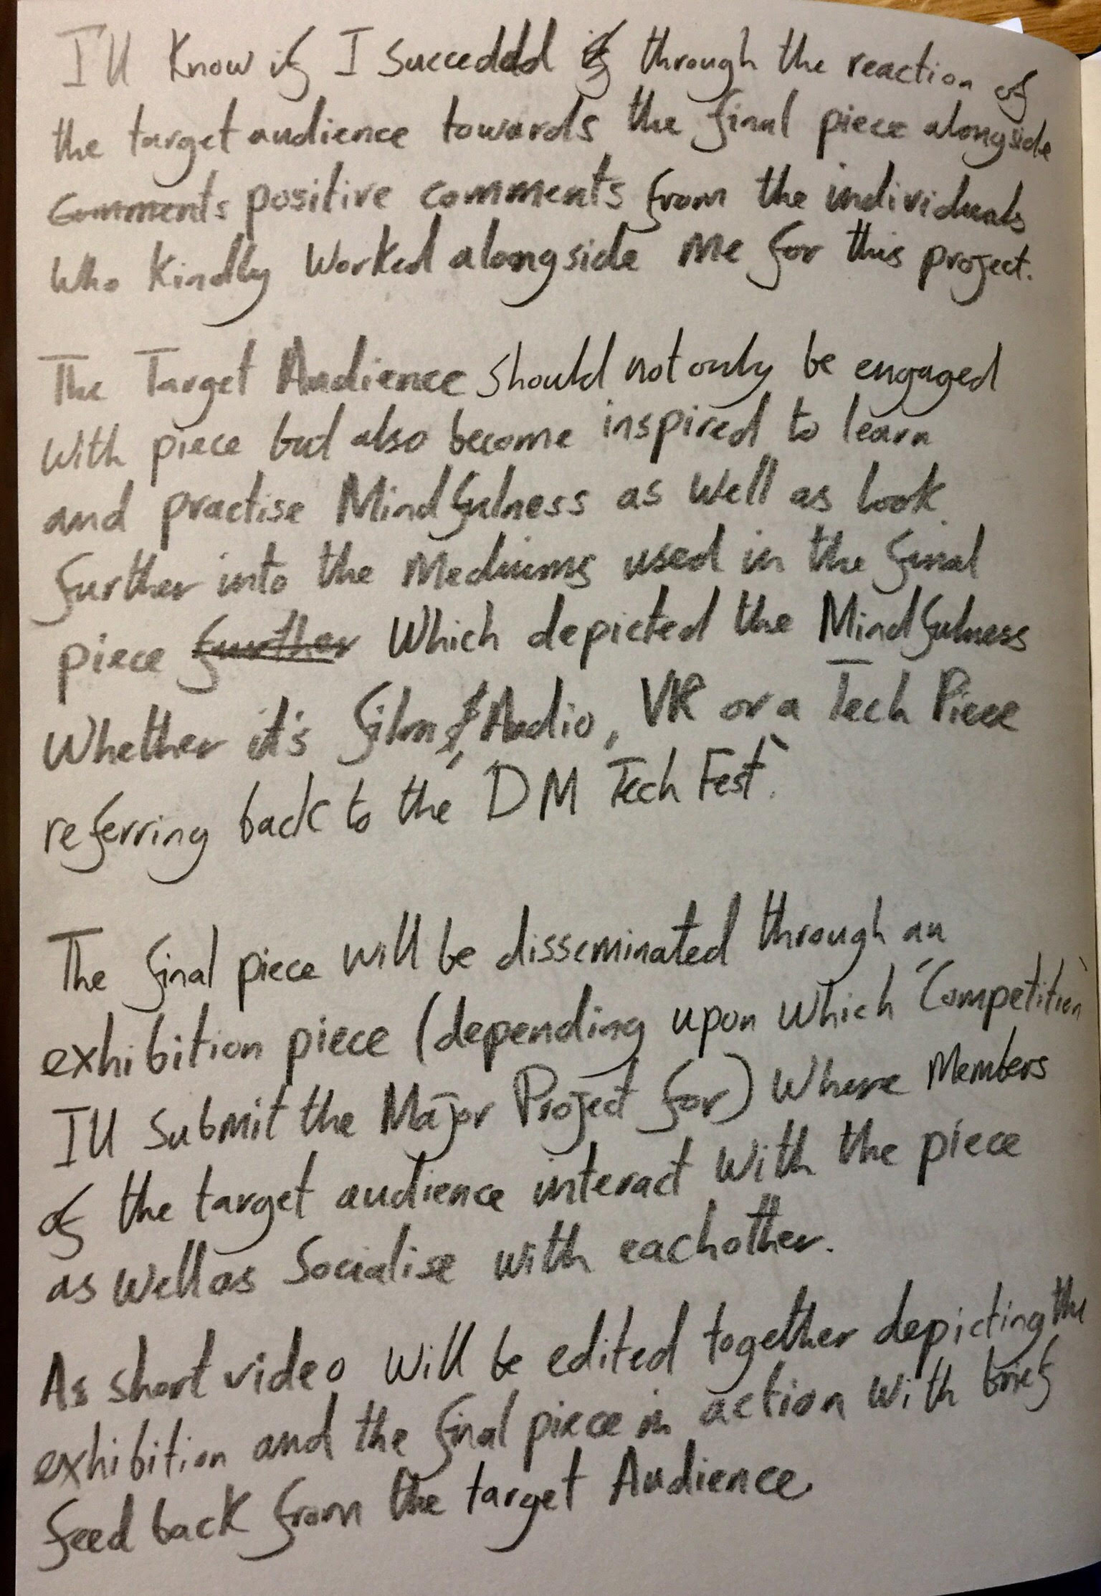
Major Project Proposal ‘How to Guide’. (Initial Notes).
Step 3 (Part 4)

Slide 9
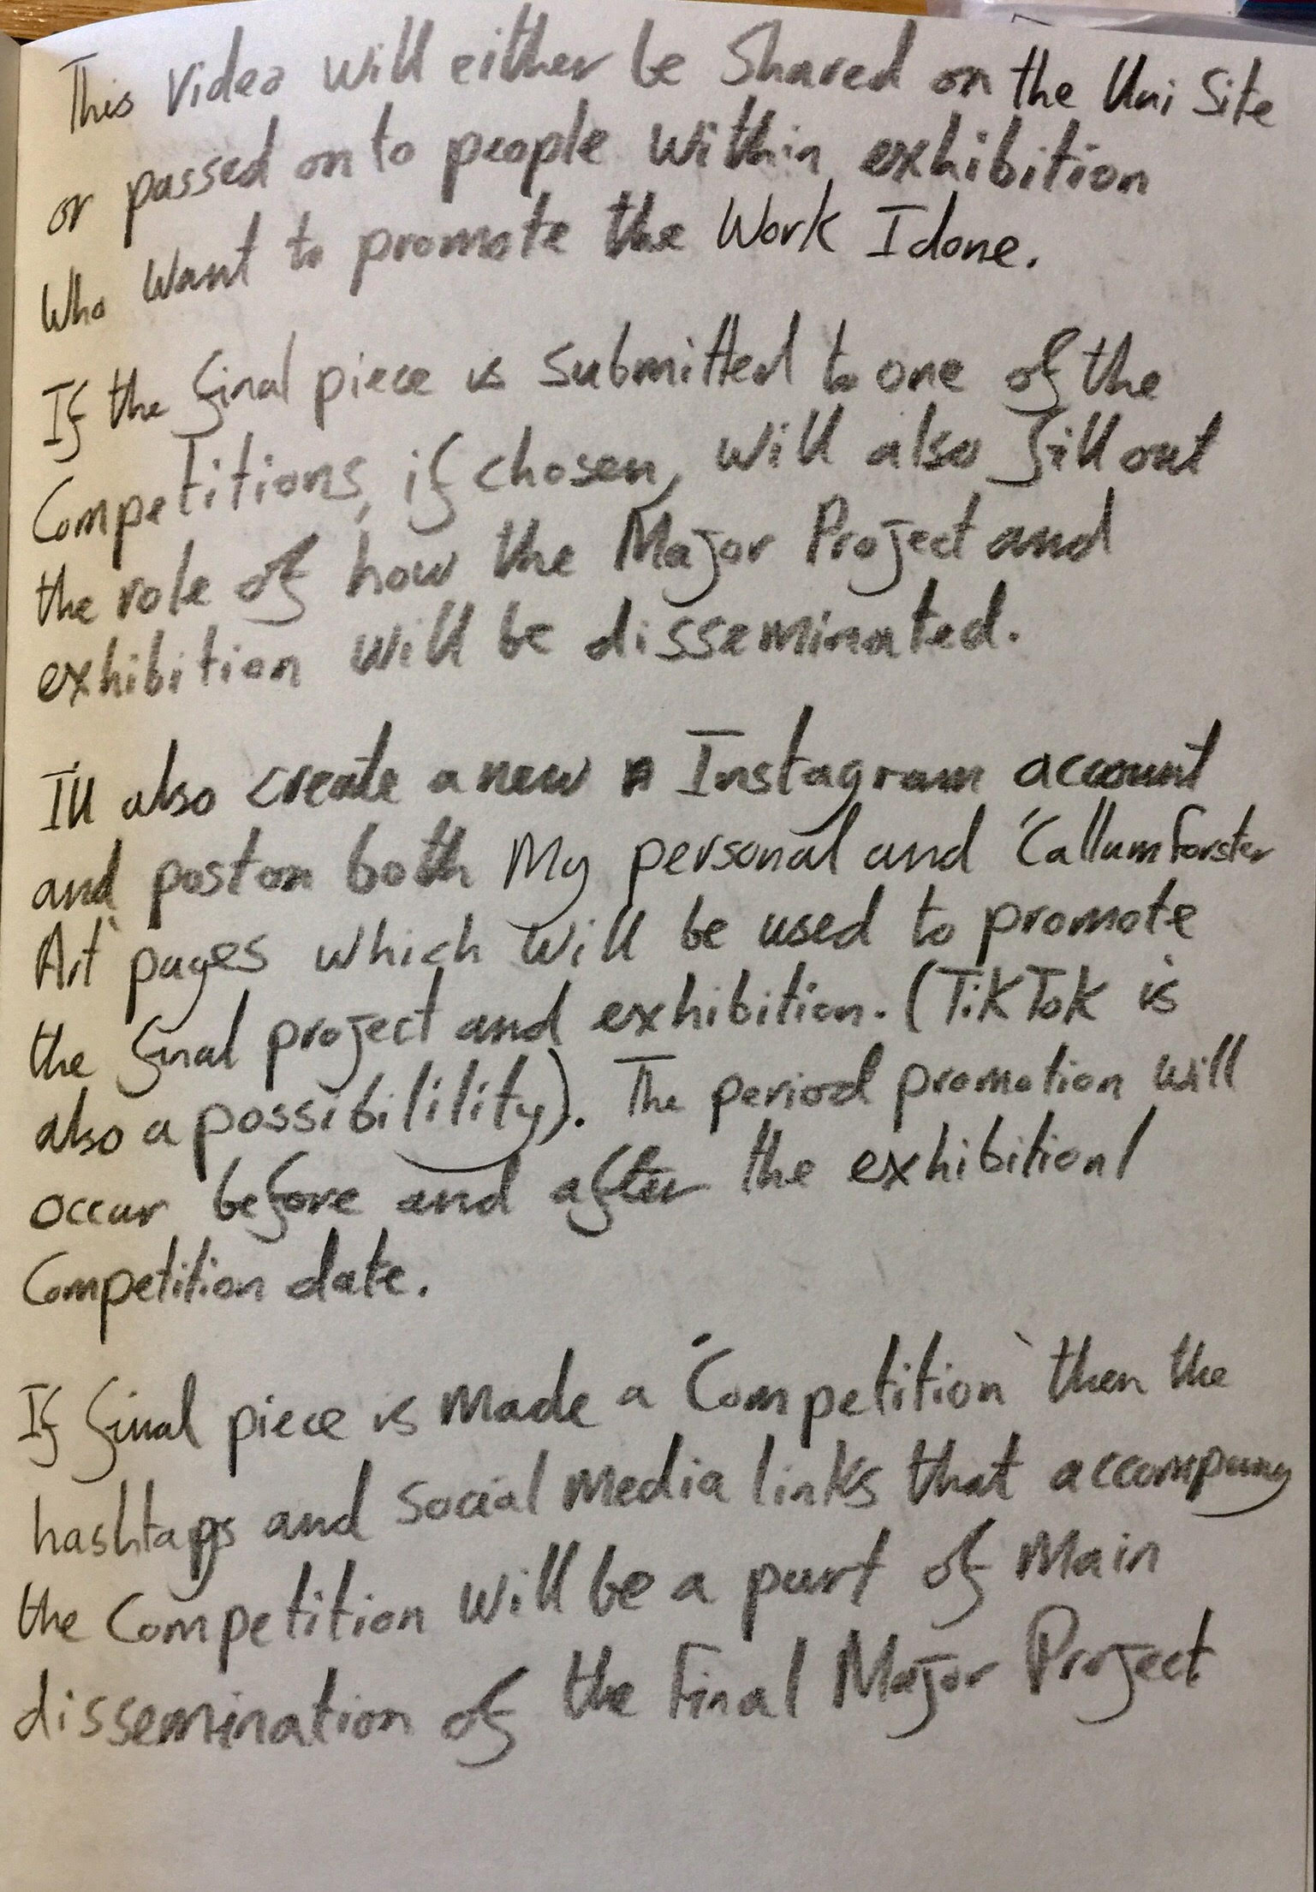
Major Project Proposal ‘How to Guide’. (Initial Notes).
Step 3 (Part 5)

Slide 10
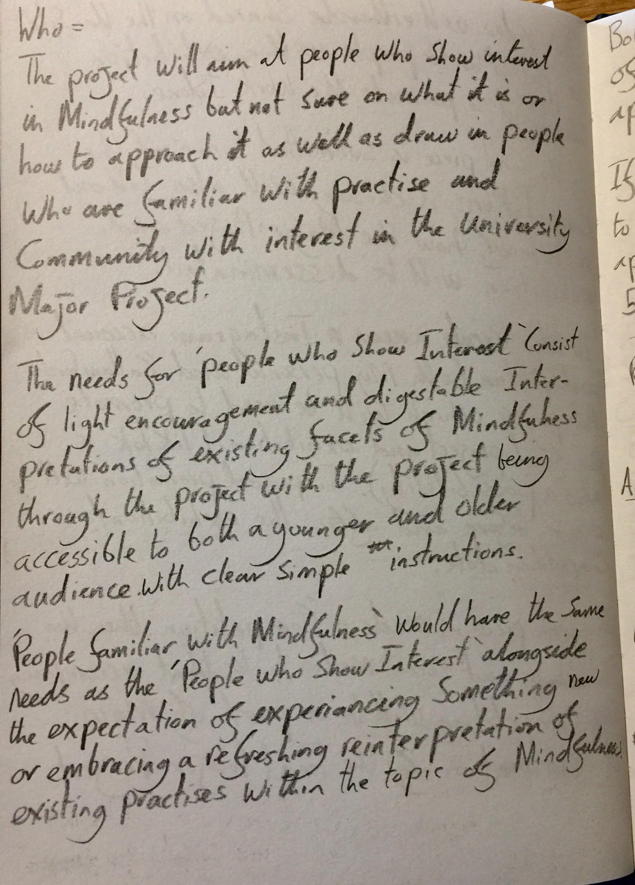
Major Project Proposal ‘How to Guide’. (Initial Notes).
Step 3 (Part 6)

Slide 11
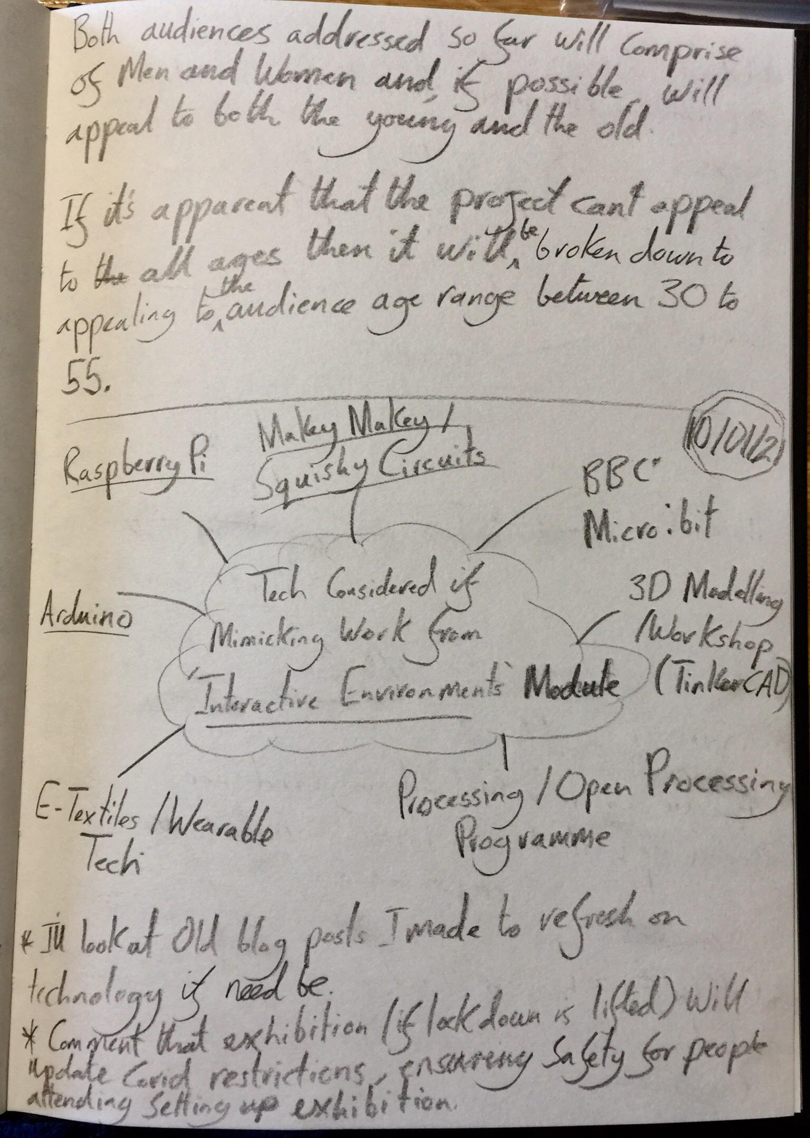
Major Project Proposal ‘How to Guide’. (Initial Notes).
Step 3 (Part 7)
Notes expanding on potential technologies for proposed Tech Piece for Final Major Project if it comes into fruition.

Slide 12
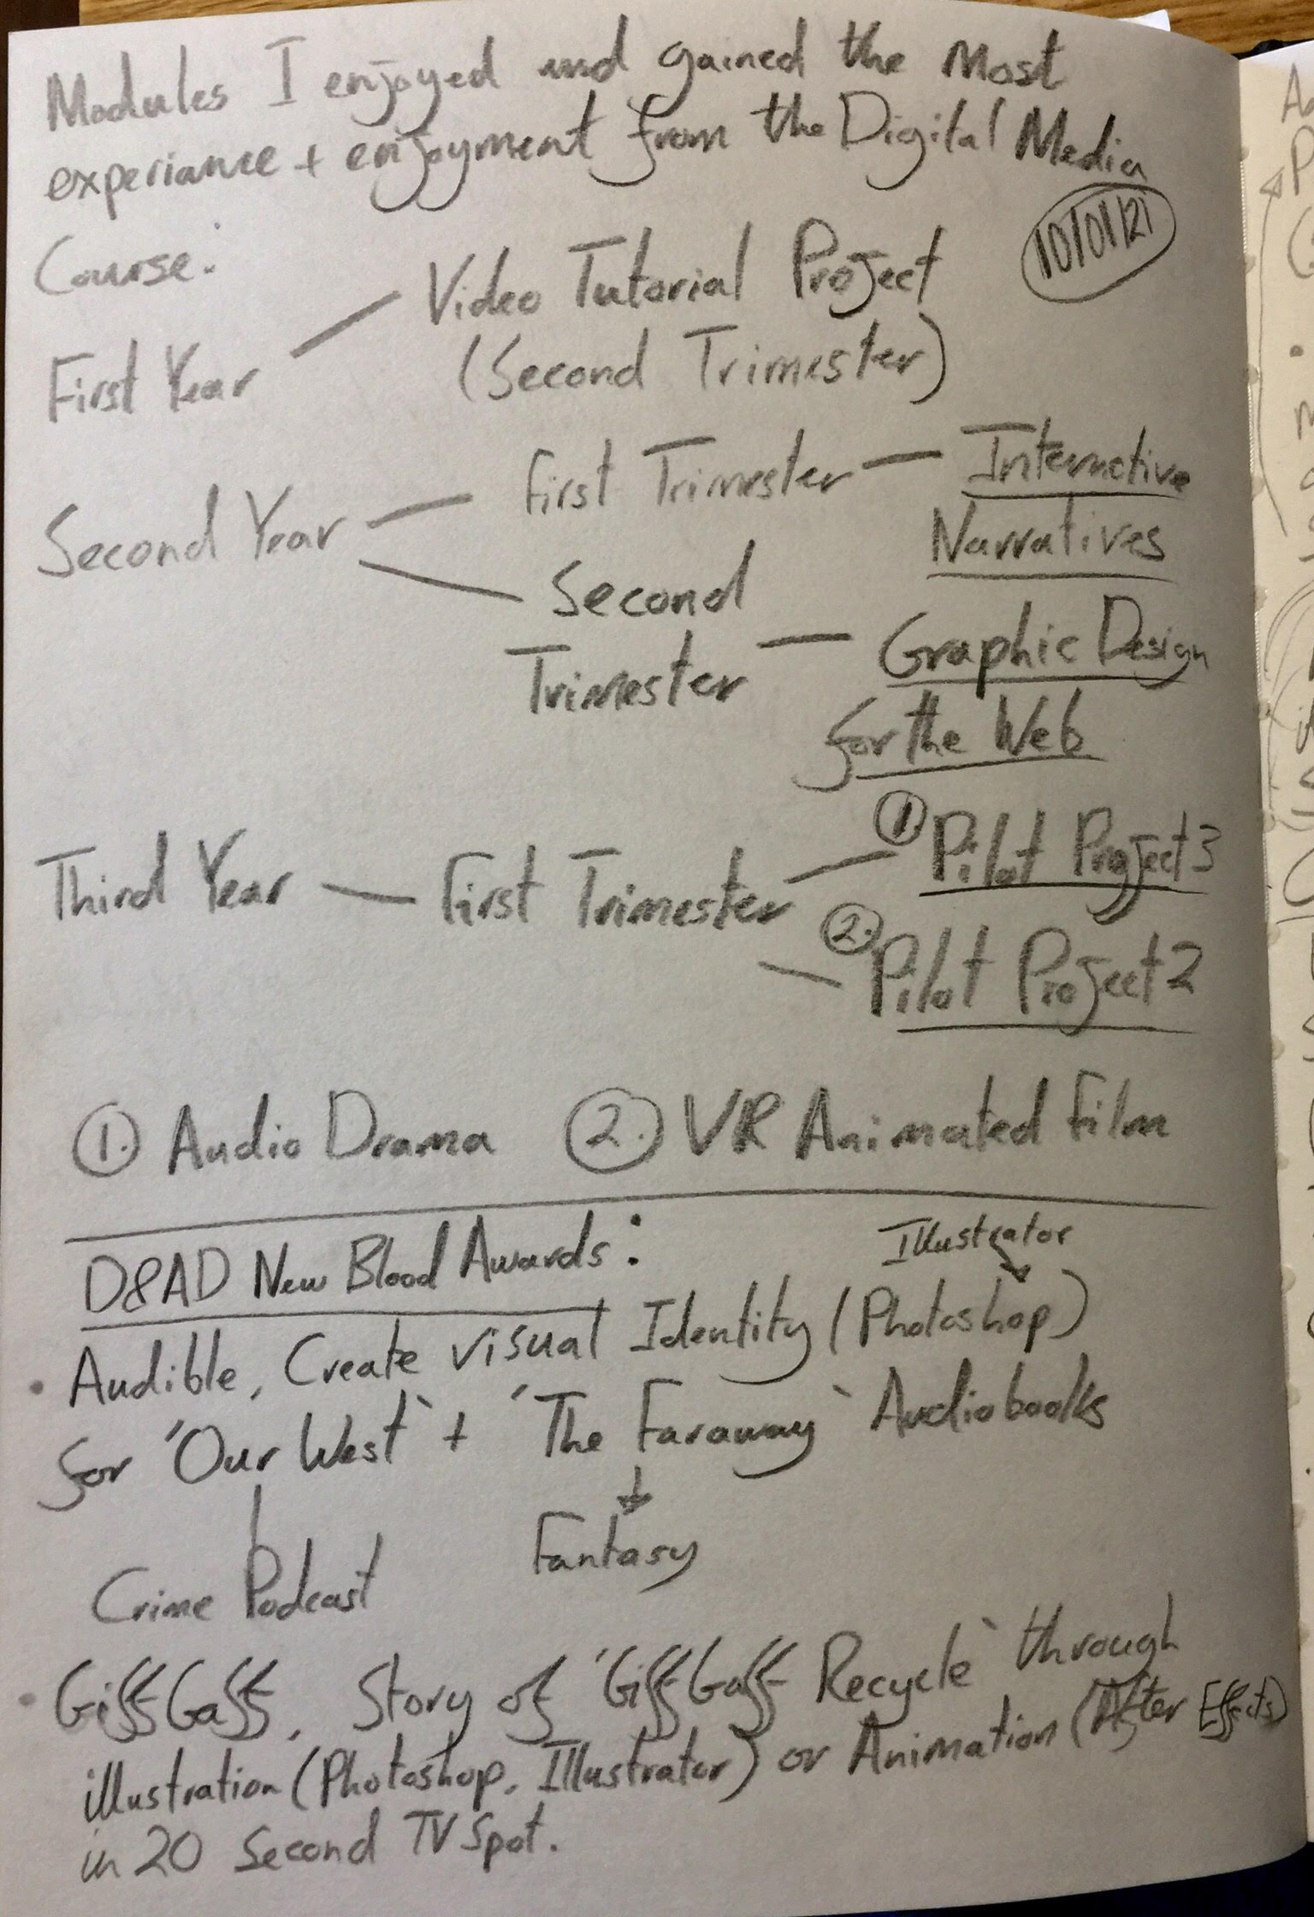
Competition Research (Part 1)
Notes on Past Modules relevant for Final Major Project.

Slide 13
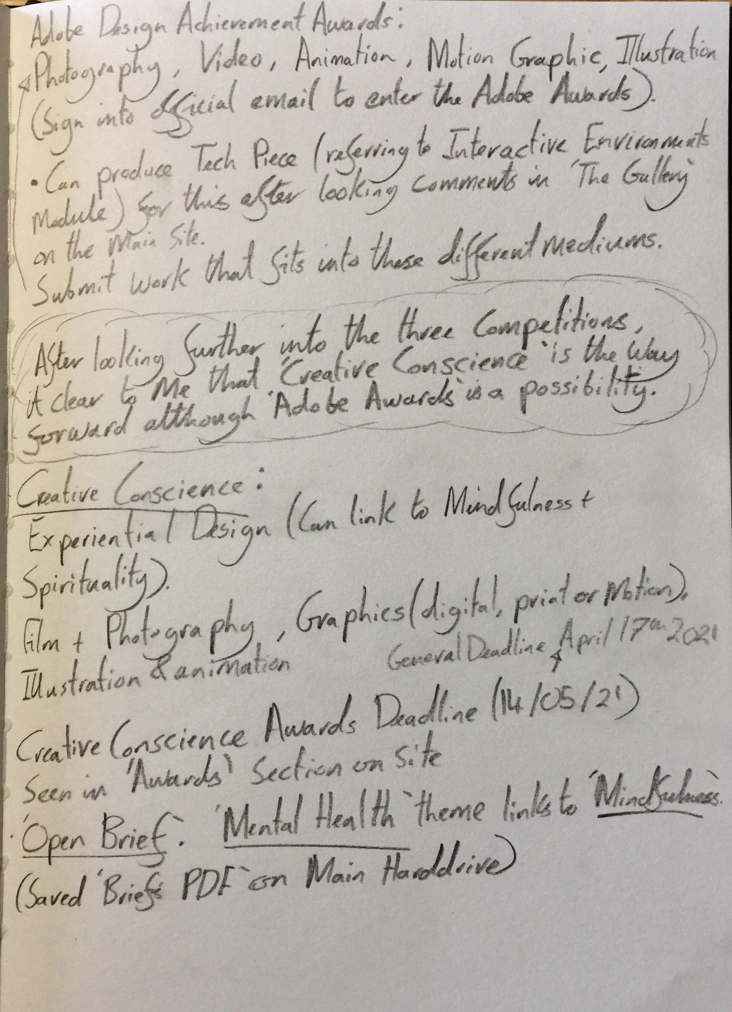
Competition Research (Part 2)
Final notes in competition research and the competition which will be looked into further when development commences on the Final Major Project.

