Slide 1
Professional Brief Project. Trimester 1.
‘Sookio School Tiktok Course Promo’ Development. Sketchbook Pages.

Slide 2
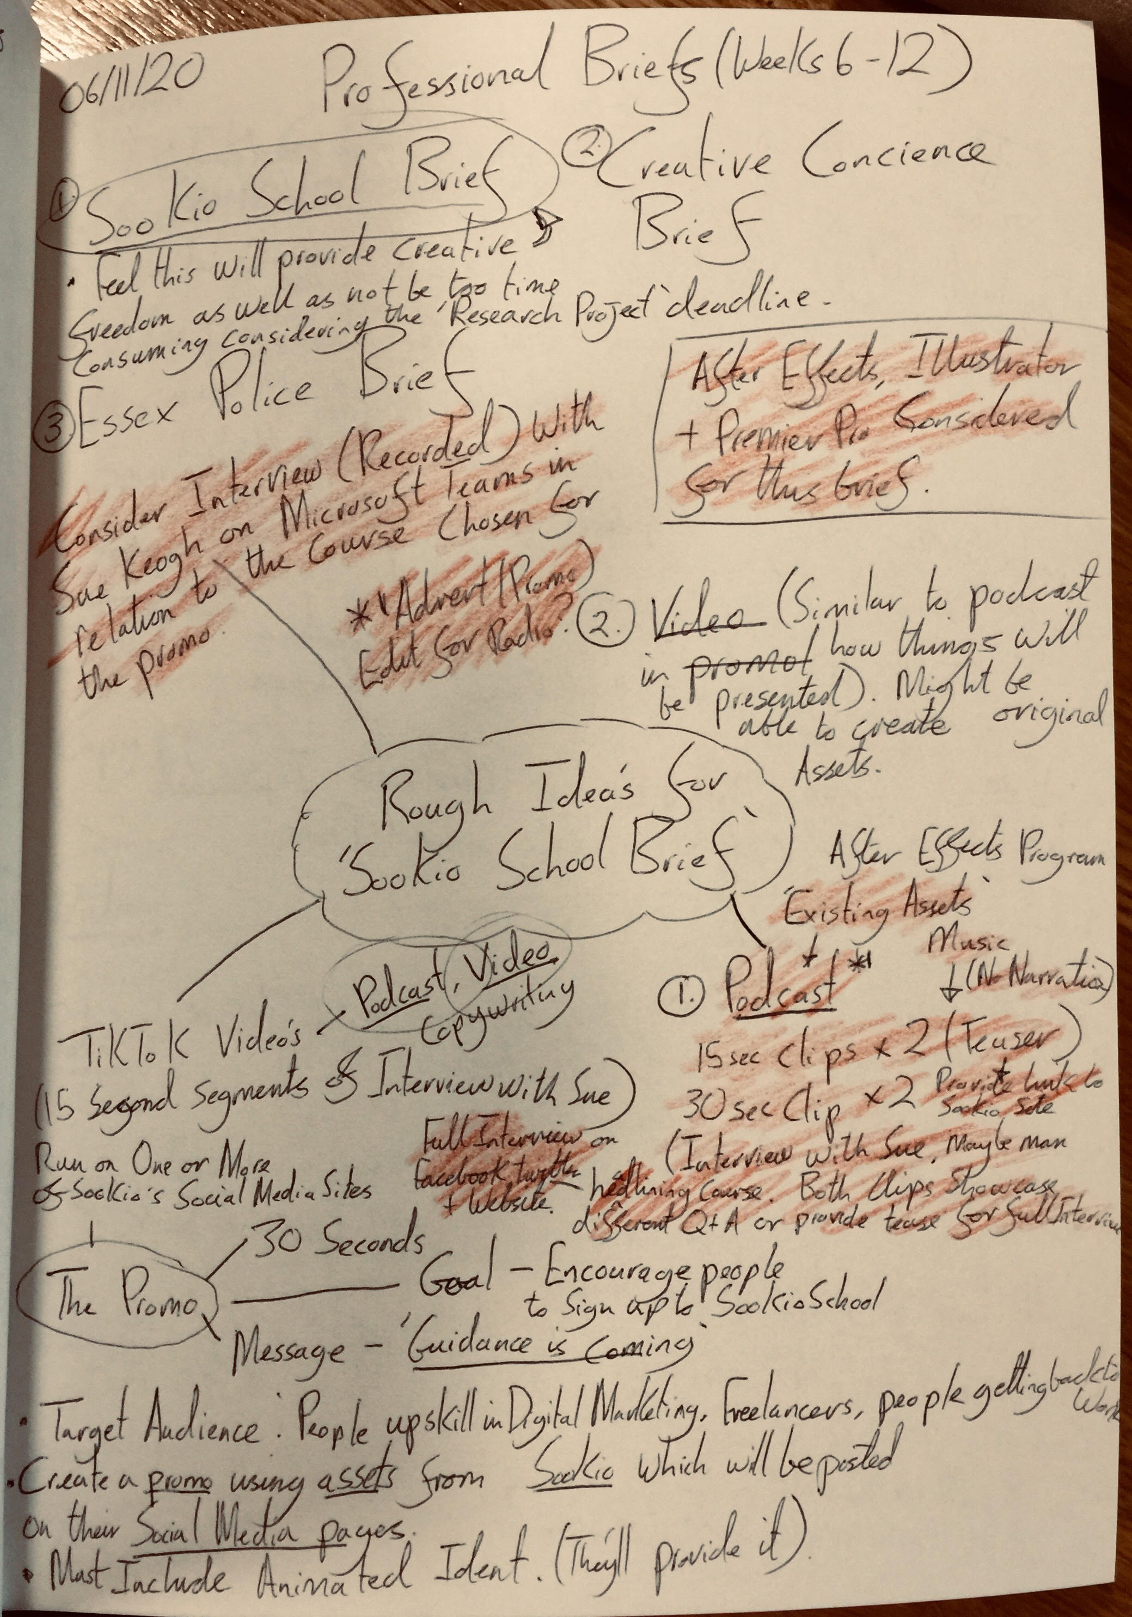
06/11/20
Mind map for initial ideas for Sookio School Promo.

Slide 3
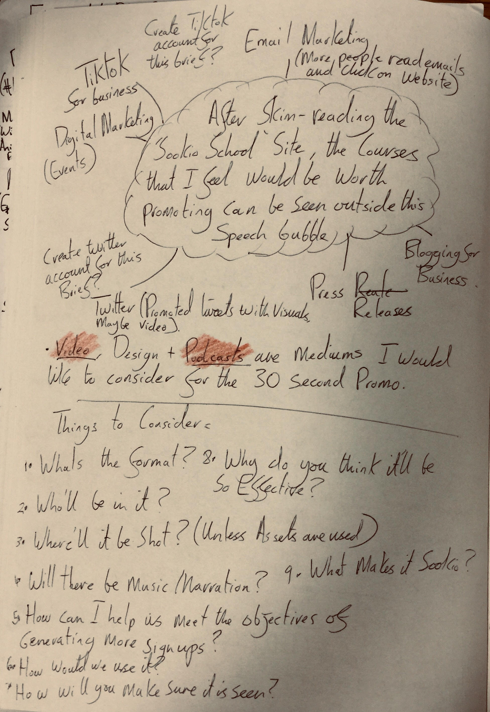
06/11/20
Further development on possible ideas for Sookio School Promo.

Slide 4
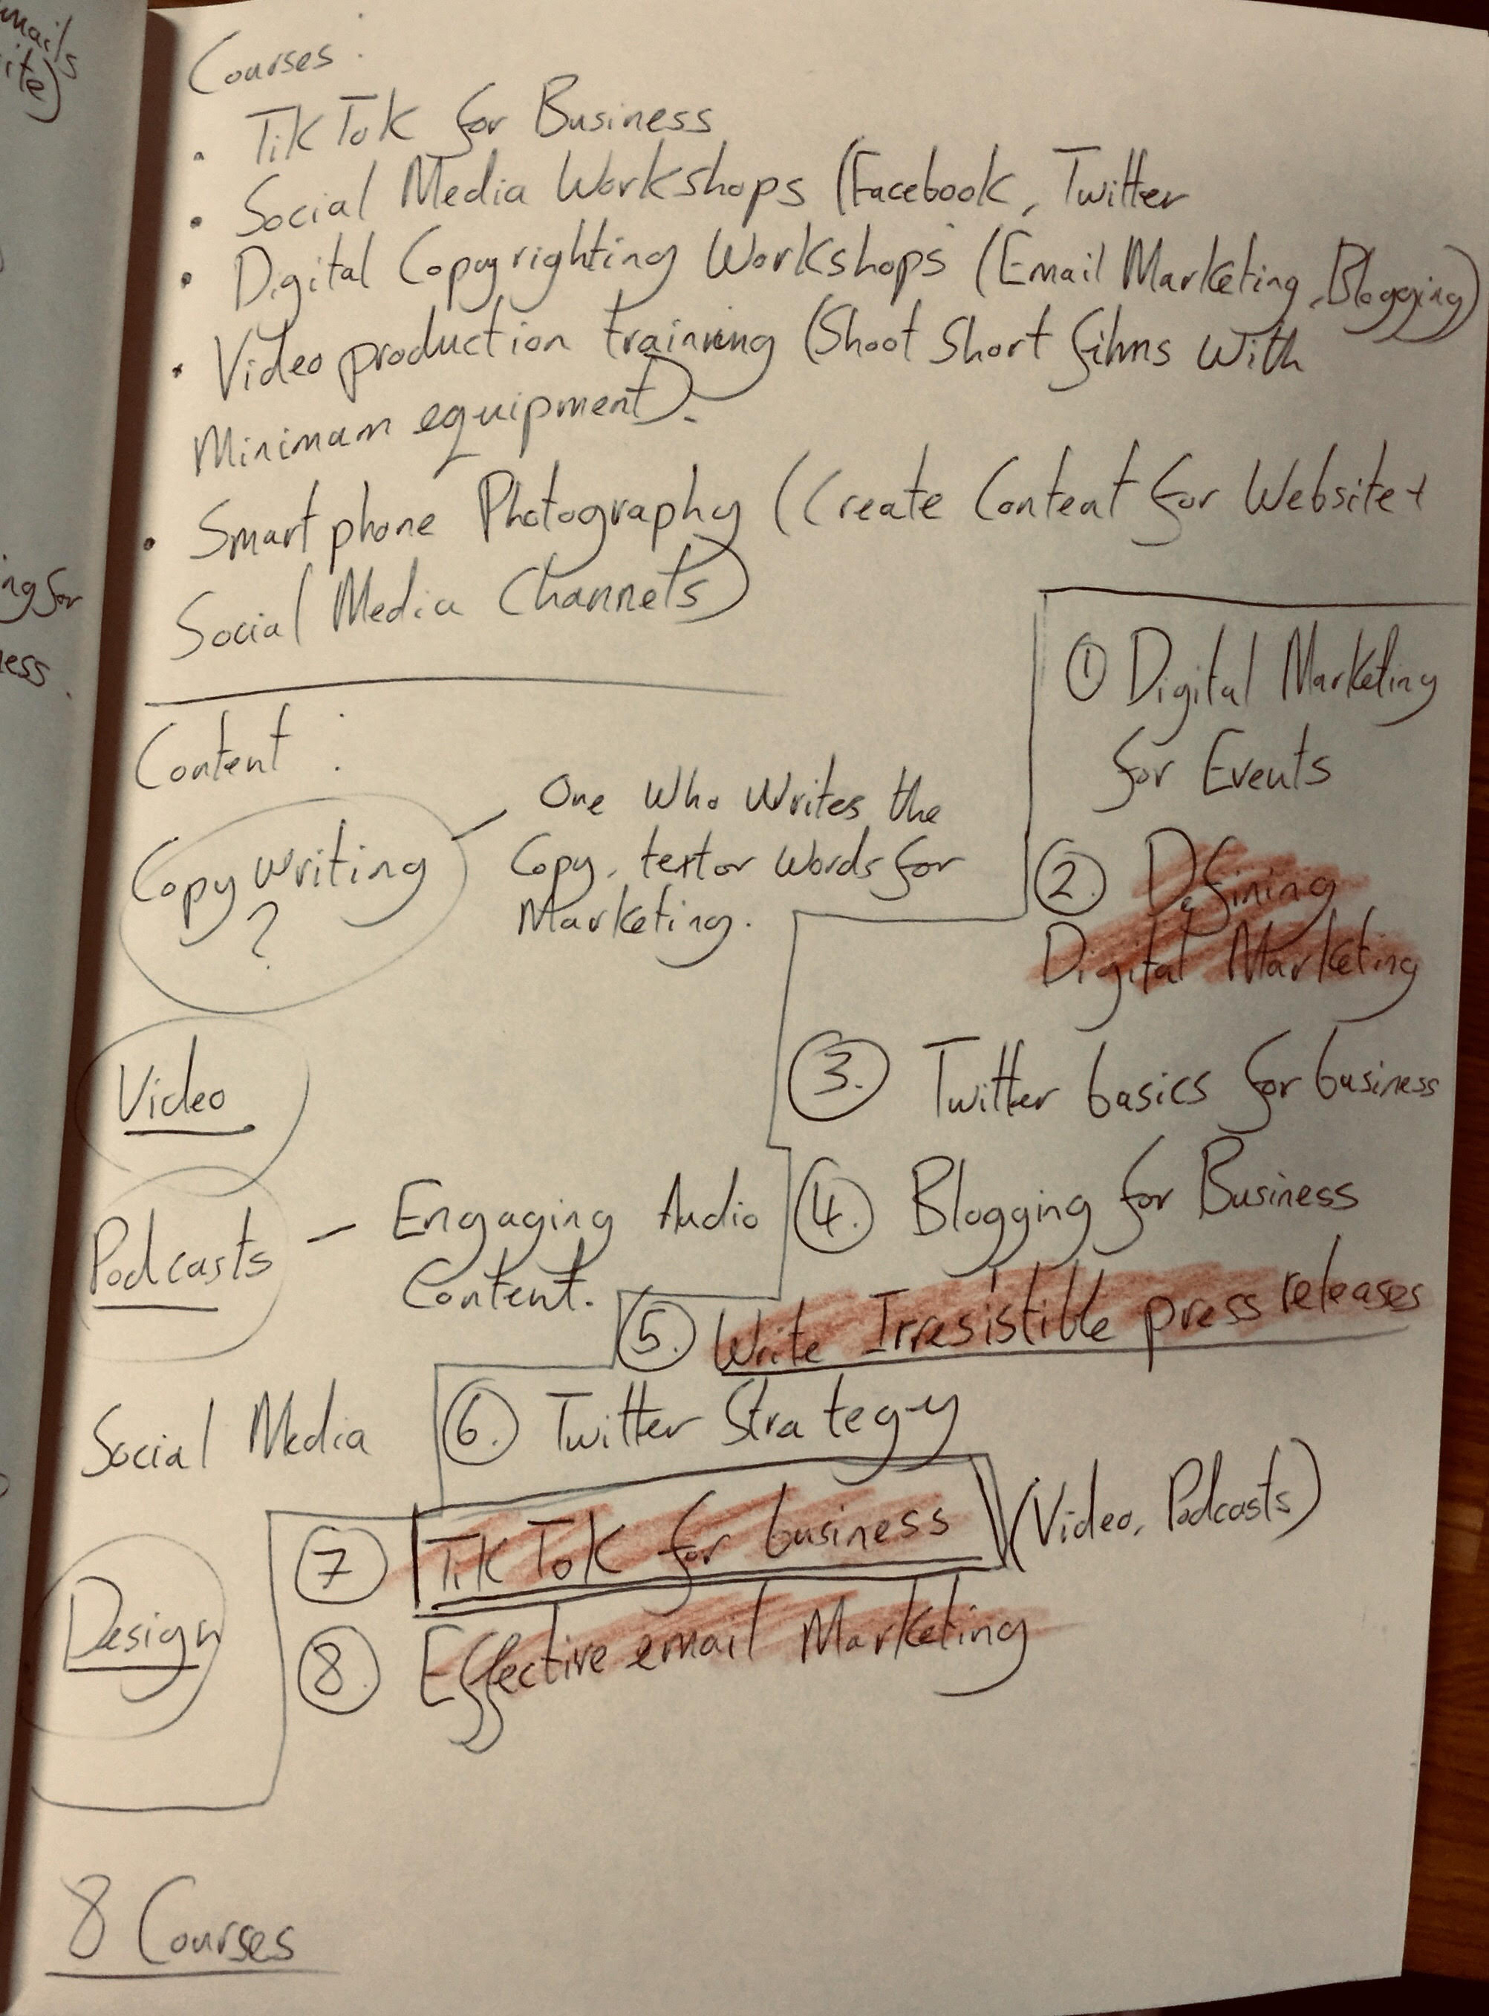
06/11/20
Refining of final idea (TikTok for Business Course) for Sookio School Promo.

Slide 5
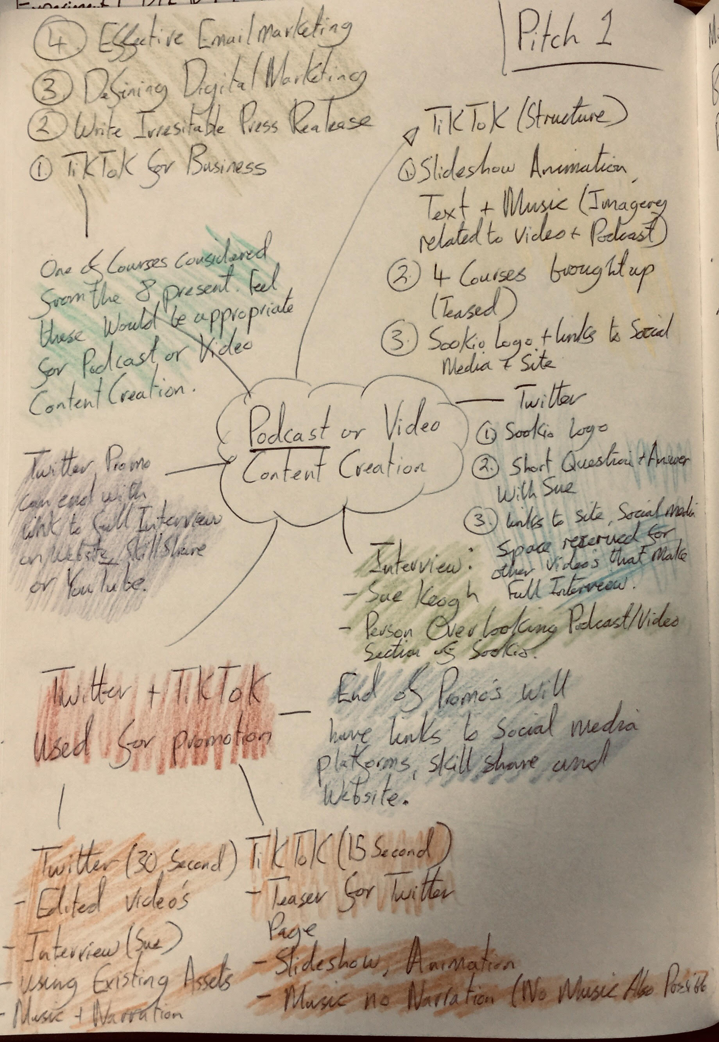
06/11/20
Extra Mind Map produced for initial ideas for Sookio School Promo.

Slide 6
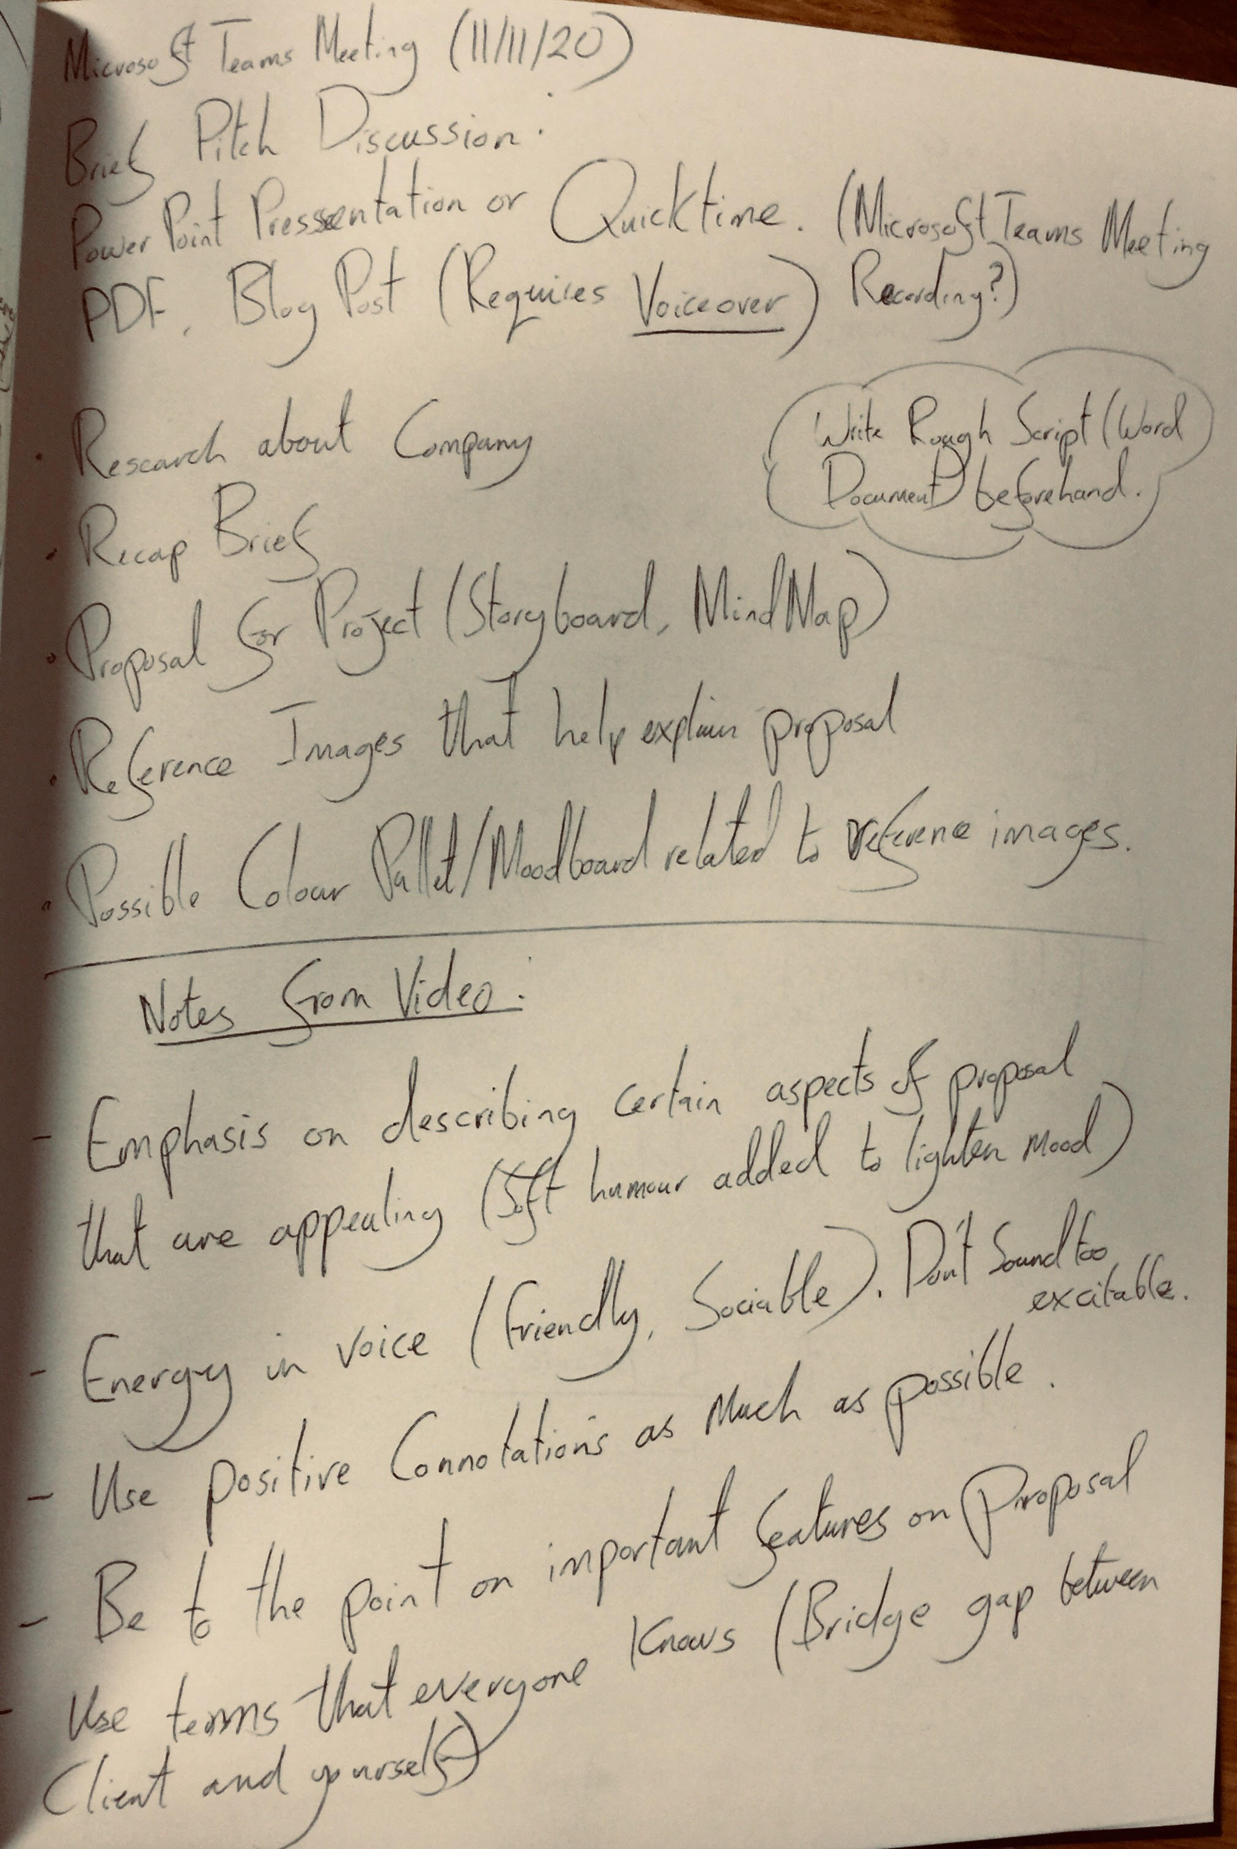
11/11/20
Notes written from Recorded ‘Microsoft Teams Meetings’ in prep for producing Sookio School Promo.

Slide 7
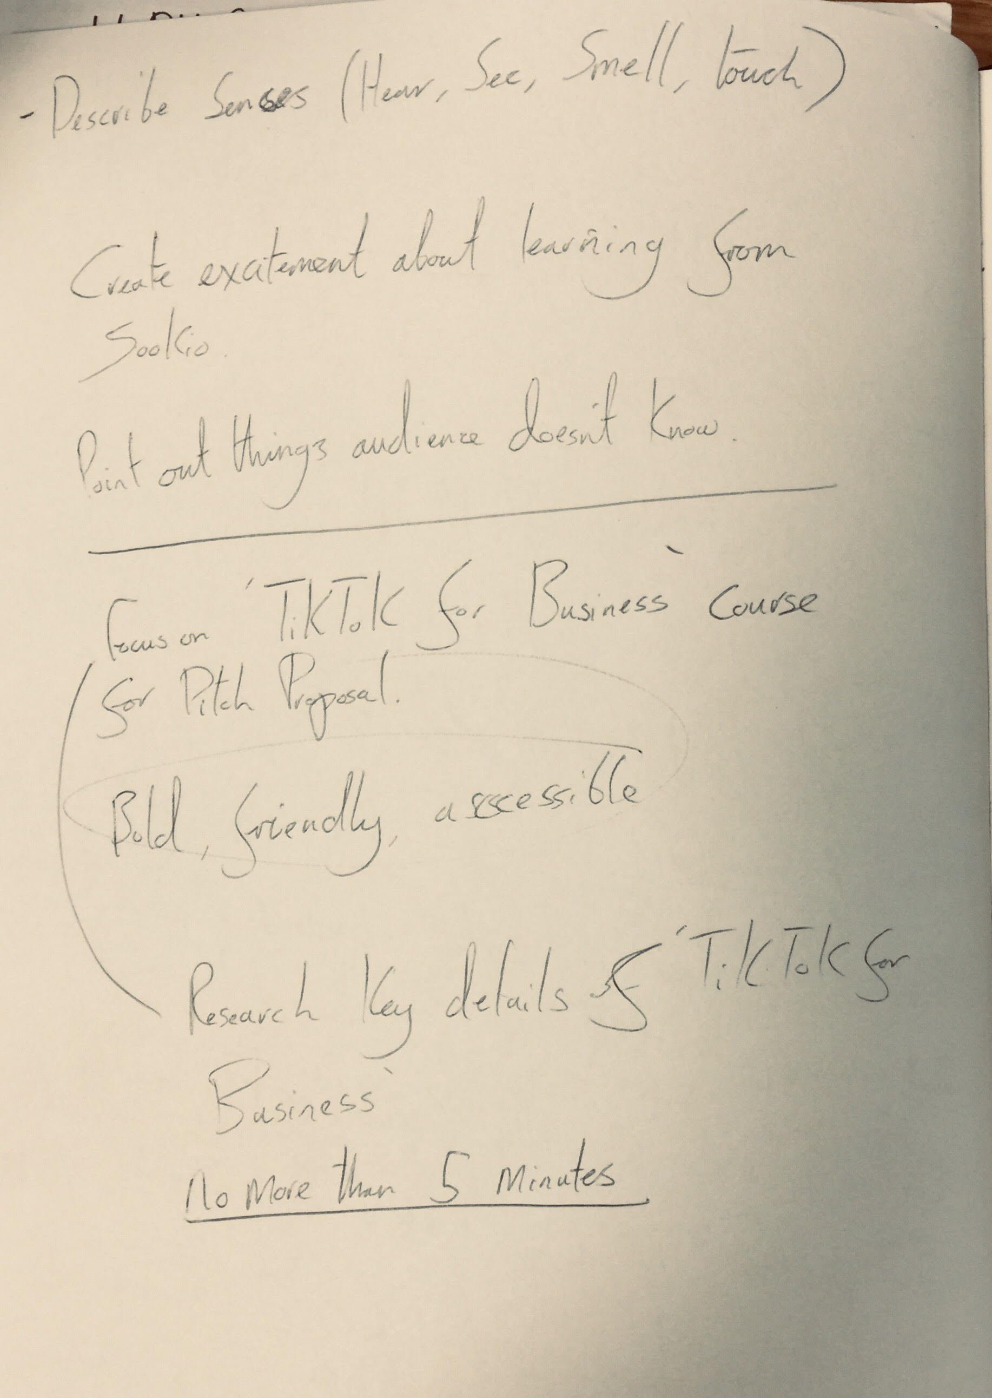
11/11/20
Extra notes from recorded ‘Microsoft Teams Meetings’ and choosing ‘TikTok For Business’ course for the Sookio School Promo.

Slide 8
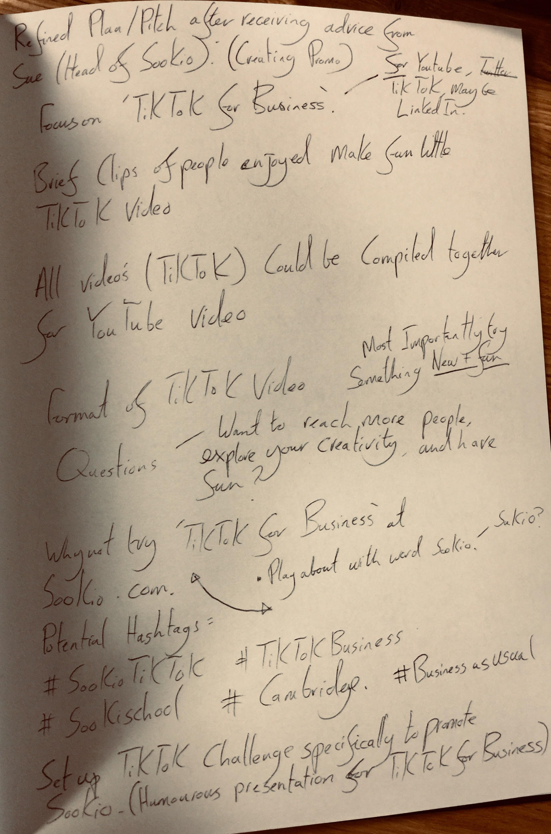
11/11/20
Notes for initial pitch to Sue before starting work on the Sookio School Promo.

Slide 9
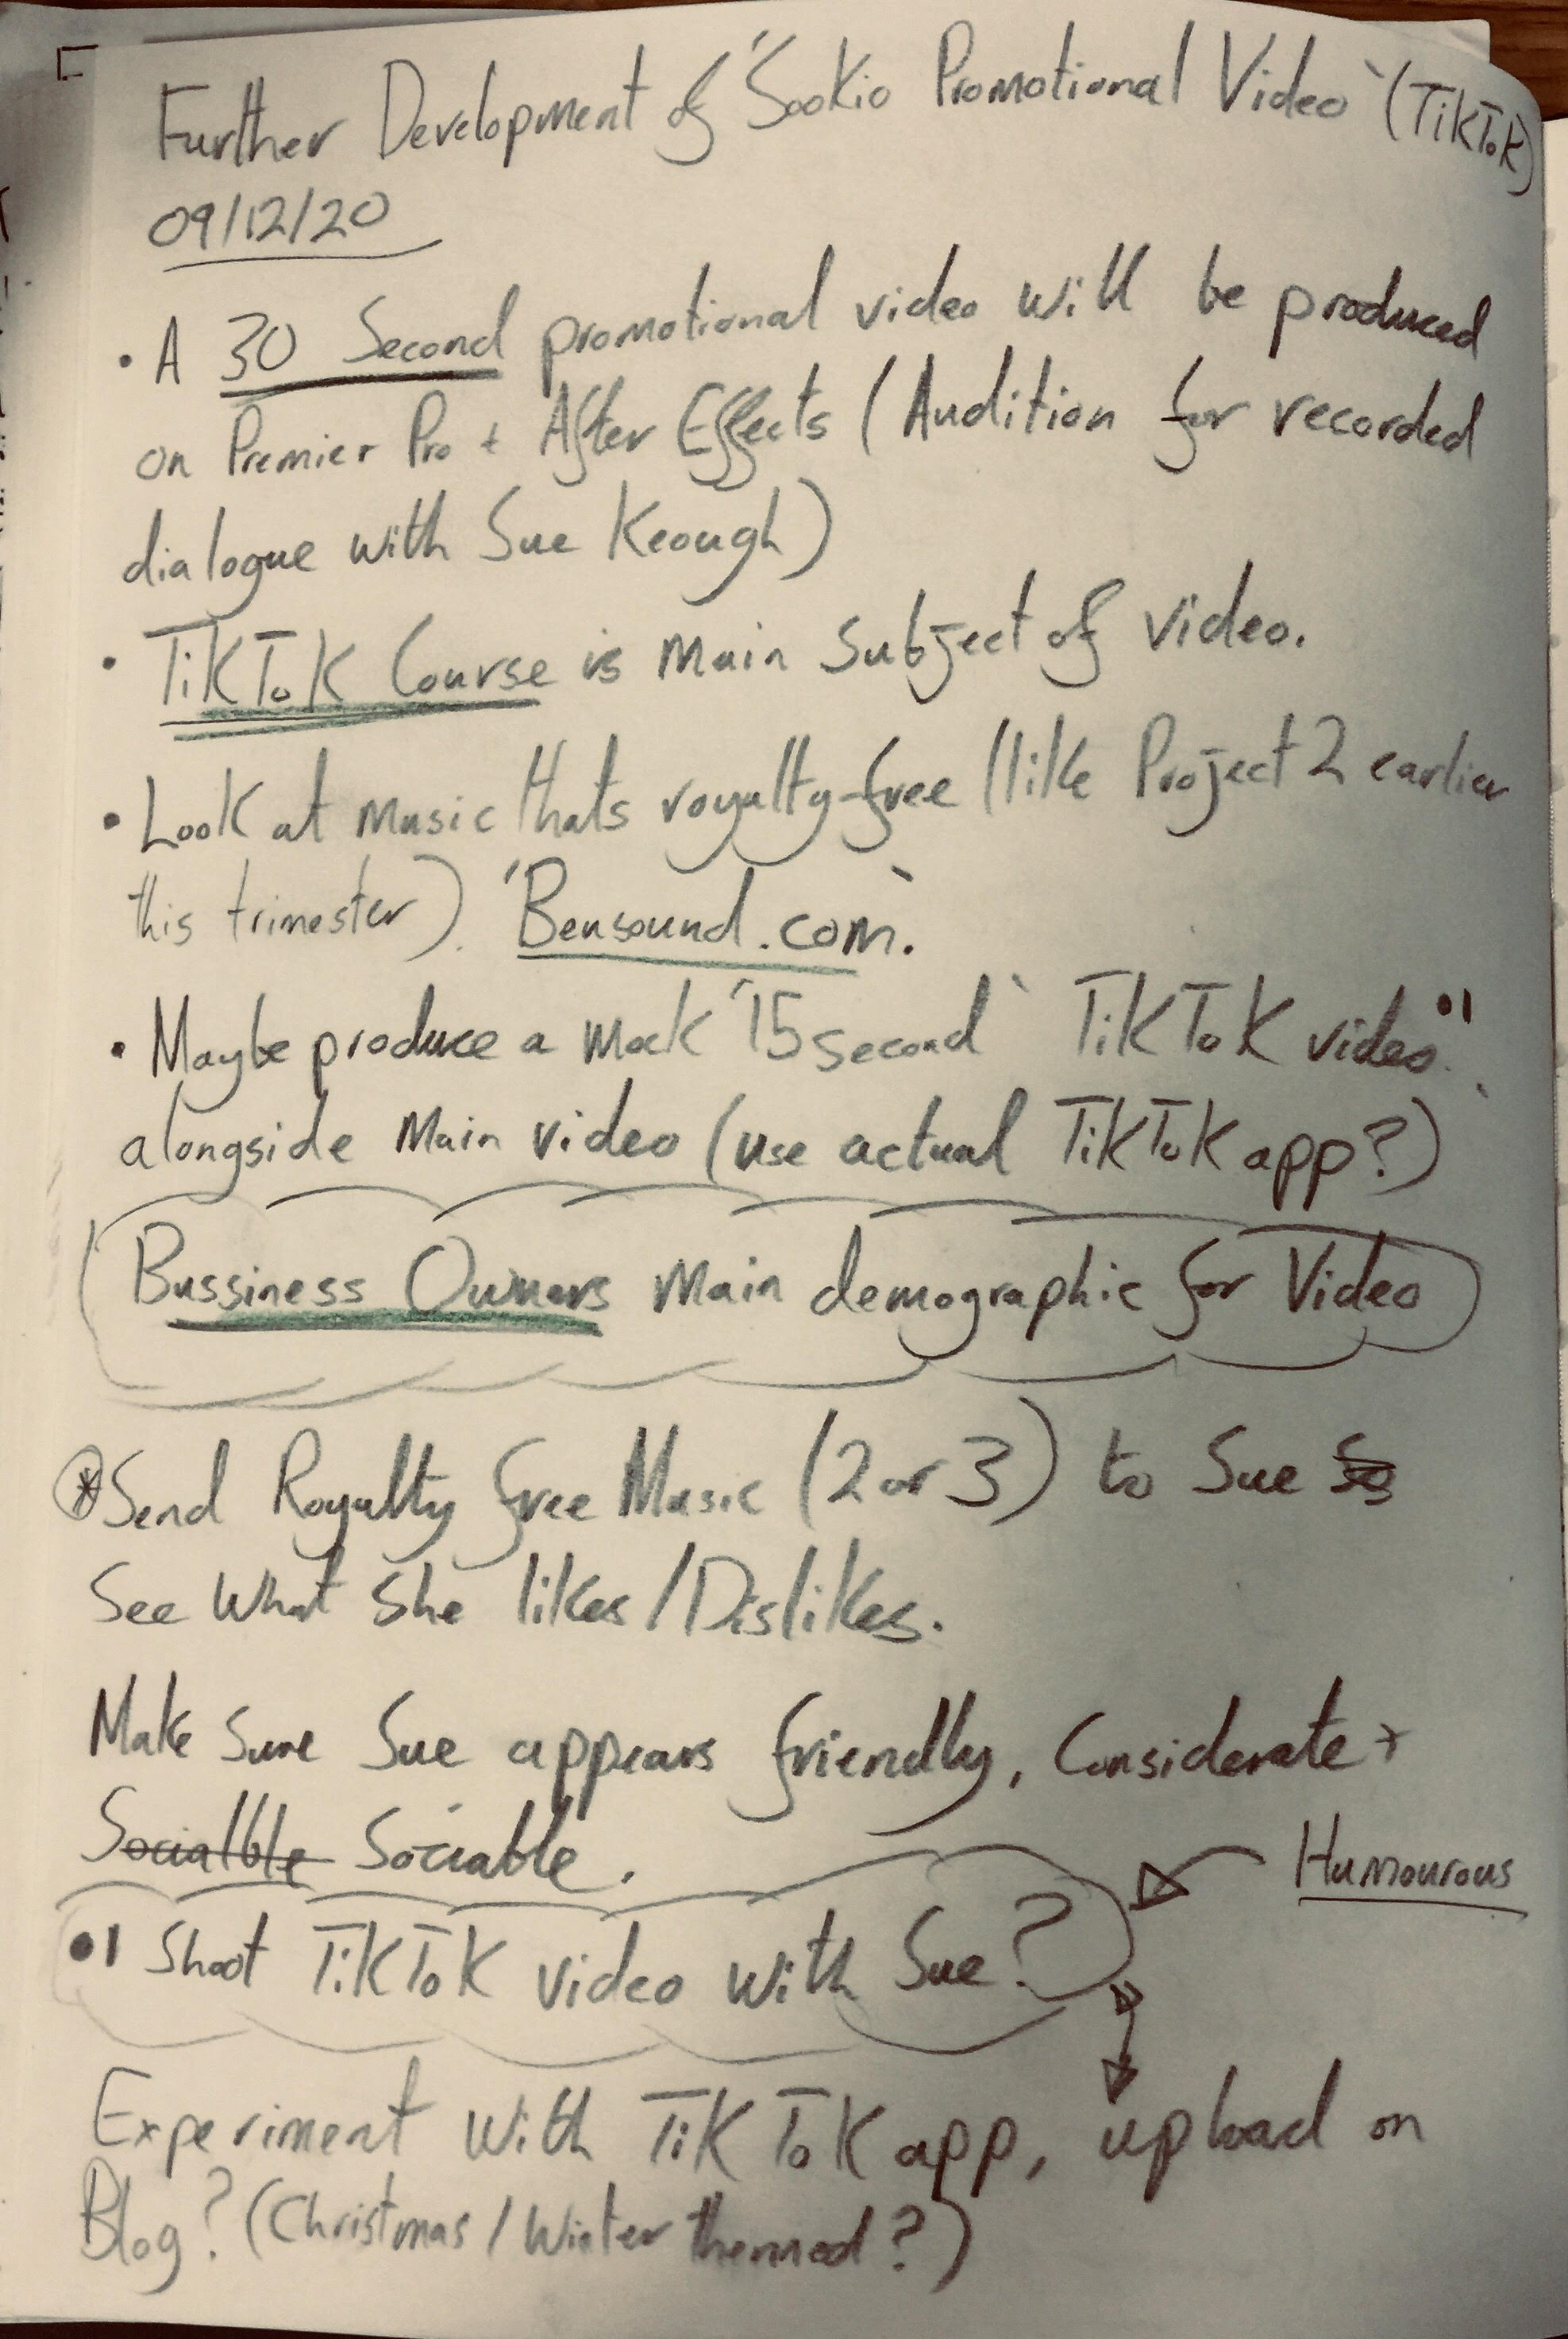
09/12/20
Rough plan on how the promo will be constructed alongside planning for recording session with Sue Keough.

Slide 10
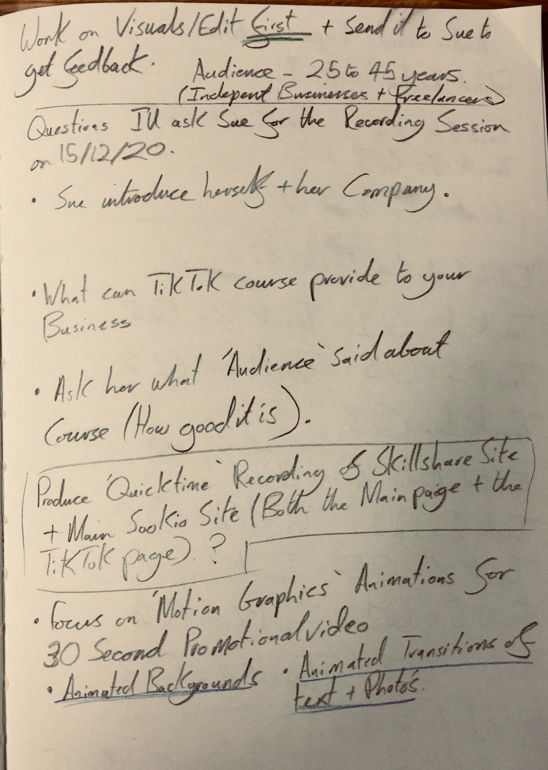
09/12/20
Questions for Recording Session with Sue Keough alongside further notes on Promo development.

Slide 11
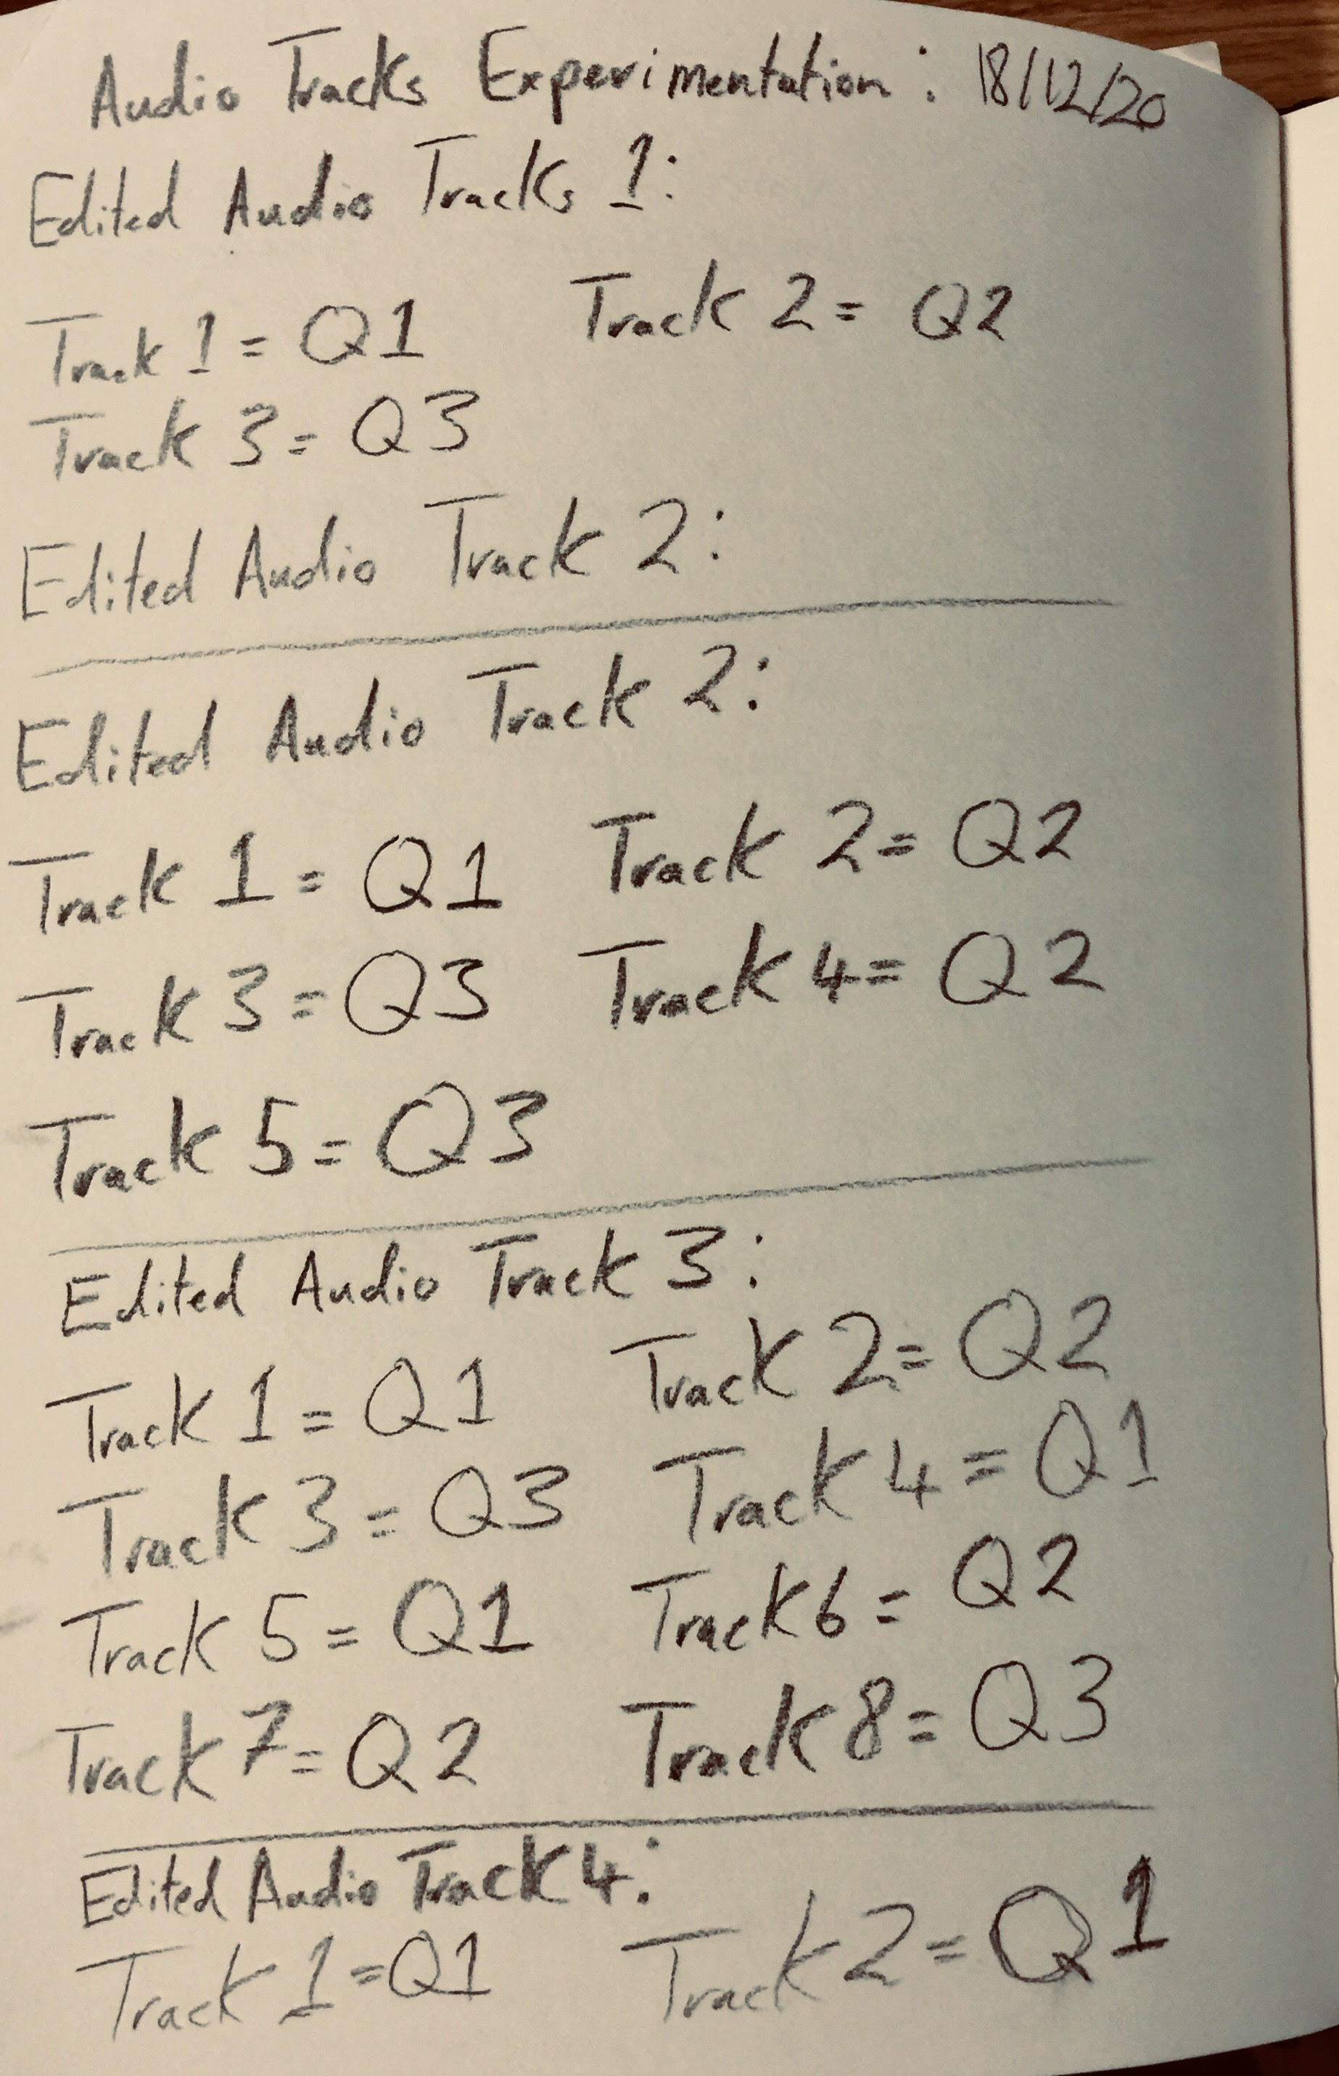
18/12/20
Development of sorting out appropriate tracks for Promo. Tracks being recordings with Sue.

Slide 12
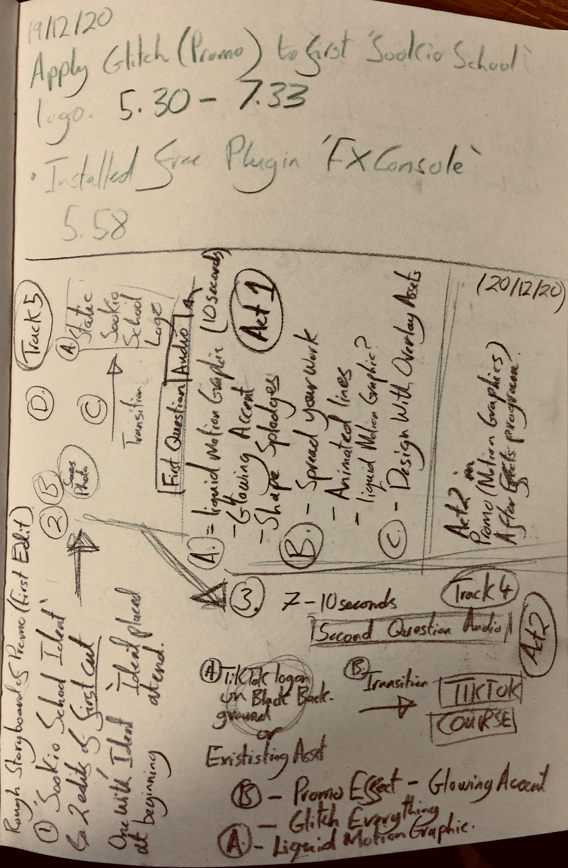
19/12/20
Development on First Edit of Promo 1.

Slide 13
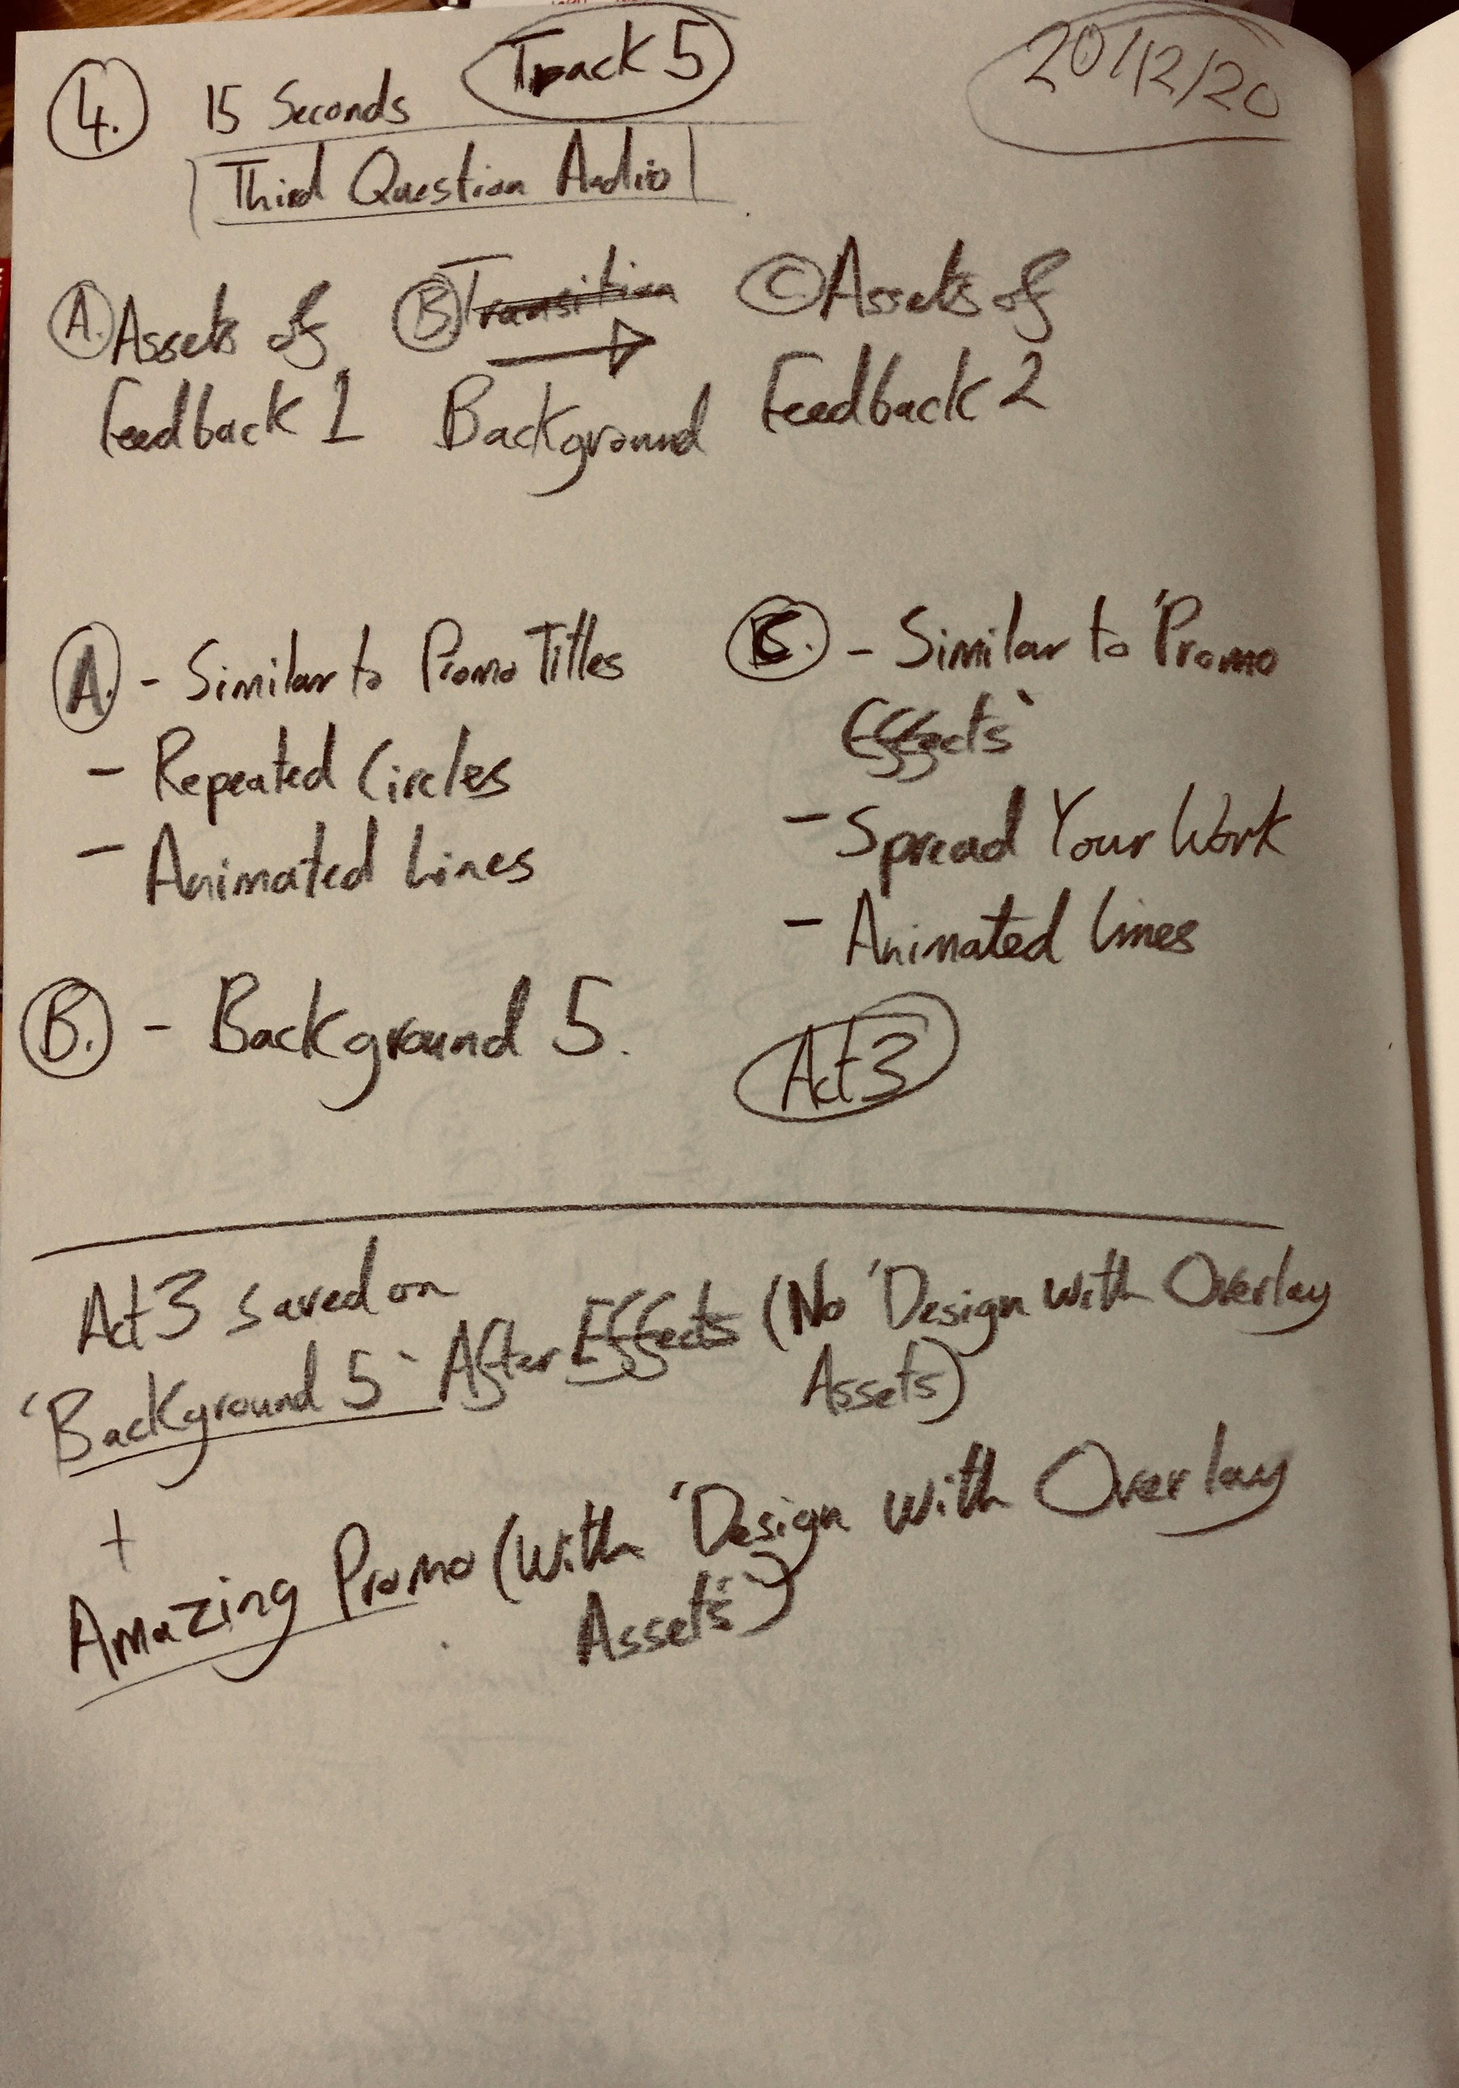
20/12/20
Development on First Edit of Promo 2.

Slide 14
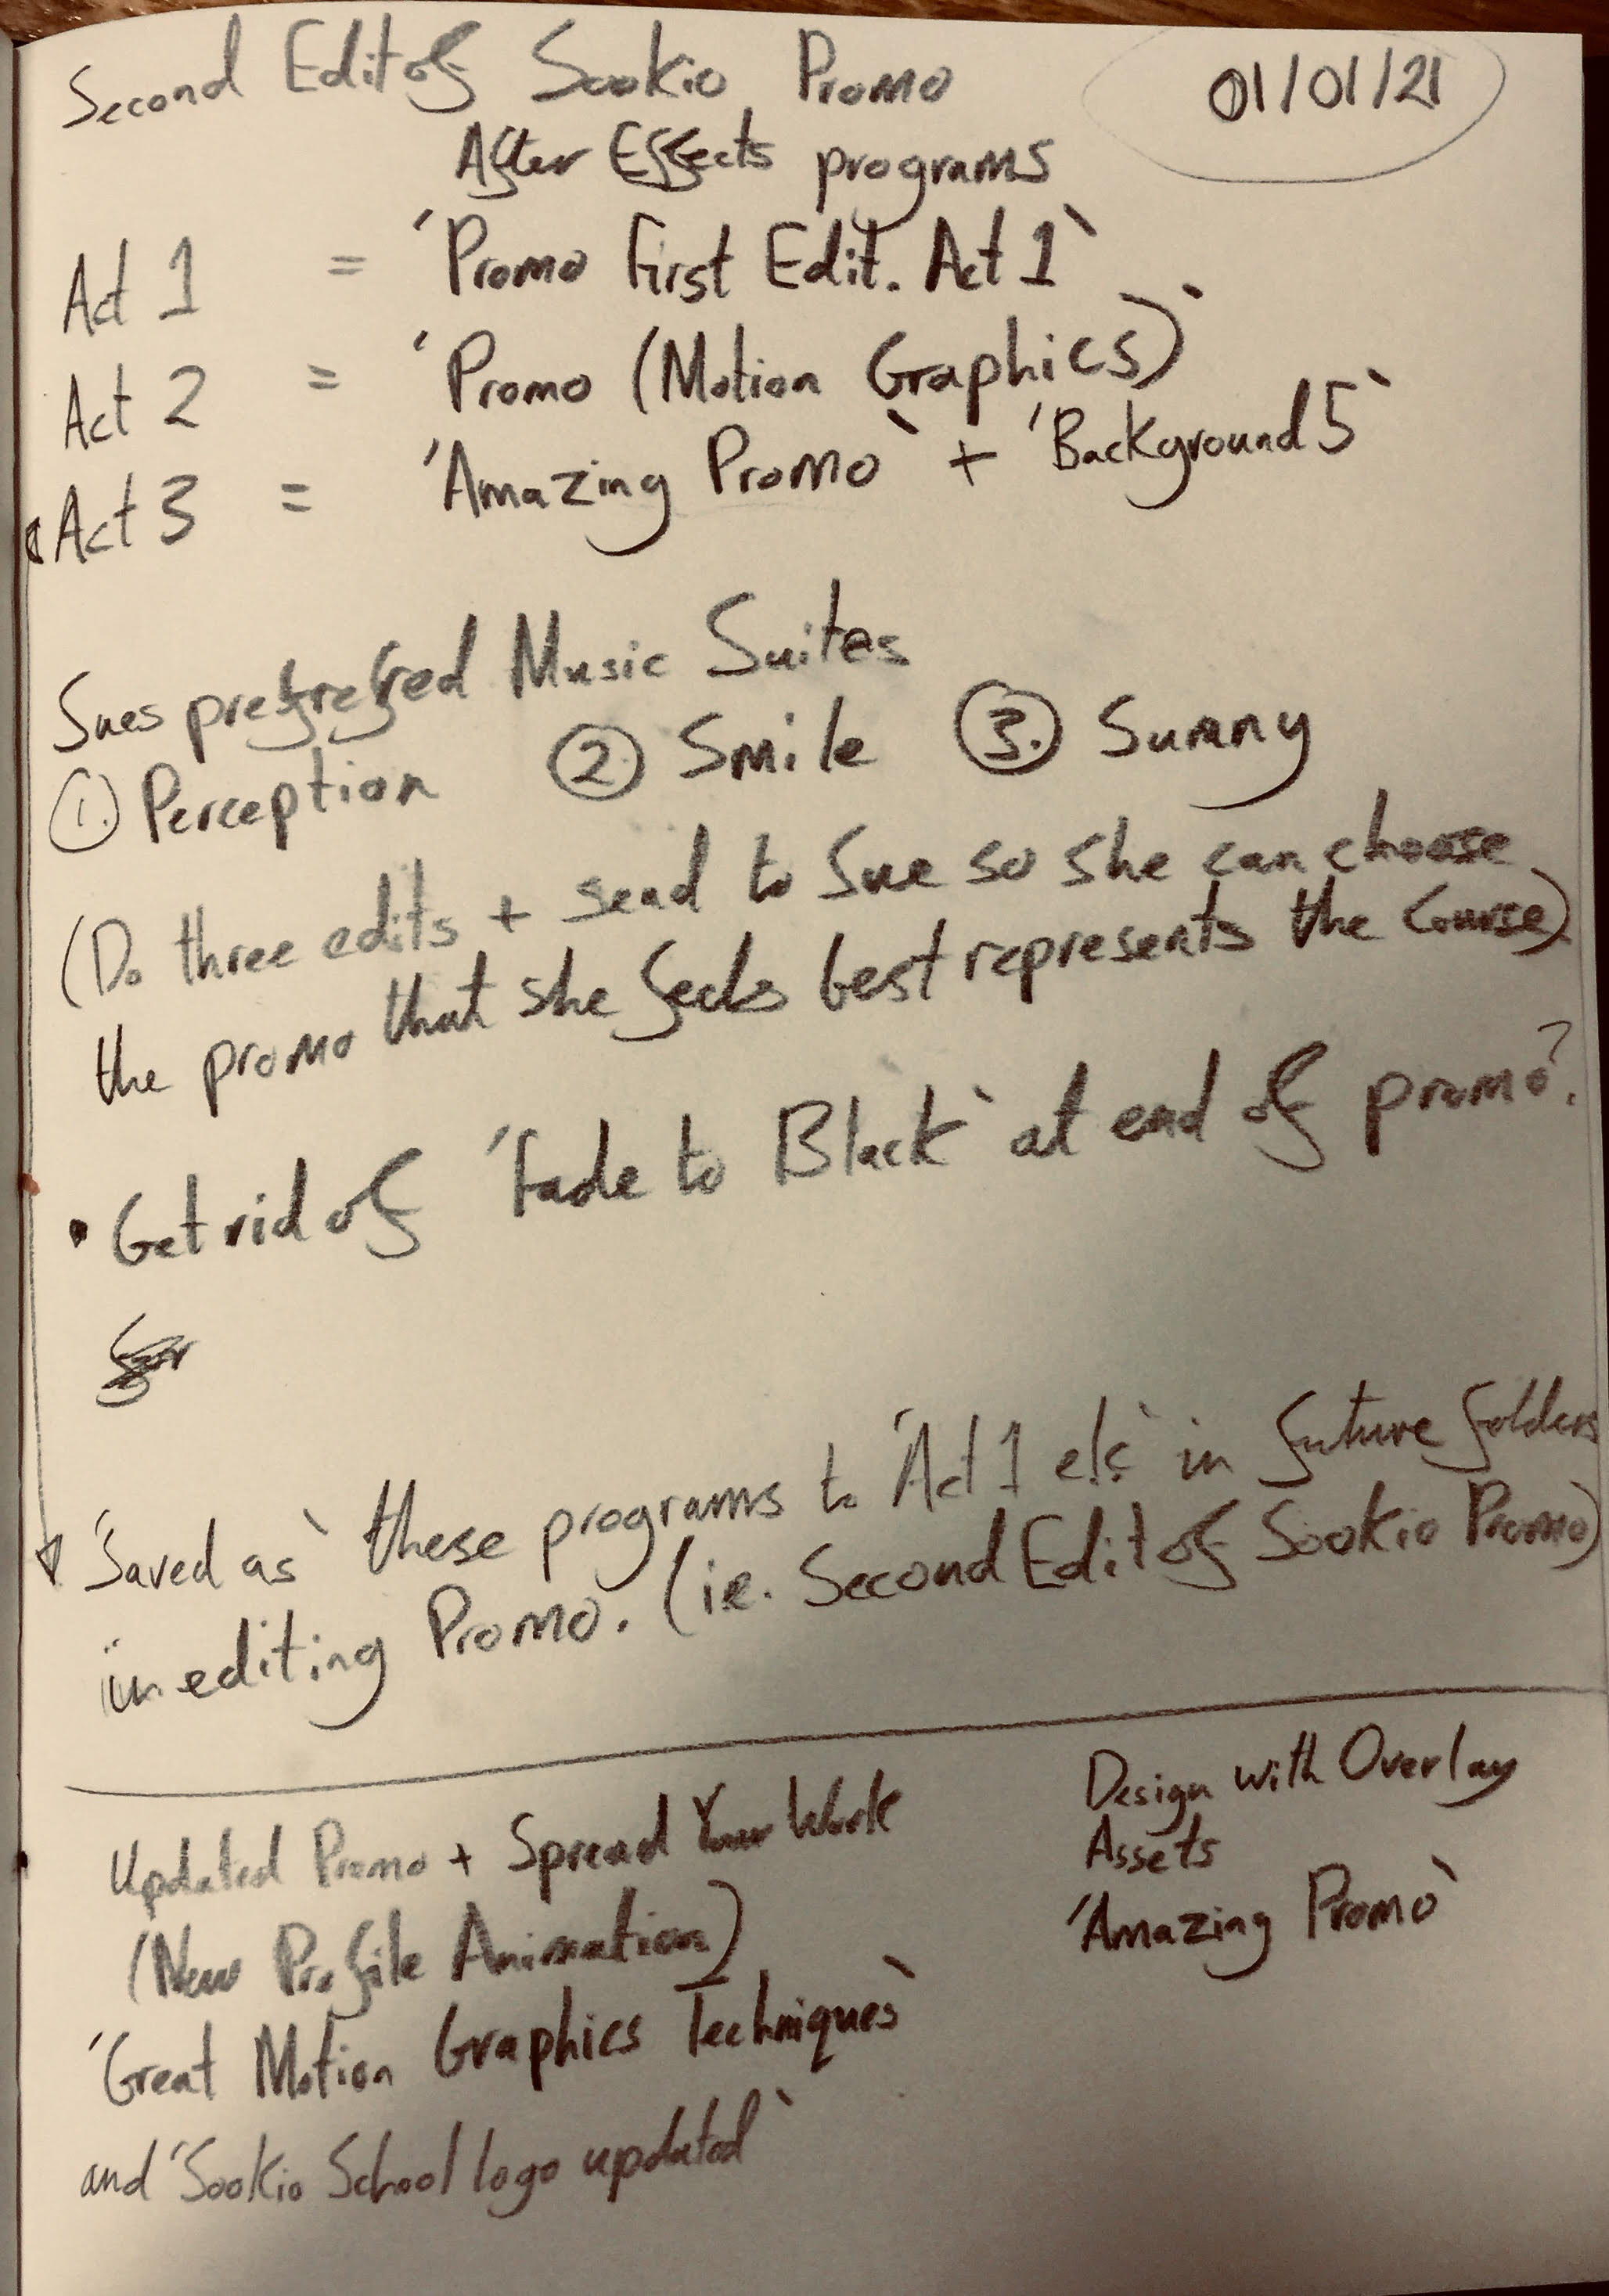
03/01/21
Final Development on Sookio School Promo for Sue Keough in relation to Adobe Programs.

