Slide 1
Storyboard for
‘TikTok For Business’
Video Promo
‘Sookio School Pitch Proposal’
Callum Forster

Slide 2

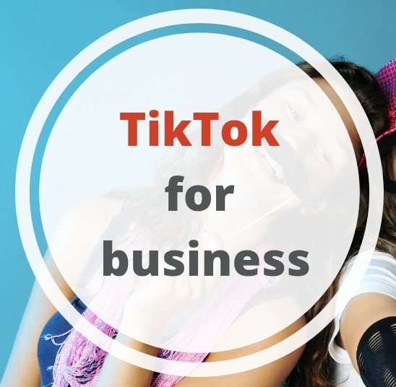
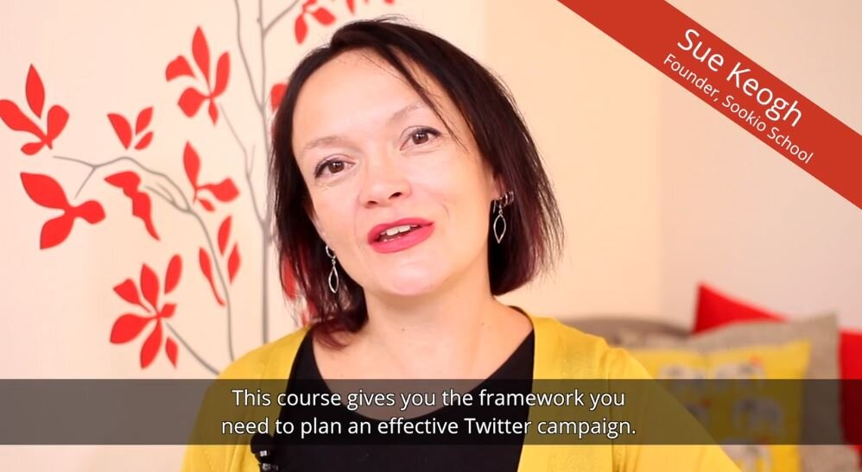
The images depicted on this slide showcase how the opening of the video will be structured:
The Sookio School logo and ‘TikTok for Business’ title will appear at the beginning before being followed by Sue Keogh intro to Sookio School and the course in question.
Transitions of title animations and footage will be mimicking TikTok videos in being slightly fast paced but colourful and fun.
Animations (created by myself or provided by Sookio) could be added to the footage (and the pitch video) as a whole to link to the subject matter of TikTok.

Slide 3
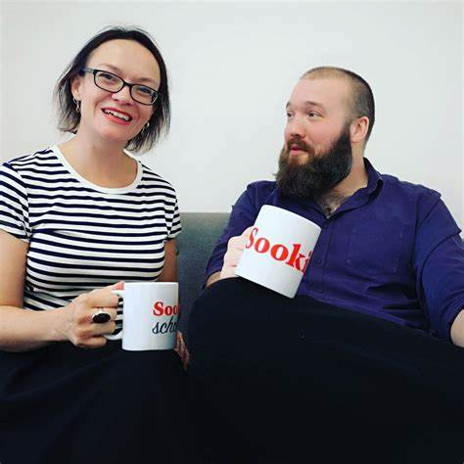
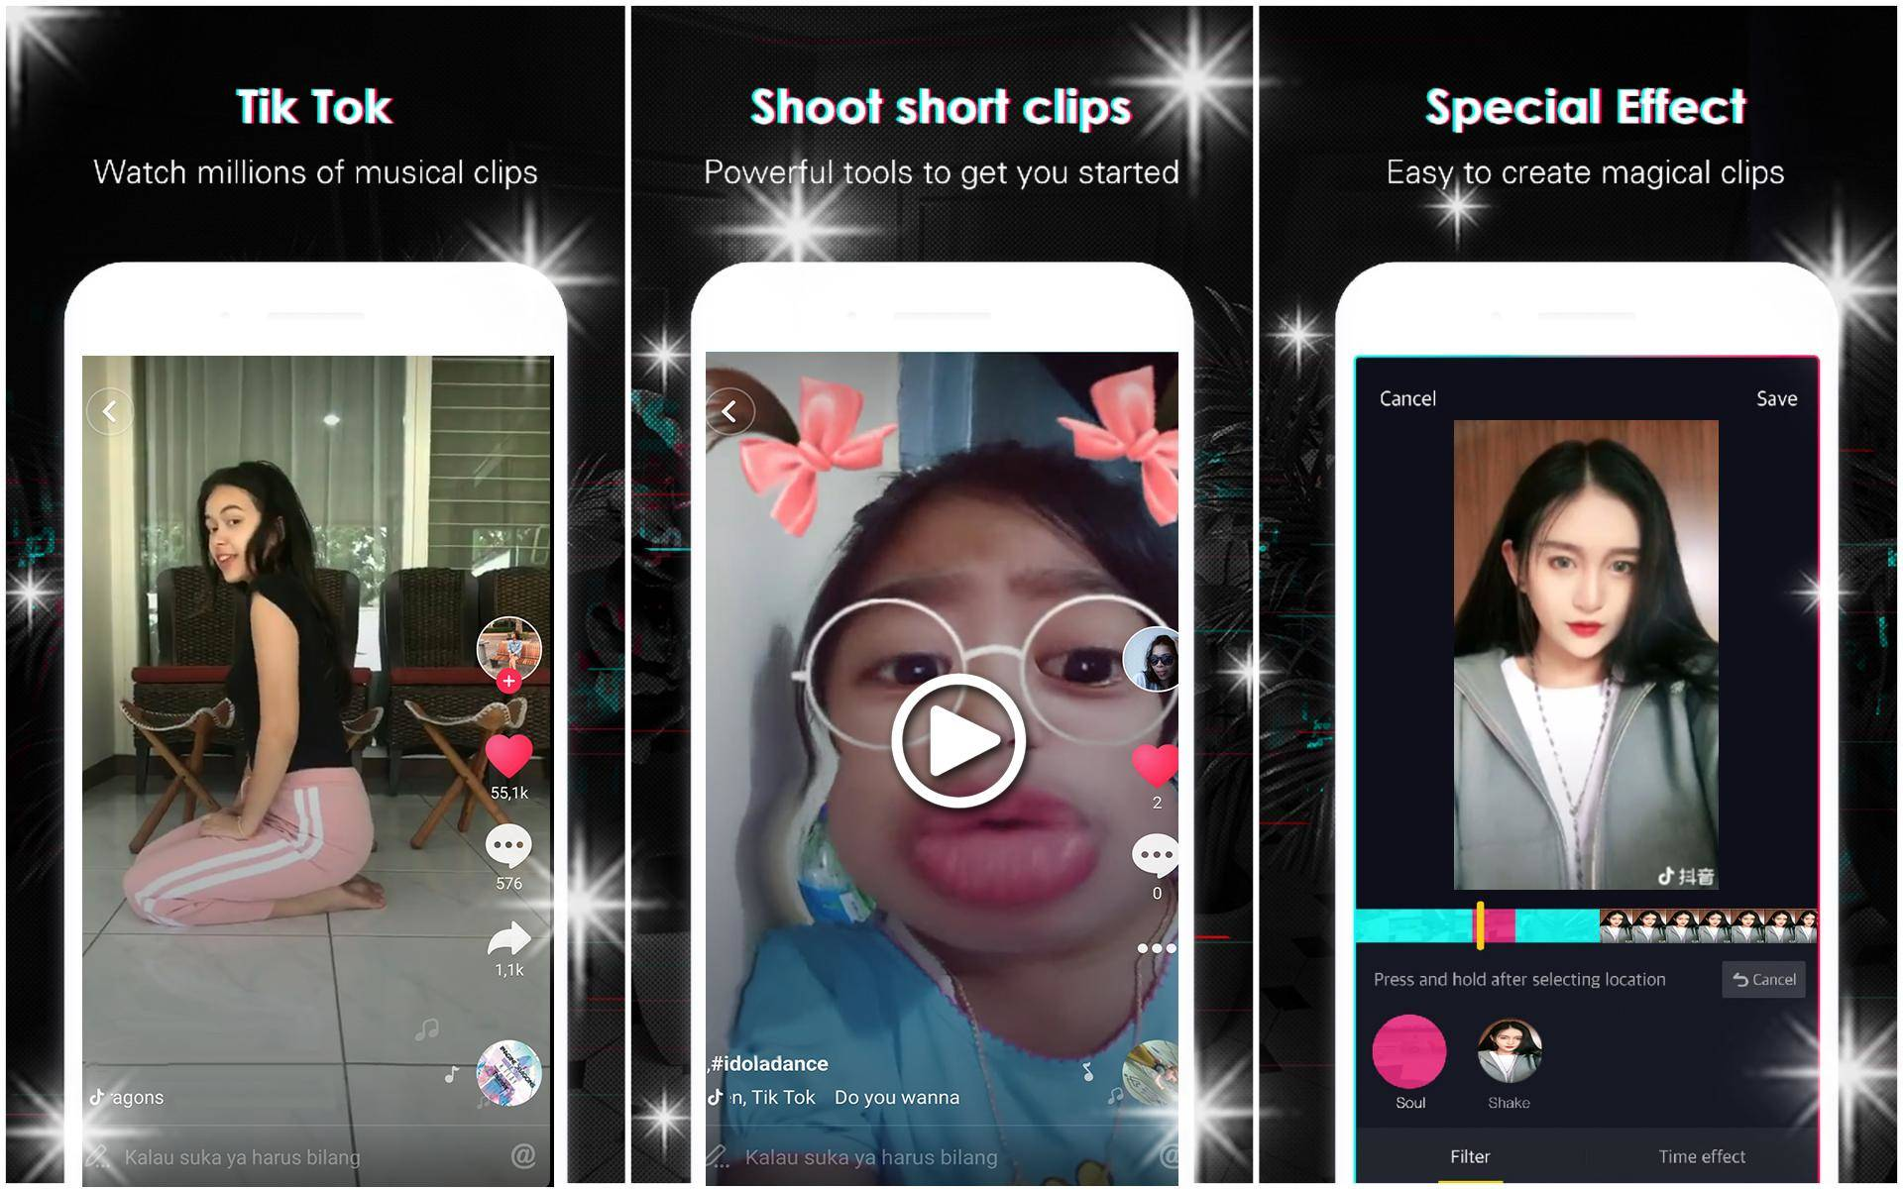
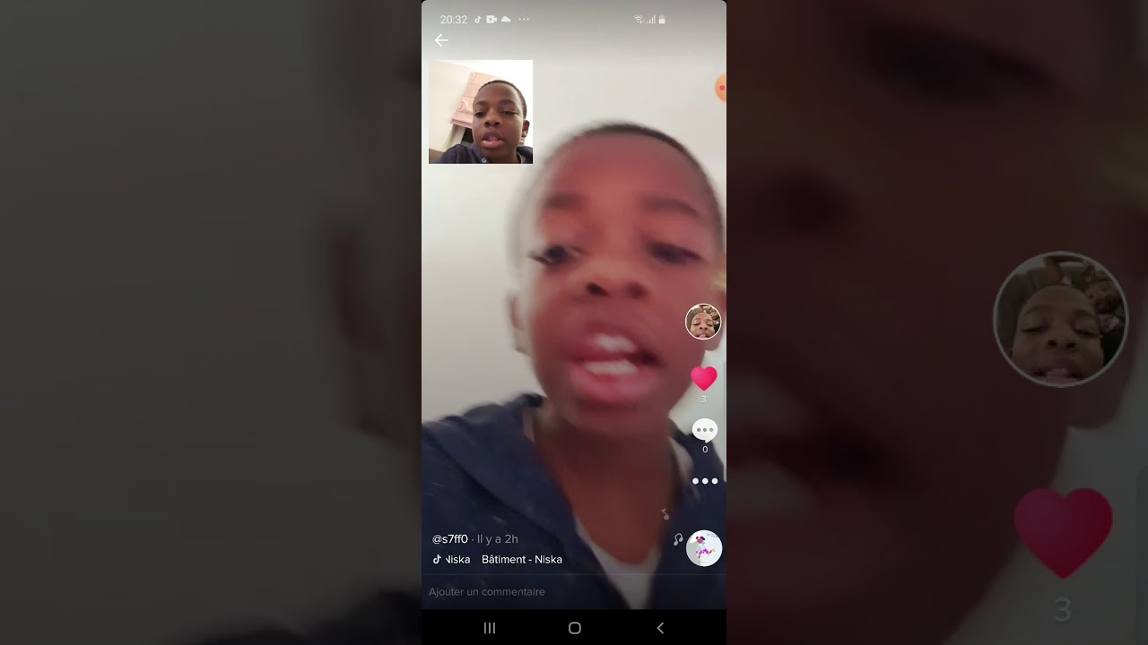
The following images above depict the rough conception of how Sues interview with her students who studied the ‘TikTok for Business’ course alongside individual videos the students created (traditionally or through TikTok) will be laid out.
This sequence of images will make up the bulk of the video promo in question.
Depending on whether one or more students participate in this video this sequence of images (i.e. potential edited footage) will be repeated from student to student.

Slide 4
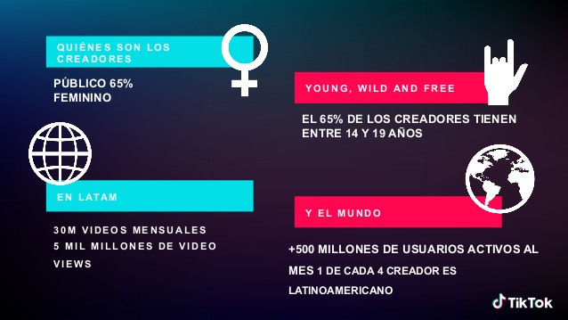
Possible Colour and Font Presentation overlaying footage of Sue Keough/Students of TikTok Course.
This could act as separate segments breaking down
Sue’s comments in digestible imagery and text.

Slide 5



Possible Liquid Animations I could create on After Effects (or even existing assets you have within your company?)

Slide 6
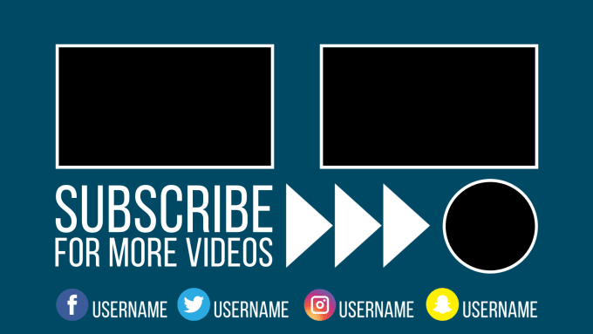
The Promo will end with the ‘Sookio School’ logo animation. Template for YouTube Outro I could create for promo unless there is an existing asset appropriate for the promo’s subject matter.

Slide 7
Harvard References (Reference Images). 1.
Microsoft, 2020. sookio school – Bing. [image online] Available at: <sookio school - Bing images> [Accessed 23 November 2020].
Sookio, 2019. How to use TikTok for business: a beginners guide | Sookio. [image online] Available at: <How to use TikTok for business: a beginners guide | Sookio> [Accessed 23 November 2020].
Microsoft, 2020. sookio school logo – Bing. [image online] Available at: <sookio school logo - Bing images> [Accessed 23 November 2020].
Microsoft, 2020. presnetation of tiktok videos – Bing. [image online] Available at: <presnetation of tiktok videos - Bing images> [Accessed 23 November 2020].

Slide 8
Harvard References (Reference Images). 2.
Microsoft, 2020. tik tok presentation – Bing. [image online] Available at: <tik tok presentation - Bing images> [Accessed 23 November 2020].
Agence 90, 2019. 1997-2019: Histoire des reseaux sociaux et de leurs innovations | Agence 90. [image online] Available at: <1997-2019: Histoire des réseaux sociaux et de leurs innovations | Agence 90> [Accessed 23 November 2020].
(Still Image)
Microsoft, 2020. liquid animations – Bing. [image online] Available at: <liquid animations - Bing images> [Accessed 23 November 2020].

Slide 9
Harvard References (Reference Images). 3.
(First moving gif. ‘S’)
Microsoft, 2020. liquid animations – Bing. [image online] Available at: <liquid animations - Bing images> [Accessed 23 November 2020].
Dribble, 2020. Liquid Animation by Eduard Mykhailov on Dribble. [image online] Available at: <Liquid Animation by Eduard Mykhailov on Dribbble> [Accessed 23 November 2020].
Fiverr, 2020. Design a youtube outro video end screen animation by Pixovideo. [image online] Available at: <Design a youtube outro video end screen animation by Pixovideo (fiverr.com)> [Accessed 23 November 2020].

