Slide 1
Project Brief Proposal
‘Sookio School’ Idea Pitch.
Callum Forster

Slide 2


Slide 3



Links to Digital Media Course Social Media Pages:
Instagram Account:
https://www.instagram.com/digital_media_csa/
Facebook Account:
https://www.facebook.com/Digital-Media-at-Cambridge-School-of-Art-379048378875801

Slide 4
What is the Pitch?
What can I offer to your Agency?

Slide 5
Learning, Growing
And Creating

Slide 6

YouTube Promo
‘TikTok For Business’
A Short Edited Promo on your YouTube Channel which thus can be shared on your Facebook and Twitter pages.

Slide 7


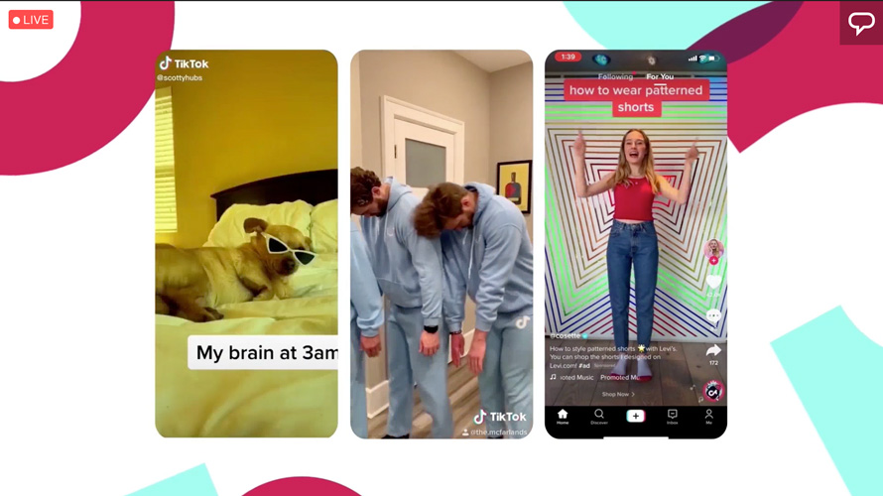


Colour Palettes considered for Promo Video

Slide 8
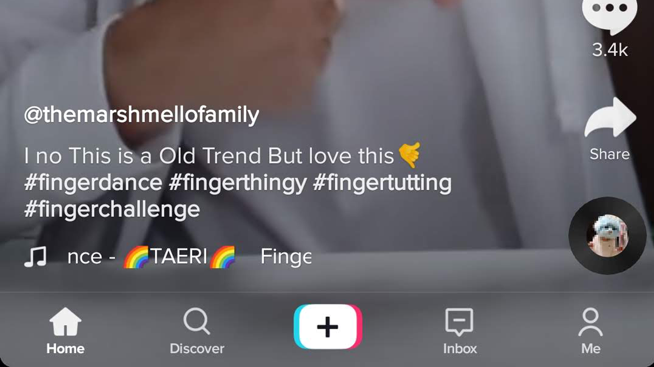
Same Stylistic Presentation as TikTok Video.
Image on the right could have hashtags comprising of #tiktokbusiness, #cambridge, #sookiotiktok, #sookioschool

Slide 9

Any Questions?

