Slide 1
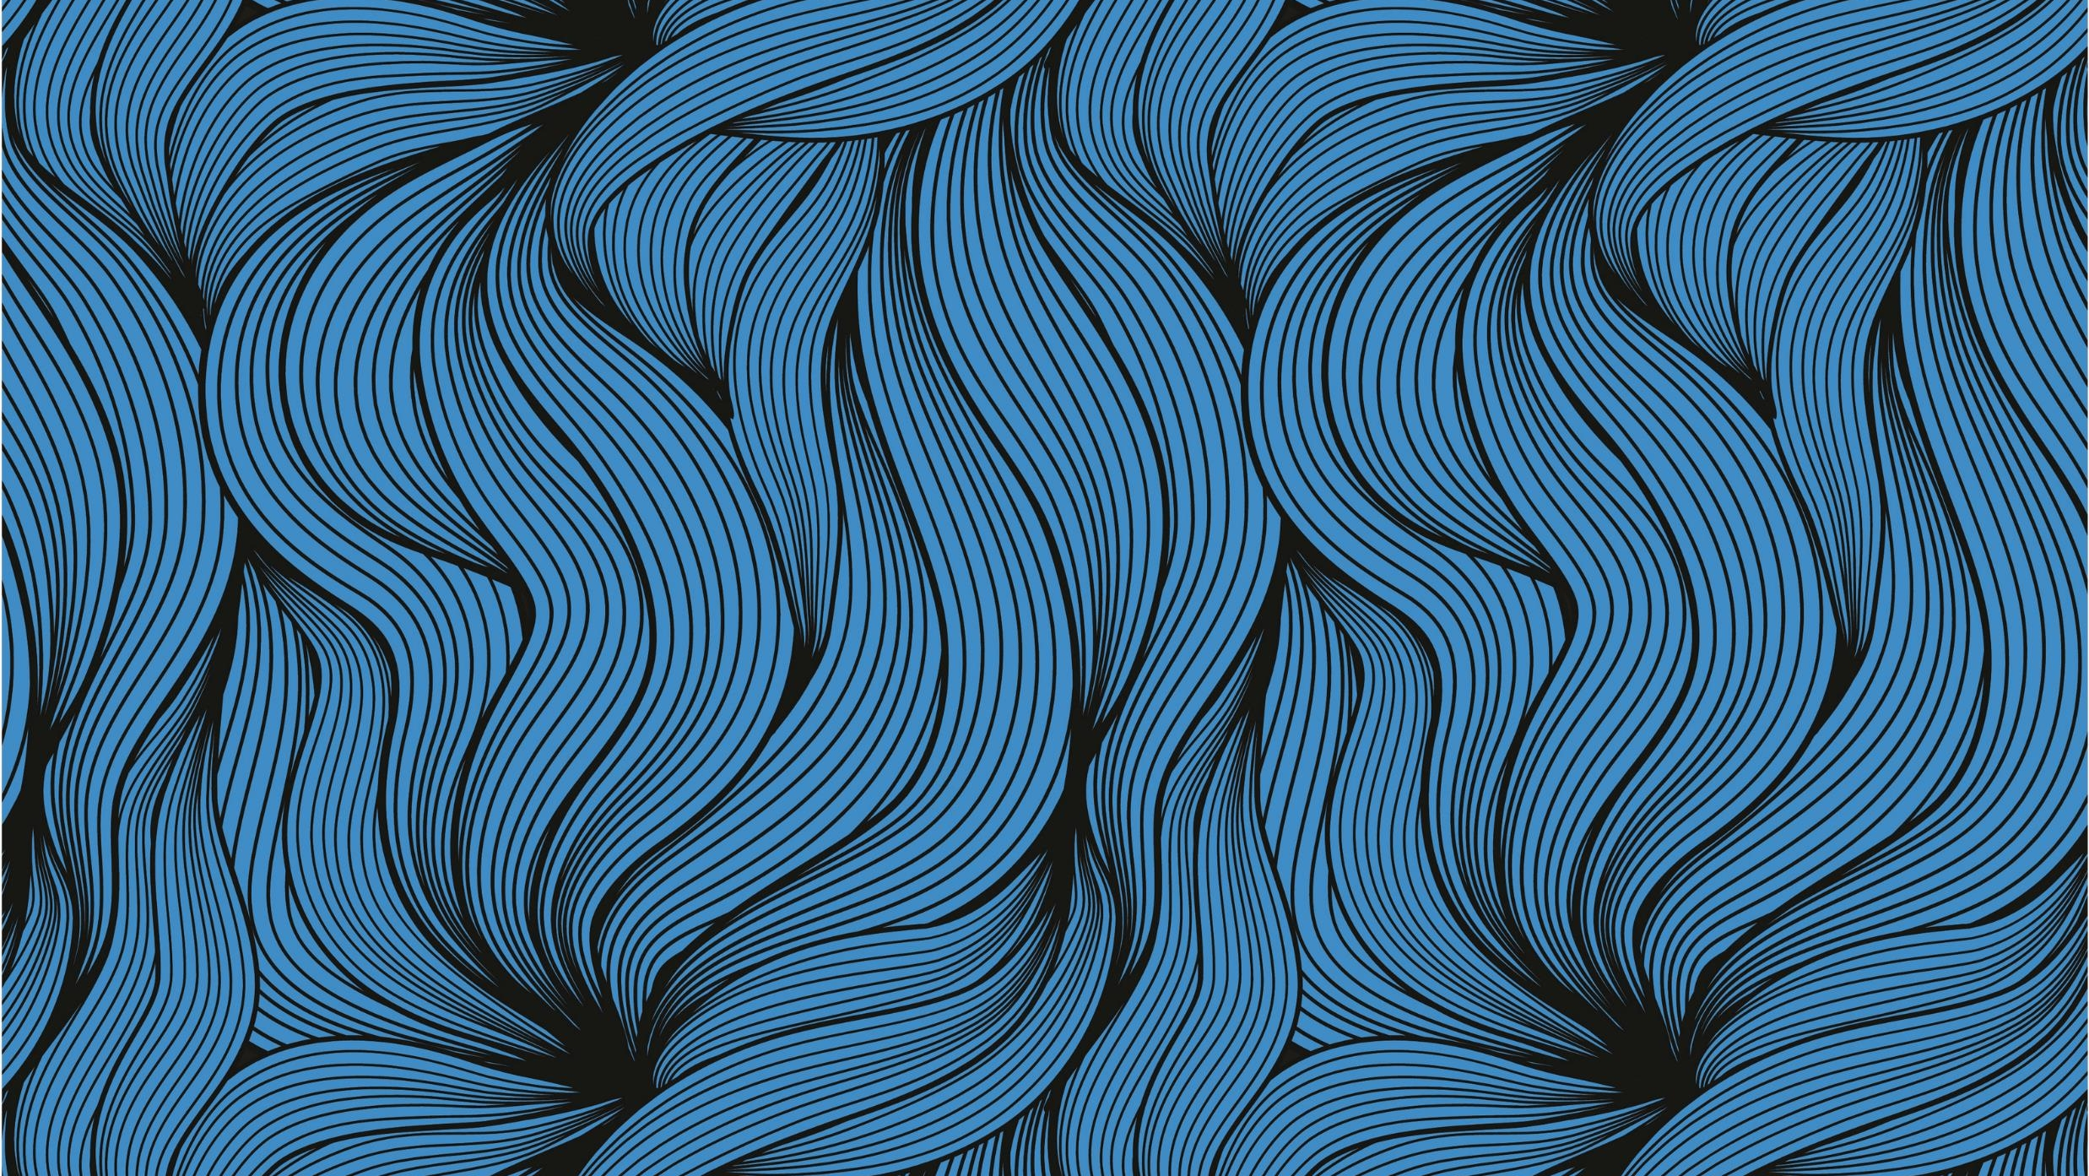
‘THREE PROJECT
Proposal’-
Final Major Project
CALLUM FORSTER

Slide 2
Project 1: (Weeks 1 and 2)
Short Animation on Adobe Animate/After Effects. Influenced from a Story from English Folklore (The Hare etc). 2-5 Minutes Maximum for Duration of Animation. Experimenting to create a professional and experimental piece using After Effects tools. The 2 minute YouTube link below gives a better insight in what I plan to do;
https://www.youtube.com/watch?time_continue=158&v=-ewe8aGGGFk&feature=emb_title

Slide 3
Project 2: (Weeks 3 and 4)
Either=
Short ‘Animation in VR’. Trippy Dreamscape Environment (1960’s Aesthetic, Kaleidoscope). Could borrow Insta360 Camera again or reuse older footage and photos not used in other projects during the Second Year (If I’m allowed). Experiment with perspective and effects. 2-5 Minutes Maximum for duration of Animated/Experimental VR Short Film.
Or
2. Short Experimental/Professional Documentary or Advert of Wildlife (Animals etc.) in the Village I live in. 3-5 Minutes Maximum for Duration of Documentary. This would further expand on the ‘Documentary Project’ that was produced in the early part of the first year.
Or
3. Experimenting with the Adobe Program ‘Character Animator’ which could be interesting to expand upon (Create a comedy sketch? Etc.). A link to the 3 minute video ‘create a basic face’ better explains the ‘Character Animator’ program; https://helpx.adobe.com/adobe-character-animator/how-to/build-animated-face.html?playlist=/services/playlist.helpx/products:SG_CHARACTERANIMATOR/learn-path:get-started/set-header:ccx-designer/playlist:orientation/en_us.json&ref=helpx.adobe.com

Slide 4
Project 3: (Week 5 and 6)
Short Audiobook Narration (Royalty Free or Original Monologue/Poem. Voice Actor or Myself will read it out) with added original Sound Effects and Music. 3-5 Minutes Maximum Duration.
A possible idea for ‘Project 2’ (Previous Slide) is to possibly expand on creating original ‘Fonts and Logos’ to a professional degree as taught in the ‘Creative Digital Media’ module in the First Year using Adobe Illustrator? (Alphabet in unique Font etc.)

