Slide 1
Final Idea Pitch (Meditation/Mindfulness Interactive Application)
Callum Forster
SID-1708564
Graphic Design for the Web
Week 4

Slide 2
What am I doing for the Module.
I plan to create an immersive VR Headset or Interactive Application via a Mac based upon the Spiritual Journey that is undertaken when implementing the method of Meditation (encouraging Mindfulness) as well as provide tips, information and possibly passages from books that teach Mindfulness and how it can be incorporated into the players everyday life outside the VR/Interactive Game.
Other Programmes and Methods will be considered for this idea from further improving skills in several Adobe programmes to brining actors or people who specialise in creating this sort of piece I plan to create over the next few weeks.

Slide 3
What is the proposed Interactive Applications main Narrative. Part 1.
The main Narrative follows the slow transition of a Man/Woman finding peace in the present moment through tackling their own thoughts and emotions. The game will start off very murky, chaotic and potent through two features within the game via Sound and Imagery (Imagery and Sound mimicking potent thoughts and voices of people) until after going through several levels the chaos slowly subsides, bringing other images and sounds that are balanced with the existing negative sounds and images from the beginning.
The conflicted thoughts and imagery will be related to family members and other people who appear to provide an ideal future (according to the Man/Woman ‘Player’) despite the flaws and circumstances of the individual that appears in their thoughts.

Slide 4
What is the proposed Interactive Applications main Narrative. Part 2.
For Example the main character fancies a boy or girl, starts off with strong positive images and sounds that slowly change to lower, painful sounds and images linking to sad revelations of said boy or girl not living up to what the main character thought they were or could be.
A level in the game lasts about 5/10 minutes. Levels start off hard before getting easier once the player knows how balance their tasks effectively.

Slide 5
What is the proposed Interactive Applications main Narrative. Part 3.
A large Maze/Labyrinth will be placed in front of the player with the player drawing within the Unicursal Maze/Labyrinth to reach the centre (Right Hand drawing within the maze). Player has to interact with Imagery and Sound by selecting the said imagery or sound until going back to the Maze/Labyrinth which will reset itself after the player stops drawing and interacts with the said sound and imagery.
Imagery take the form of clouds or flashy animation (Like stream lights in a nightclub) that quickly comes in and out, becoming more visible and louder in volume if the player does not interact with it.

Slide 6
Why do I want to pursue this Idea. Part 1.
I want to pursue this idea as I feel the mediums of the Interactive Applications in question would lend quite nicely to the very fascinating subject of Meditation and Mindfulness. The links to the ‘Human Condition’ and the potential to encourage a wider audience of people to look more into the realm of spirituality feels like the right path to pursue especially in an age where games often involve warfare, cooking, puzzle solving and not much else as far as content or providing positive developments in a persons life spiritually.

Slide 7
Why do I want to pursue this Idea. Part 2.
As I’ve been performing the practise of meditation for more than a year now with the inclusion of reading a couple of books related to mindfulness as well as insight into the chaos life can impose on us after events that occurred to myself and my family over the past year, I feel I can provide a lot to the subject with an understanding of the main themes in the Interactive Application and how the Narrative will be played out within the game itself.

Slide 8
Next Few Images showcase what the ‘Idea Pitch’ might look like when further worked upon.

Slide 9
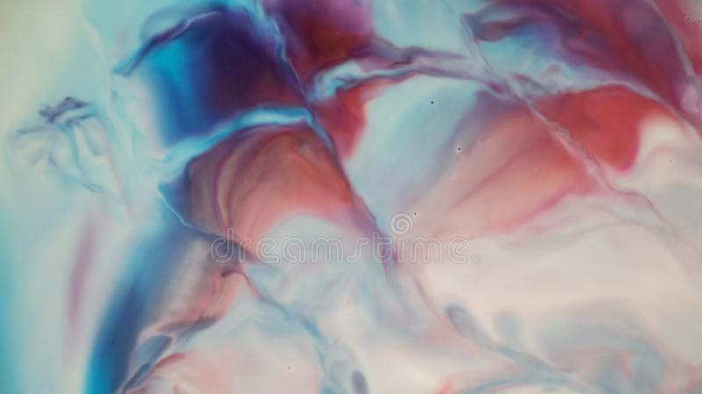
A Digital Art Dreamscape Background that changes colour to signify positive and negative Imagery and Sounds acting as a metaphor to emotions and thoughts.

Slide 10

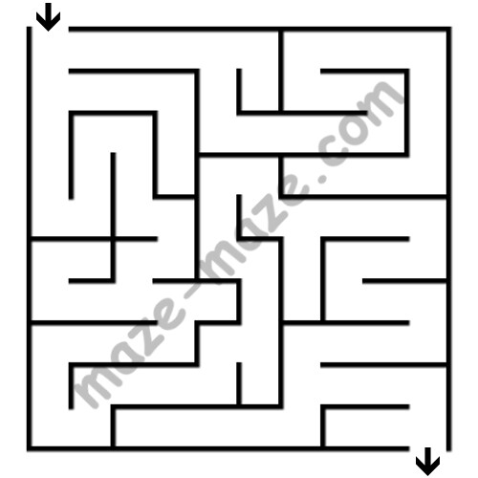
Potential Maze template that will be facing towards the player with the player drawing within the maze to get to the other exit (Cursal) or the Centre (Unicursal).

Slide 11
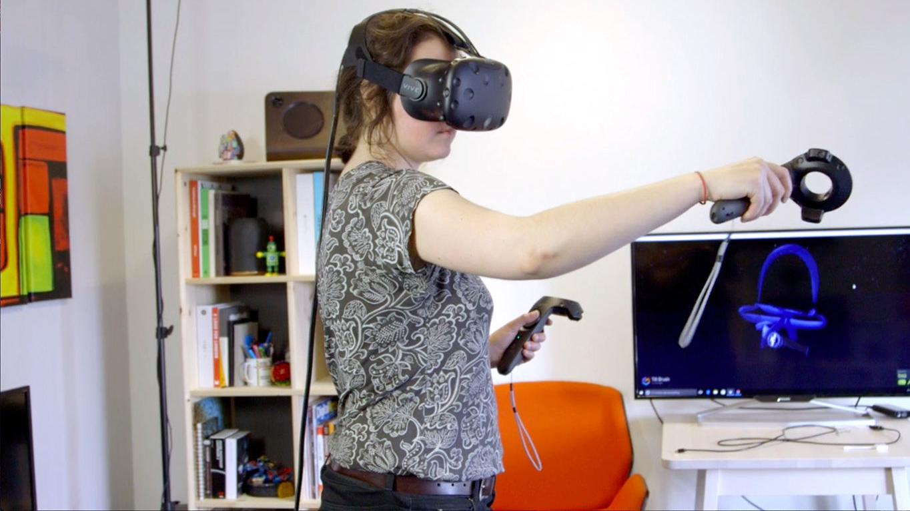
Player interacting with the VR. Carrying controls to draw within maze. They would stand in one place for the entirety of the levels discussed in previous slides.

Slide 12
Harvard Referencing for images used in this Idea Pitch Presentation.
Dreamstime, 2020. Dreamscape Stock Photos - Download 987 Royalty Free Photos. [image online] Available at: <https://www.dreamstime.com/photos-images/dreamscape.html> [Accessed 04 February 2020].
Flickr, 2011. basic-maze-10x10-04 | maze-maze.com | Mitsu Hoshi | Flickr. [image online] Available at: <https://www.flickr.com/photos/maze-maze/6191131783> [Accessed 04 February 2020].
Digital Arts, 2018. The 7 best tools for painting, 3D modelling and sculpting in VR – Features – Digital Arts. [image online] Available at: <https://www.digitalartsonline.co.uk/features/hacking-maker/7-best-tools-for-painting-3d-modelling-sculpting-in-vr/> [Accessed 04 February 2020].

